Slide 1
Protecting the Public’s Health in Emergencies

Slide 2
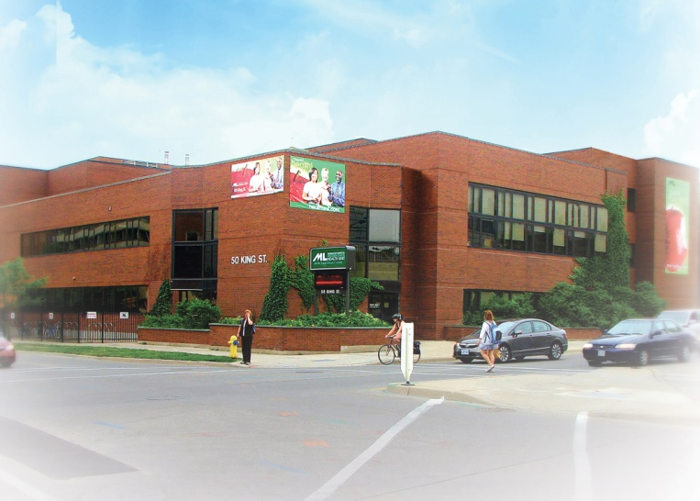
“To enable and ensure a consistent and effective Board of Health response to public health emergencies and emergencies with public health impacts.”
Middlesex-London Health Unit, 50 King Street, London, ON N6A 5L7

Slide 3
Federal:
Health Canada
Public Health Agency of Canada
Provincial:
Ministry of Health and Long-Term Care
Public Health Ontario
Regional:
36 Public Health Units in Ontario
Notes:
Board of Health - Vance Blackmore (Chair)
COMOH - Graham Pollett
Affiliates:
ANDSOOHA
AOPHBA
APHEO
ASPHIO
Dentists
Health Promotion Ontario (Public Health)
Nutritionists

Slide 4
Programs and services are designed to help people live a healthy life, free of disease and injury.
Staff monitor the air,
food and water supply in the community to make sure it is safe.
Notes:
Principles and Values

Slide 5
Board of Health
City Council Appointees - 3
County Council Appointees - 3
Provincial Appointees - 5
Funding
Provincial
City
County
Notes:
City Council
- 2 elected
- 1 appointed
County Council
- elected representatives
Provincial
- appointed

Slide 6
Mandates
1. Health Protection and Promotion Act
2. Mandatory Health Programs and Services Guidelines
3. Immunization of School Pupils Act
4. Tobacco Control Act
5. Safe Drinking Water Act
Notes:
Ontario Smoke Free Act

Slide 7
Service Areas
1. Oral Health, Communicable Disease
& Sexual Health Services (OHCDSH)
2. Environmental Health & Chronic Disease Prevention Services (EHCD)
3. Family Health Services (FHS)
4. Information Technology (IT)
5. Human Resources & Labour Relations (HR & LR)
6. Finance and Operations (FO)
7. Office of the Medical Officer of Health (O-MOH) including Emergency Preparedness
Notes:
Section 5 of HPPA

Slide 8
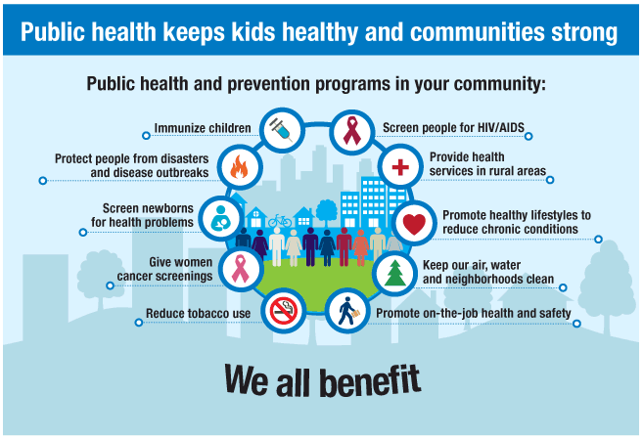
➔

Slide 9
When Disaster Strikes, Our Part Includes:
emergency health communications
disease outbreak management
immunization
monitoring of water quality
food safety
home safety
hazardous materials
air quality
family preparedness
extreme weather response
pandemic planning
business continuity planning

Slide 10
Roles
World Health Organization
Federal Government
Includes Public Health of Canada
and Health Canada
Provincial Government
Includes Ministry of Health and Long Term Care
Response
Municipal Government/
Middlesex-London Health Unit
Includes London, Middlesex County and municipalities
Community Agencies
Includes non-profit and industry
Personal Preparedness
-72 Hours

Slide 11
Community Partners in Emergency Response
1. Medical Officer of Health (MOH) is an integral part of the Community Control Group (CCG)
2. Representation at city, county, upper tier and all county communities in lower tier
3. Provincial representation
4. Website re-development (2013)
5. Telephone inquiry lines
6. Community Emergency Response Volunteers (CERV)
7. Fact Sheets/Bulletins/Alerts
8. Educational Workshops
Notes:
Section 5 of HPPA

Slide 12
Roles and Responsibilities
Defined in municipal emergency plans
Includes advice, mass immunization, liaison, ensures water precautions are met, control spread of disease
Co-ordinates care of bed-ridden citizens and other special needs persons
Interacts with, provides guidance and expert advice to emergency responders
Amateur radio station

Slide 13
Ontario Public Health Standards
1. Foundations
2. Chronic Diseases and Injuries
3. Family Health
4. Infectious Diseases
5. Environmental Health
6. Emergency Preparedness (2009)
Notes:
Section 5 of HPPA

Slide 14
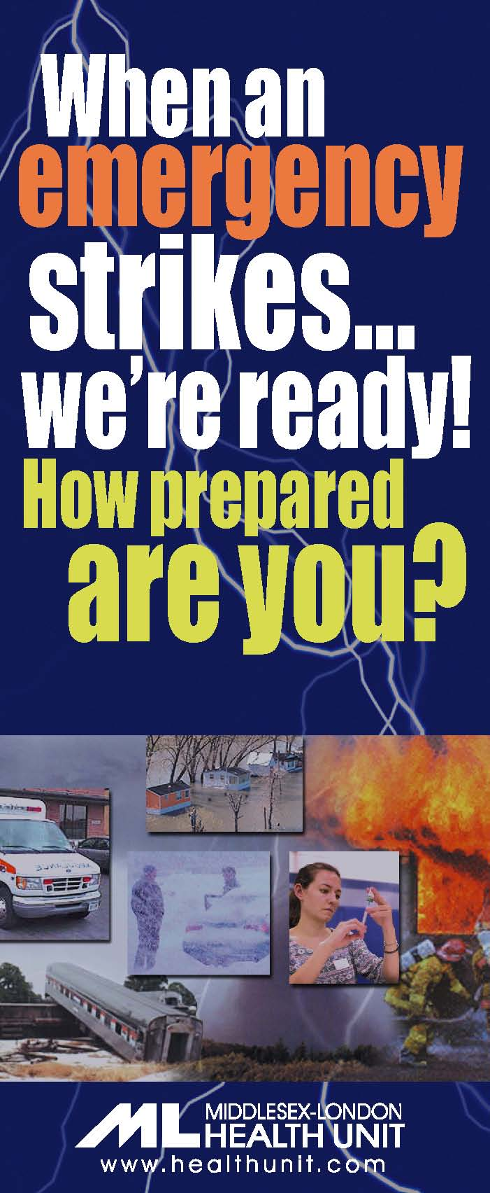
Emergency Preparedness Protocol
Surveillance and assessment
Health protection
Risk communications and
public awareness
Education, training and exercises

Slide 15
Requirements
Hazard Identification and Risk Assessments for Public Health
Continuity of Operations Plan
Emergency Response Plan
24/7 Notification Protocol
Public Awareness Activities
Education Program
Orientation Program
Exercise Program

Slide 16
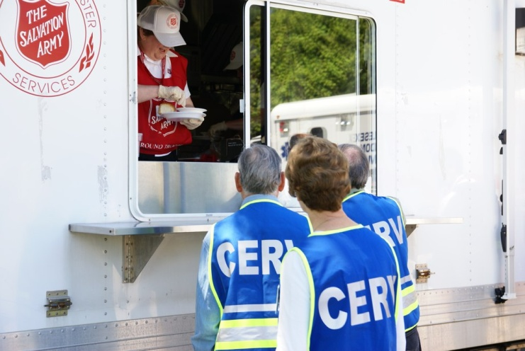
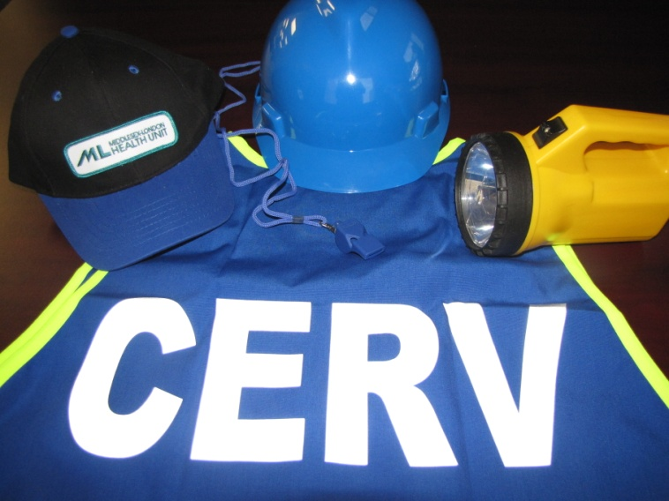
CERV – Community Emergency Response Volunteer

Slide 17
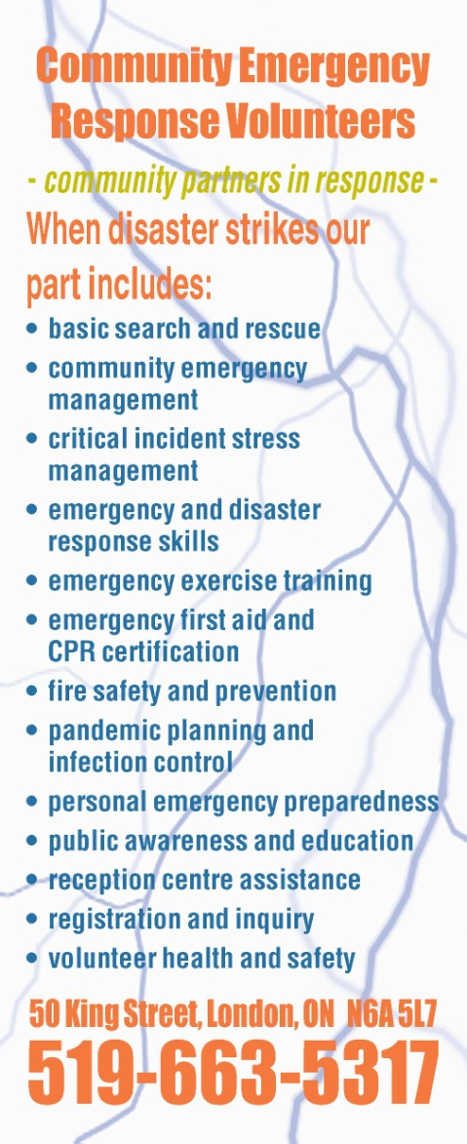

Slide 18
Public Health
Many unknowns (air, water, virus, etc)
Develop partnerships and open lines of communication with all key stakeholders
Effective business and personal continuity plans and community participation are essential
Routine Infection Control practices
Every Emergency has a public health component to it!

Slide 19
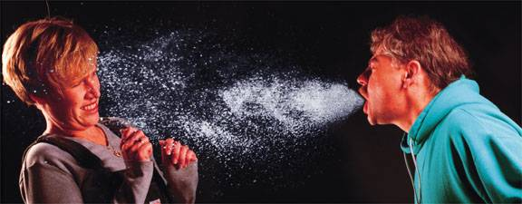

Slide 20
Community Infection Control
Hand washing, alcohol based hand-sanitizers
Coughing etiquette
Social distancing
Vaccination and immunization clinics
Use of self screening tools
Cleaning and disinfection
Routine precautions
Personal Protective Equipment (PPE)
Fit-testing

Slide 21
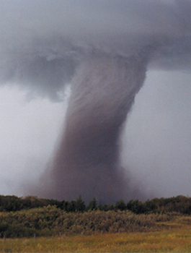
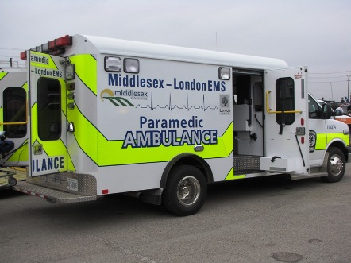
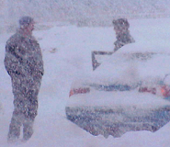
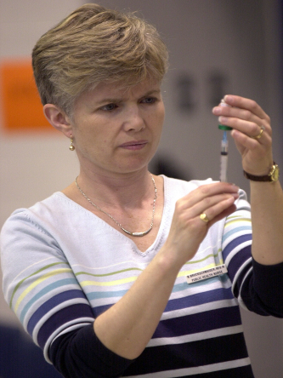
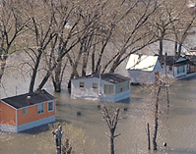
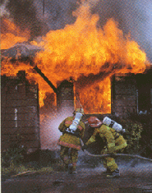
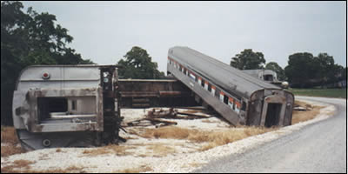
When an Emergency Strikes … We’re Ready! How Prepared are You?
Notes:
Ontario Smoke Free Act

Slide 22
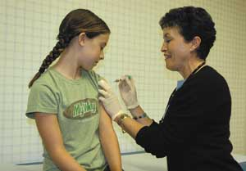
What Else Can We Do to Prepare for Emergencies?
Learn first aid & CPR so you can help others when disaster strikes
Keep your immunizations up-to-date, to avoid getting sick in an emergency (talk to your doctor about vaccines for the flu, tetanus, hepatitis A & B and others)

Slide 23
Patricia Simone ABCP, CMM III-EMP Manager, Emergency Preparedness Middlesex-London Health Unit, 50 King Street, London, ON N6A 5L7 * tel: 519-663-5317 ext. 2371 * fax: 519-663-9413 * blackberry: 519-617-0571 email: pat.simone@mlhu.on.ca web: www.healthunit.com/emergency Call sign: VA3HIS

