Slide 1
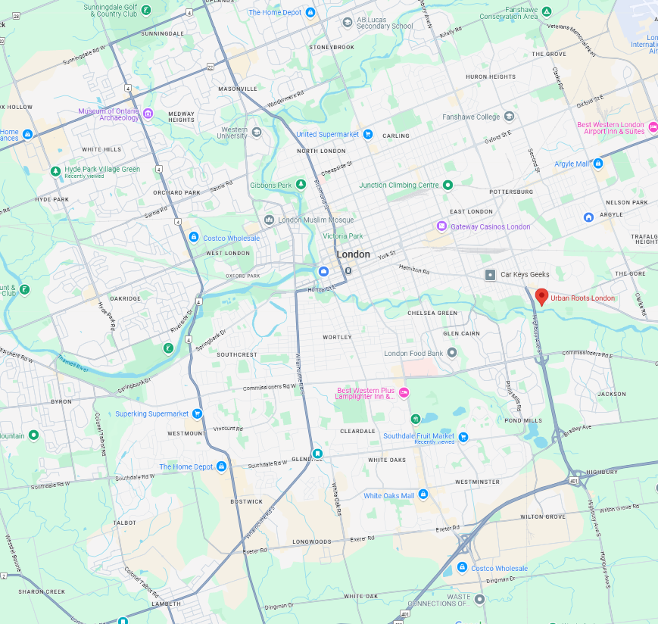
Harvest Bucks Locations
5
1. Berries Market
820 Wharncliffe Rd S Unit 4
2. Covent Garden Market
130 King St
3. The Hyde Park Uptown Market
1695 Hyde Park Rd
4. Superking Supermarket
785 Wonderland Rd, South
5. Your Masonville Market
1635 Richmond St
6. Southdale Fruit Market
775 Southdale Rd E
7. Market at Western Fair District
900 King St
8. Urban Roots London
21 Nolan Ave
9. London Food Co-op
621 Princess Ave
10. United Supermarket
1062 Adelaide St North
11. Millar Berry Farms
7375 Longwoods Rd
Other Locations
Ilderton Farmers Market
100 Meadowcreek Dr, Ilderton
New Moon Community Homestead
27093 New Ontario Rd, Ailsa Craig
10
3
9
7
2
8
1
4
6
11
(Map data ©2025 Google)
Notes:
Back of the voucher includes list of locations, days, season (not all open year round), hours, address
Ask participants to share their experiences at any of the locations
Provide suggestions for locations, times, produce in season etc
Grey markets are closed for the season (review and update before each presentation)
1. Berries Market
820 Wharncliffe Rd S Unit 4
Mon-Sat 9am-8pm, Sun 9am-7pm (519)204-3222
2. Covent Garden Market
130 King St.
Mon-Sat 8am-6pm, Sun 11am-4pm (519)439-3921
3. The Hyde Park Uptown Market (closed for the season)
1695 Hyde Park Rd.
Sunday 10am-2pm hydeparkbia.ca/events/uptown-market/
4. Ilderton Farmers Market (closed for the season)
22609 Hyde Park Rd, Ilderton
Saturday 9am-12pm www.ildertonfarmersmarket.com
5. Komoka Community Market (closed for the season)
1 Tunks Ln, Komoka
Saturday 9am-12pm (519)-245-3550
6. Your Masonville Market (closed for the season)
1635 Richmond St.
Friday 8am-1pm (519)808-1879
7. Millar Berry Farms
7375 Longwoods Rd.
Mon-Fri 10:30am-5:30pm, Sat 10am-4 (519)652-2065
8. Southdale Fruit Market
775 Southdale Rd E
Mon-Sat 8am-9pm, Sun 9am-8pm (519)204-9411
9. The Market at Western Fair District
900 King St.
Sat 8am-3pm, Sun 10am-2pm (519)931-3615
10. Urban Roots London
21 Nolan Ave.
Wed 4pm-8pm, Sunday 10am-1pm (226)378-8175

