Slide 1


Food4Thought
E-Learning Training Module
Notes:
Welcome. This e learning training module is an overview of the #Food4Thought program and is designed to provide the important information you require to facilitate the Program.​
​
This program was carefully designed considering evidence and best practice, and designed in consultation with Public Health Inspectors around food safety and so it needs to be implemented as close to the facilitators guide as possible.
​
To successfully complete this training, you must submit the quiz as directed at the end of the module. ​

Slide 2

Program Overview
4 Session Program that follows a Cook, Eat, Chat model
The goal of Food4Thought is building relationships and connectedness
Target: Students that would benefit from connecting with peers and or a trusted adult in the school community
  Appropriate for students in grade 6+
  Suggested ~6-12 participants per program
  Can target students based on a specific Social Emotional Competency if desired
Notes:
Food4Thought is a four session program that follows a cook, eat, chat model. The Goal of Food4Thought is to build relationships and connectedness through cooking, eating and chatting together as research shows that there is an association between school connectedness and improved emotional health, increased academic achievement, and reduced risk-taking behaviours among children and youth (Chapman, Buckley, Sheehan & Shochet, 2013).
#Food4Thought is meant to be a targeted program, inviting students that would benefit from connecting with peers and trusted adults in the school community. School staff such as teachers, guidance councilors or social workers can provide suggestions for students that would benefit from this program. It is suggested to be ran with students in grade 6 and older and with a group of around 6-12 students. Food4Thought can also target students based on a specific social emotional competency, such as stress management and coping, if desired.

Slide 3
Program Overview
Building relationships and connectedness is accomplished through cooking and sharing a meal together
  Built off literature on the connection between cooking and eating together and mental well-being
  Meals are a great time to share and connect
  Relaxed atmosphere
  The potential to gain food skills is a bonus!
Notes:
As I already noted, the Goal of #food4thought is building relationships and connectedness. This is achieved by cooking and sharing a meal together and is built off literature on the connection between cooking and eating together and mental well-being. Cooking and eating together provides an opportunity to talk and share in a relaxed, unforced atmosphere. The potential to gain food skills through the program is a bonus.

Slide 4
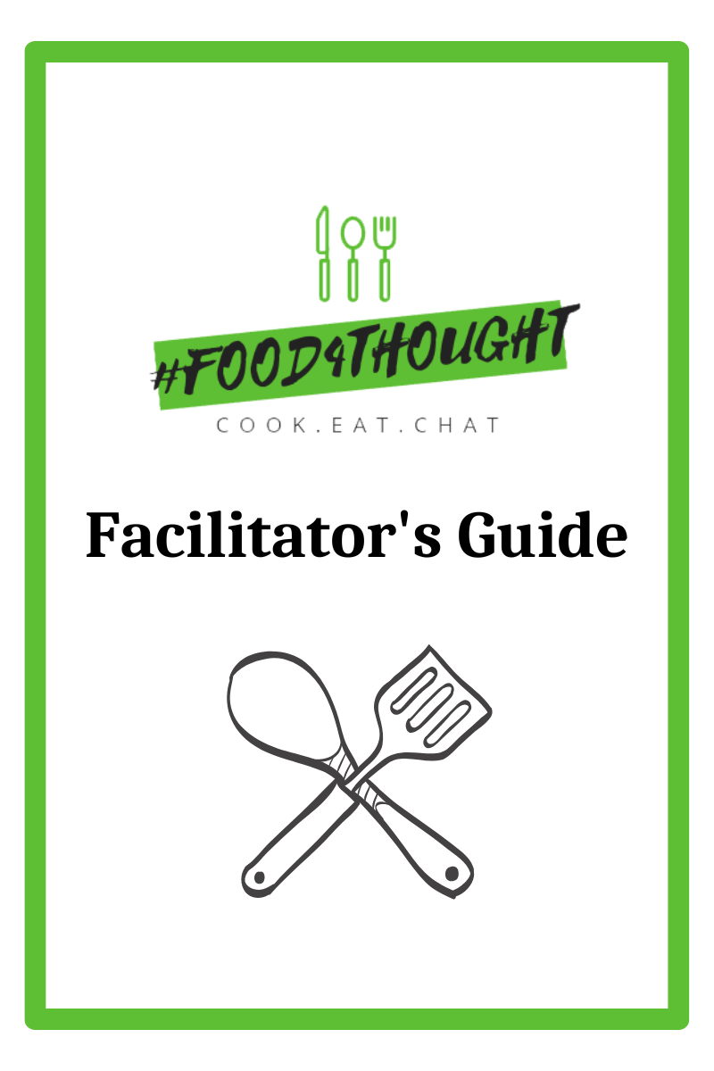
Facilitator’s Guide
Includes:
  Program overview
  Food and kitchen safety information
  Recipes and shopping lists
  Chat activities
Notes:
To support the smooth operation of the program, a facilitator's guide is available, containing a program overview, food and kitchen safety information, recipes and shopping lists, as well as chat activity suggestions. This comprehensive resource is conveniently accessible through a portal on our website. Upon completion of the e-learning module, please navigate to the portal to access all necessary materials to run the program

Slide 5
Logistics
Consent:
  Caregiver consent is needed. A sample consent form is in the facilitator’s guide
Timing:
  Total length of each session is approximately 40-45 minutes (cooking 20-25 minutes, chat ~20 minutes) with 30 minutes needed for set up and clean up)
Location Needs:
  Nearby sink/refrigerator
  Electrical outlets
  Adequate ventilation
  Handwashing stations
  Enough space to work safely
Notes:
There are some important details to be aware of before beginning the program.
Caregiver consent is required for all participants. There is a sample consent form at the end of the facilitator’s guide that you can use.
The total length of each session is approximately 40-45 minutes plus set up and clean up time. The cooking portion will take about 20-25 minutes, leaving approximately 20 minutes for the chat portion. Set up prior to students coming will take approximately 30 minutes and clean up will take about 30 minutes as well.
- Finally, when choosing the room location consider the following factors:​
There should be a sink and refrigerator close by​
Ensure there are enough electrical outlets​
Ensure the room is adequately ventilated so that steam from a skillet will not set off the fire alarm. ​
Consider how and where the participants will wash their hands. For example, is there a need to set up a portable handwashing station? ​
Finally, ensure there is adequate space in the room so that all participants can work safely.​

Slide 6
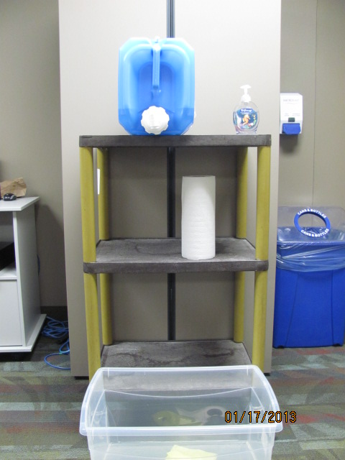

Logistics
Water Jug
Hand Soap
Paper Towels for Drying Hands
Catch Basin
Notes:
If a handwashing sink is not close to the room you are cooking in, a portable handwashing station can be set up like the one shown. It can be set up using a portable water jug filled with hot water, a table or cart to set it on, a plastic bin or catch basin, hand soap and paper towels. After using the portable water jug ensure that it is properly drained and aired out after each use.

Slide 7
Logistics
Prior to running the program (2-3 weeks prior):
Invite selected students to participate in an informal meet and greet to provide a brief overview of the program, program expectations, and kitchen safety.
Hand out consent forms.
Invite participants to express interest in topics to discuss during the program (located on the back of the consent form).
Notes:
About 2-3 weeks prior to running the program, it is suggested to invite the selected students to participate in an informal meet and greet. Provide a brief overview of the program, program expectations and kitchen safety information. You can also hand out consent forms at this time which includes a brief questionnaire on the back for students to express interest in topics to discuss during the program.

Slide 8
Logistics
Prior to each session you will:
Gather materials needed for the session (i.e., groceries, recipes, cooking equipment, materials for Chat activities, etc.).
Set up the cooking station and chat area (to save time, consider washing produce before).
At each session you will:
Welcome participants and prepare the recipe as a group. Name tags with pronouns are suggested for each session.
Sit together and eat the food prepared (note to facilitator: do not pressure anyone to eat).
Discuss the session topic area.
Notes:
Prior to each session you will: gather all materials needed for each session which includes necessary groceries, recipes, cooking equipment and any materials needed for the Chat activities. Set up the cooking station and chat area prior to students of the session.
At each session you will: Welcome participants and prepare the recipe as a group. Name tags with pronouns are suggested for each session; Sit together and eat the food prepared (note to facilitator: do not pressure anyone to eat).
Discuss the session topic area.

Slide 9
Logistics
Equipment Needs:
  Check with your school board to see if there is equipment available to loan out. If you would like to purchase the equipment needed to run the program, there is an equipment list at the end of the facilitators guide
  Food:
  It costs approximately $130 to run the program (4 sessions). It is the facilitator’s responsibility to purchase the food
  Handling Injuries:
  A First Aid Trained staff member must be available at all times when the program is running
Notes:
Each session requires basic cooking equipment—such as cutting boards, knives, measuring cups, and an electric skillet, to name a few. Check with your school board to see if this equipment is available to borrow. If you choose to purchase your own, an equipment list is provided at the end of the facilitator’s guide.
The estimated food cost for running the full program is approximately $130. Facilitators are responsible for purchasing and safely storing the food before each session.
Finally, please ensure that a staff member with first aid training is present at all times while the program is in session.

Slide 10
Safe Food Handling
As food is being prepared, the food handler certification recommended:
Principals of safe food handling:
    Personal hygiene
    Hand-washing
    Cleaning and sanitizing
    Temperature control
    Proper storage and holding of food
  All information can be found in the facilitators guide. Posters are included on the portal to provide information to students
Notes:
Keeping all participants safe is a key objective as incorrect handling or cooking of food can result in food poisoning. It is important to follow the basic principals of food safety which include: personal hygiene; hand washing; cleaning and sanitizing; safe food handling and temperature control, and proper storage and holding of food.
While this is not mandatory, the Food Handler Certification program is a course that may be considered to increase knowledge related to food safety and safe food handling practices. Upon successful completion of the course, a food safety certificate will be issued and is valid for 5 years. More information about this is available on our Health Units website.
​

Slide 11
Personal Hygiene
Tie long hair back
Remove dangling jewelry, watches and rings
Do not cook when unwell.
Cover cuts and wounds with a Band-Aid and gloves.
  Unless a glove is being used to cover a cut it is not needed. Gloves can compromise food safety.
Notes:
Before cooking participants should: ​
Tie back long hair. It can be helpful to have some extra hair ties on hand for this!​
Remove any dangling jewelry, rings or watches and store them in a safe place.​
If a participant isn’t feeling well it is best if they don’t cook that day.
If a participant has a cut or wound, the hand and wound should be washed, covered with a band-aid and a glove should be worn on that hand. ​
Unless a glove is being used to cover a cut, it is not needed. Frequent handwashing while cooking is the best way to prevent the spread of bacteria. Gloves can increase the chances of contamination (or compromise food safety) if they are not used properly and changed often.​
​
​

Slide 12
Handwashing
The most effective way to stop the spread of illness
Handwashing is recommended over alcohol-based hand cleansers.
Hands should be washed:
  before starting to cook;
  after touching hair or face;
  after using the washroom;
  after handling raw meat, poultry, or eggs (not in the program)
  After switching food preparation tasks or handling the garbage or dirty dishes.
Wearing gloves does not replace handwashing
Notes:
The best method for stopping the spread of illness is handwashing. Handwashing is recommended over alcohol-based hand cleansers. Examples of times when you should wash your hands include:​
before starting to cook​
after touching hair or face​
after using the washroom​
After handling the garbage or dirty dishes. ​
After handling raw food like meat, poultry or eggs or switching food preparation tasks​

Slide 13
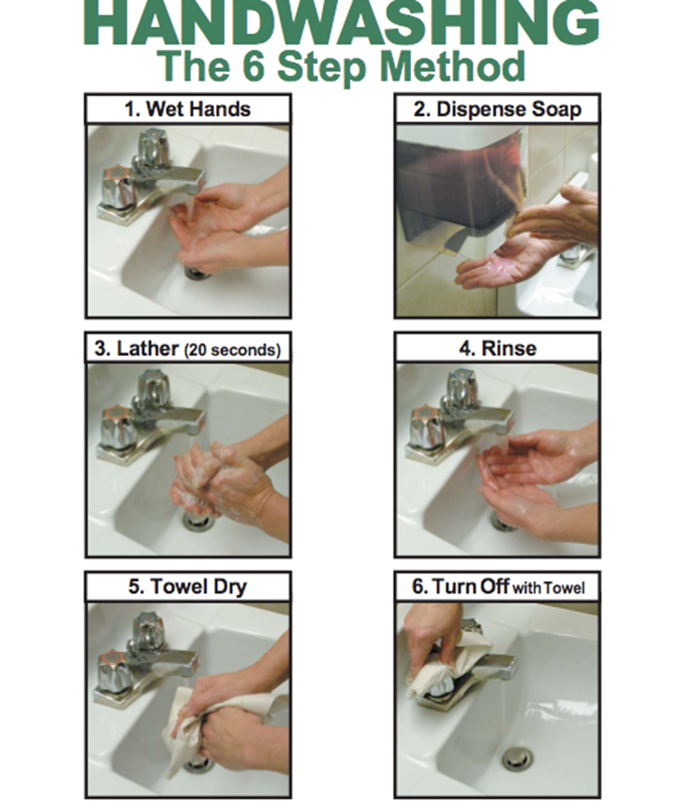
Notes:
This poster illustrates the 6 steps involved in handwashing.
A copy of the poster is available on the portal and can printed and displayed as a reminder in the room where the cooking sessions will be conducted. ​
​

Slide 14
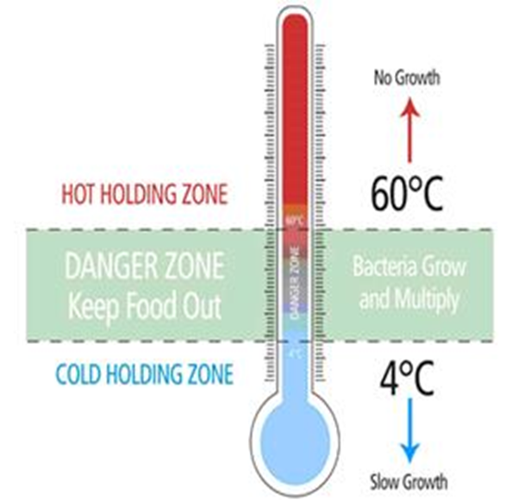
Storage and handling of food
Always maintain proper food temperatures
  The Danger Zone (4°C and 60°C or 40°F and140°F) is the temperature zone where bacteria grow most rapidly ​
  Keep refrigerated, frozen and cooked food out of this zone
  Keep this in mind when shopping and transporting foods
  Foods in this zone for more than 2 hours are not safe to eat
Wash your hands before handling food
Thoroughly wash vegetables and fruits prior to preparation/cooking
Notes:
Proper storage and handling foods are key components of food safety.
It is important to always maintain proper food temperatures. The danger zone is the temperature zone where bacteria grow most rapidly and is between 4°C and 60°C (40°F and140°F) ​​
Keep refrigerated, frozen and cooked food out of this zone by keeping cold food at or below 4°C and hot foods above 60°C for holding purposes ​​
Foods in the danger zone for more than 2 hours are not safe to eat ​​and should be thrown away.
Always remember to wash your hands before handling food and thoroughly wash vegetables and fruit prior to food preparation and cooking.
​​

Slide 15
Cleaning and Sanitizing
Cleaning and Sanitizing Dishes, Pots & Equipment:
By machine:
If you use a dishwasher it must be commercial grade and meet the Ontario Food Premises Regulation (O. Reg 493/17) . This code sets out the minimum standards that each food premises must meet.
Notes:
In order to properly clean and sanitize equipment in a dishwasher, it must be commercial grade and meet the Ontario Food Premises Regulation. Usually commercial dishwashers have the temperature gauge located on the outside of the dishwasher.

Slide 16
Cleaning and Sanitizing
Handwashing dishes:
You will need a three compartment sink (or bins) for washing dishes by hand.
Sanitizing solution will be included with the cooking equipment bin.
Notes:
Many locations do not have a commercial dishwasher, in these cases, dishes will need to be handwashed using the three sink method.
When using the three-sink method to wash dishes follow these steps:​
Scrape off any excess food and rinse the dishes before starting to wash​
Ensure all sinks are clean. Fill the first sink with warm water and dish soap. Dishes will be washed in this sink​
Fill the second sink with clean water, temperature no less than 43 Celsius or 110 Fahrenheit. This is the sink that dishes will be rinsed in. Note if you don’t have 3 sinks clean bins can be used.​
The third sink is where the dishes are sanitized using a food grade sanitizing solution like chlorine, ammonia, or iodine. ​Sanitizer is included in the #food4thought bin and will need to be diluted to the proper concentration for use.
The final step of this process is to air dry the dishes or, dry with paper towels, and store the dishes in a safe, clean and secure place​
​

Slide 17
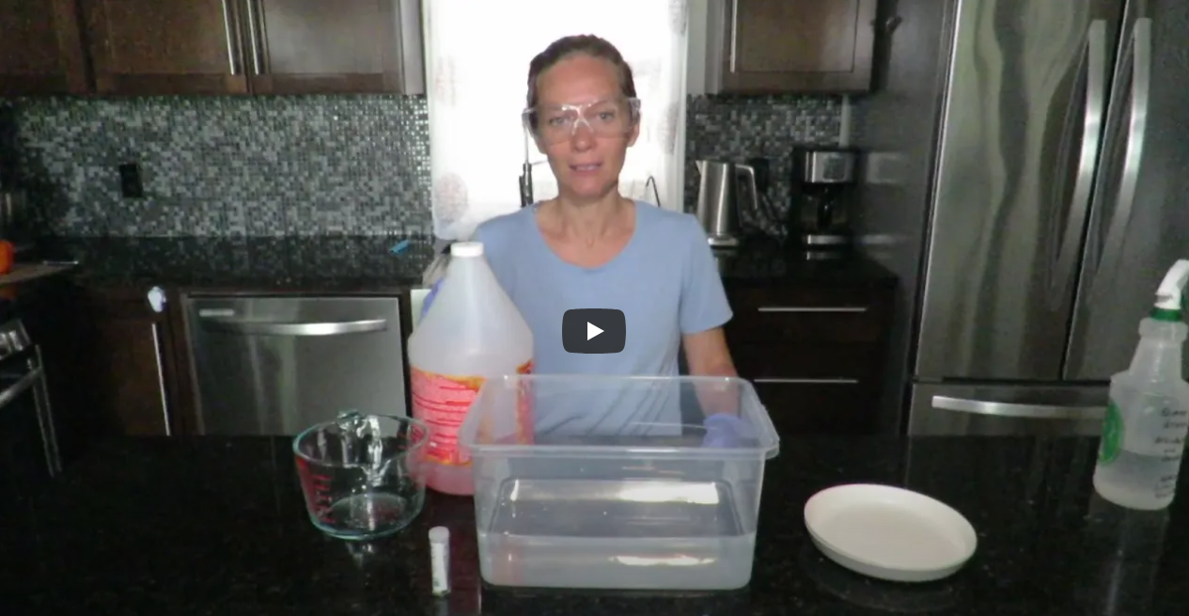
Using Quaternary Compound Solution
Watch on YouTube: www.youtube.com/watch?v=1KmGnVG5p2o​
Notes:
Please click on the video link to watch how to properly use a quaternary compound solution to sanitize dishes and cooking surfaces

Slide 18
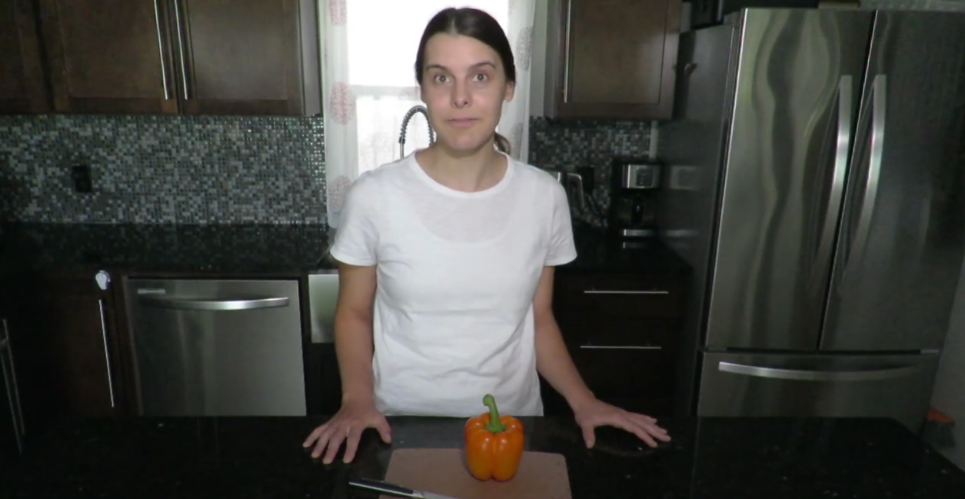
Knife Safety
Watch on YouTube: https://www.youtube.com/watch?v=L3z9YmARd20
Notes:
Please click on the video link to watch a video on knife safety
Since knives will be used extensively in the cooking program, participants will need instruction and practice with safe knife handling. The following are important tips to communicate and demonstrate to participants to help ensure safety when using a knife.
When carrying a knife, it is important to hold it so that the tip of the blade faces downwards or towards the floor.
If a knife falls never try to catch it as an injury may result. Call out to others that a knife is falling and to move back. Let it fall to the ground and then safely pick it up.
Sharp knives are safer to use compared to ones that are dull. When a knife is dull it can result in pressing harder which could result in a slip with the knife.
When cutting, hold the knife by the handle and always cut away from the body and not towards it.
Never try to cut something while holding it.
Always use a cutting board to cut on. Stabilize the cutting board using a clean wet cloth or paper towel to act as a traction between the cutting board and the countertop. This will ensure safety when chopping.
There is a knife safety poster on the portal with all of this information.

Slide 19
Cook
Getting Prepared:
  Shop
    Shopping lists included for each session
  Set up cooking station:
    Clean and sanitize all tables where food preparation will occur
    Equipment, utensils, dishes should be clean and sanitized
    Set out required equipment (Equipment lists on the recipes)
    Set out required food to prepare the recipe
Notes:
To assist with purchasing the correct food for each session, the facilitators guide includes a shopping list for each session.
To set up the cooking station:
Clean and sanitize all tables where food preparation will occur
Ensure equipment, utensils, and dishes are clean and sanitized
- Set out the required equipment (There is also an equipment list at the bottom of each recipe to ensure that you are taking out all equipment necessary to prepare the recipe.
- Set out required food to prepare the recipe

Slide 20
Cook
One Recipe per session:
  Recipes easy to prepare, minimal time
  Limited equipment required - no oven needed (skillet based)
Notes:
There is one recipe per session. Each recipe is easy to prepare in minimal time. Each recipe also includes a vegetable or fruit, whole grain and protein food to align with Canada’s Food Guide. Limited equipment is required as each recipe either does not require heat or uses an electric skillet. This ensures that all schools can run the program.

Slide 21
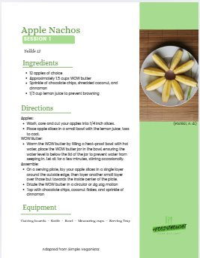
Recipes
Session 1: Apple Nachos​
​
Session 2: Pizzadillas​
​
Session 3: Rice Vermicelli​
Session 4: Speedy Meatless Chili
Notes:
The following are the recipes that will be made in the program:
Session one: Apple Nachos
Session two: Pizzadillas
Session three: Rice Vermicelli
Session four: Speedy meatless chili

Slide 22
Eat & Chat
Chat sessions have activities that are aligned with the six social–emotional learning (SEL) competencies identified by Ontario’s Ministry of Education and School Mental Health Ontario. ​
Facilitators can focus on one SEL competency for all 4 sessions, or choose activities from various competencies based on group needs.​
  Critical and creative thinking (executive functioning)​
  Healthy relationship skills​
  Identification and management of emotions​
  Positive motivation and perseverance​
  Self-awareness and sense of identity​
  Stress management and coping
Notes:
Once students have prepared their food, invite them to sit down together and enjoy the food and start the Chat portion of the program. Chat sessions have activities that are aligned with the six social–emotional learning (SEL) competencies identified by Ontario’s Ministry of Education and School Mental Health Ontario which are:
Critical and creative thinking (executive functioning)​
Healthy relationship skills​
Identification and management of emotions​
Positive motivation and perseverance​
Self-awareness and sense of identity​
Stress management and coping
Facilitators can focus on one SEL competency for all 4 sessions, or choose activities from various competencies based on group needs.​

Slide 23
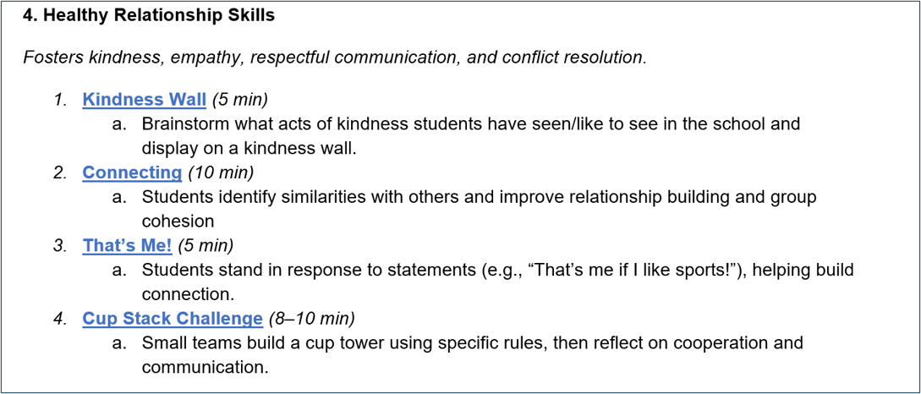
Eat & Chat
Notes:
This is an example of the types of activities included in the facilitator’s guide. Each social-emotional competency features 4–5 activities, designed to take approximately 10–15 minutes each.

Slide 24
Eat & Chat
Additionally, there are key talking points that you can use during or after the cooking time to spark conversation related to each competency
Healthy Relationship Skills
Situation​ | Prompt​
Sharing responsibilities​ | “How did you divide up the tasks today? How did you communicate who would do what?”​
Conflict or disagreement​ | “If there was a disagreement, how was it handled?”​
Team success​ | “What made your group work well together today?”​
Supporting each other​ | “What’s one way you helped or supported someone in your group?”​
Notes:
Additionally, each session can include key talking points that facilitators can use during or after the cooking time to spark meaningful conversations tied to the competencies. For example, if the focus is on healthy relationship skills, facilitators might ask students, “What helped your group work well together today?” Reflecting on this question encourages students to identify and discuss the essential ingredients of positive collaboration—such as communication, respect, and teamwork—that support healthy relationships

Slide 25
Congratulations!
You have completed the Food4Thought E-Learning Training Module!
Please click the link to access the quiz: https://chkmkt.com/Food4Thought_Quiz
Access the Facilitator’s Guide on the Facilitator Portal
For additional questions, please contact us at healthyschools@mlhu.on.ca ​
​
Notes:
Congratulations! You have now completed the #Food4thought E-leaning training module. Please click on the link below to access the quiz. Once you finish the quiz, you can access the facilitators guide on the facilitator portal. If you have any additional questions, please contact us at healthyschools@mlhu.on.ca

