Slide 1


SHSM - Infectious Diseases
Created By: School Health Team
Date Created: 2016
Revised: October 2024

Slide 2

Key Learnings for Today​
Brief Public Health Overview​
Overview of Infection Control​
  The Chain of Infection​
  Breaking the Chain of Infection​
Activity​
Questions​
Quiz​
Notes:
Image retrieved from: https://pixabay.com/en/clipboard-green-check-list-311168/

Slide 3
Role of the Health Unit​
34 health units in Ontario that are mandated to protect and promote the health of the public.
Environmental Health​
School Health​
Immunization​
Infectious Disease
Healthy Babies/Prenatal care​
Emergency Management​
Sexual Health​
Notes:
When we think about pandemics, or the spread of illness, the Middlesex-London Health Unit plays a variety of roles in our community, all of which boil down to our responsibility to protect and promote the health of the public.
There are 34 health units across Ontario, and we are all responsible to uphold and follow this mandate in our communities. While we offer unique programs and service to meet the needs of our community, there are a number of programs and teams that exist at all health units across Ontario. Some of these include:
Environmental Health- responsible for inspecting and testing for food handling practices, water safety, air quality, rabies and vector borne illness (e.g. tick collection and testing).
School Health- responsible for promoting and supporting health in elementary and secondary school settings.
Immunization- responsible for tracking vaccines and the immunization status of children in child care and school settings, as well as planning and delivering school immunization clinics. There is also a travel immunization clinic located at the Middlesex-London Health Unit.
Infectious Disease- responsible for follow-up, tracing contacts and surveillance of cases of reportable infectious diseases/conditions.
Healthy Babies- responsible for supporting and teaching parents and families about newborn and infant child care and safety practices.
Sexual Health- responsible for consulting, testing for sexually transmitted infections and providing teaching and birth control methods.
Emergency Management- responsible for planning for preparedness and response to local emergencies, including: pandemics, water contamination, extreme weather conditions, power outages, flooding and fire. Part of planning and preparedness is to have a plan in place, but to also practice and rehearse our response with other community services (e.g. fire department) to ensure that we are ready.
Reference:
Ministry of Health and Long Term Care. 2021. Ontario Public Health Standards: Requirements for Programs, Services and Accountability. Retrieved from: https://www.health.gov.on.ca/en/pro/programs/publichealth/oph_standards/docs/protocols_guidelines/Ontario_Public_Health_Standards_2021.pdf

Slide 4
Health Protection and Promotion Act
Reportable/infectious diseases or conditions must be reported to the Health Unit by:​
Physicians​
Laboratories​
School principals​
Hospitals ​
Directors of institutions​
Notes:
The Health Protection and Promotion Act is part of the legislation that Health Units are responsible to follow. The Health Unit provides follow up, contact tracing, surveillance and monitoring for these reportable diseases/conditions.
Some examples, include: covid-19, influenza, tuberculosis, meningitis, measles, mumps, pertussis, hepatitis.
Why?
We want to cast a net wide enough - fast enough - to stop the spread of disease.
Note: Surveillance and monitoring for infectious disease trends occurs worldwide (World Health Organization), federally (Health Canada), provincially (Ministry of Health and Long-Term Care, Public Health Ontario) and locally (Middlesex-London Health Unit).
References:
Middlesex London Health Unit. November 2022. Diseases of Public Health Significance. Retrieved from: https://www.healthunit.com/reportable-diseases
Ministry of Health and Long Term Care. June 2022. Ontario Public Health Standards. Requirements for Services Programs and Accountability. Infectious Disease Protocol 2022. https://www.health.gov.on.ca/en/pro/programs/publichealth/oph_standards/infdispro.aspx

Slide 5

What is an Outbreak?
An outbreak is the occurrence of disease cases, in larger numbers, than what is normally expected in a localized area.
Water, sanitation, food and air quality are vital elements in the transmission of communicable diseases and in the spread of diseases prone to cause epidemics.
Example: Legionella Outbreak in London Ontario
(Summer 2024)
Notes:
Legionnaires disease is a respiratory illness caused by a bacteria called Legionella. It is characterized by high fever, chills, a dry cough, shortness of breath and can lead to pneumonia. Symptoms of Legionnaires usually begin two to ten days after encountering the bacteria.
Legionella bacteria are very commonly found in the environment, usually in water (hot tubs, cooling towers, hot water tanks, large plumbing systems or parts of an air-conditioning system). If the bacteria are then aerosolized or misted into the air (via wind or fans), humans may breathe them in and become unwell. Legionella is not transmitted from person-to-person, through public waterworks, or through the consumption of contaminated foods.
https://www.healthunit.com/news/middlesex-london-health-unit-continues-investigation-of-outb

Slide 6
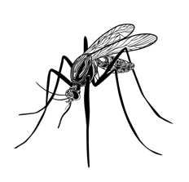
What is an Epidemic?
An epidemic is the unexpected spread of disease in a specific geographic area
Examples: Yellow fever, smallpox, measles, and polio
An epidemic disease doesn't necessarily have to be contagious. West Nile fever and the rapid increase in obesity rates are also considered epidemics.
Notes:
https://www.publichealthontario.ca/en/About/News/2022/Endemic#:~:text=The%20prevalence%20of%20the%20disease,specific%20geographical%20area%20or%20population.
https://www.publichealth.columbia.edu/news/epidemic-endemic-pandemic-what-are-differences

Slide 7


What is a Pandemic?
A pandemic is the worldwide spread of a new disease.​
A disease occurring over a wide geographic area and affecting an exceptionally high proportion of the population.​
Example: COVID-19
Notes:
A pandemic is a worldwide spread of a new disease.
A disease occurring over a wide geographic area and affecting an exceptionally high proportion of the population.
Reference:
Merriam-Webster. January 25, 2023. Pandemic. Retrieved from: https://www.merriam-webster.com/dictionary/pandemic
Image retrieved from: https://unsplash.com/photos/znhEe1cbbQE

Slide 8
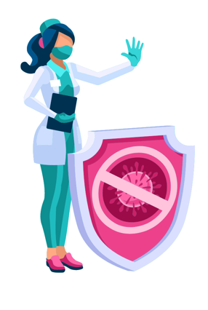
Infection Control
A set of proven practices
that help stop the spread of
illness and infection.​
Notes:
Reference:
Public Health Ontario. March 30, 2021. Infection Prevention and Control. Retrieved from: https://www.publichealthontario.ca/en/health-topics/infection-prevention-control

Slide 9
The Chain of Infection
Infectious Agent
Susceptible Host
Reservoir
Portal of Entry
Portal of Exit
Mode of Transmission
Notes:
How many people have heard of the ‘Chain of Infection’?
The Chain of infection is the way all infectious diseases spread. Each link has a unique role in the chain, and each can be interrupted, or broken, through various means. The goal of infection prevention and control practice is to break a link in the chain to prevent the transfer of microorganisms.
We will take a closer look at each of the six links of the ‘Chain of Infection’.
Reference:
Public Health Ontario. 2019. Chain of Infection and Risk Assessment Summary. Retrieved from: https://www.publichealthontario.ca/-/media/documents/I/2019/ipac-core-trainers-cot-summary.pdf

Slide 10
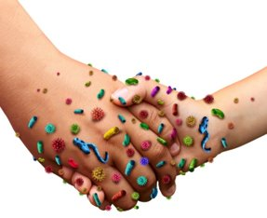
Infectious Agent​
An infectious agent is something that infiltrates another living thing, like you.
​
When an infectious agent hitches a ride, you have officially become an infected host. ​
Notes:
An infectious agent is a microorganism that is capable infiltrating another living thing and producing infection. Examples include bacteria, viruses, fungi and parasites.
When an infectious agent hitches a ride, you have officially become an infected host.
References:
Center for Disease Control. January 13, 2017. Healthcare Workers: Infectious Agents. Retrieved from: https://www.cdc.gov/niosh/topics/healthcare/infectious.html
Center for Disease Control. May 18, 2012. Lesson 1: Introduction to Epidemiology- Section 10 Chain of Infection. Retrieved from: https://www.cdc.gov/csels/dsepd/ss1978/lesson1/section10.html
Image retrieved from: \\mlhu.healthunit.com\mlhudata\SHARED\HL\CY\YAT\!Shared\Images-Purchased and Downloaded\Bigstockphoto Purchased Images\SHSM Presentation (Bigstock-Infectious-Diseases-Spread-93559700)

Slide 11
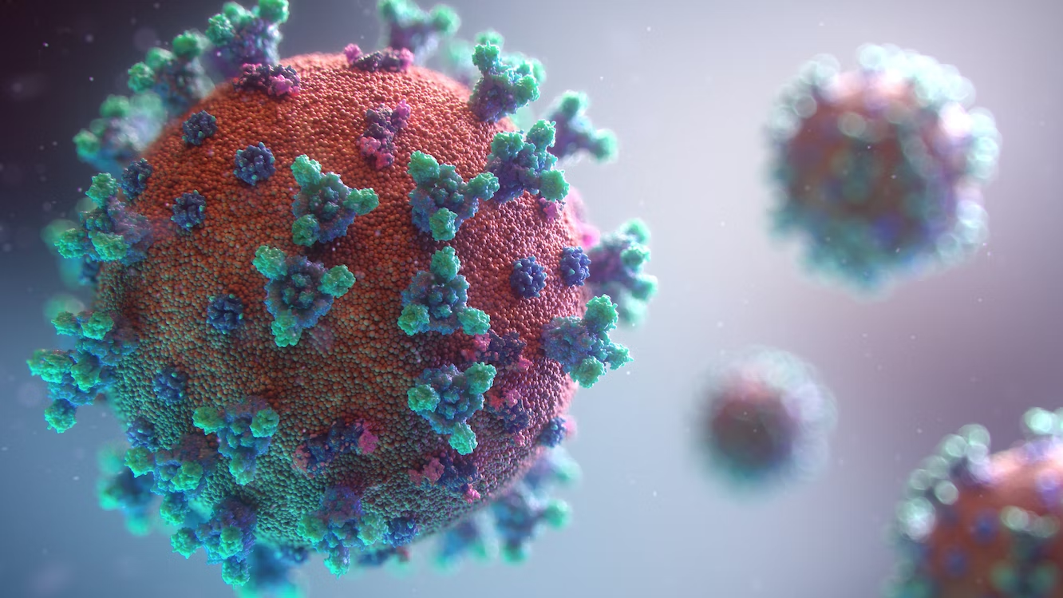
What is an Infection?​
The invasion and multiplication of microorganisms not normally present in the body such as:​
Bacteria​
Viruses​
Fungi​
Parasites ​
Notes:
What is an infection? The invasion and multiplication of microorganisms, such as: bacteria, viruses, fungi and parasites that are not normally present within the body.
We will focus on bacteria and viruses, and the difference between these two types of infections.
Reference:
Mayo Clinic. September 2017. Bacterial vs. viral infections: How do they differ?. Retrieved from: https://www.mayoclinic.org/diseases-conditions/infectious-diseases/expert-answerrs/infectious-disease/faq-20058098
Image retrieved from: https://unsplash.com/photos/rnr8D3FNUNY

Slide 12
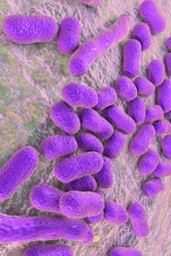
Bacteria​
Can thrive in many different types of environments including; extreme heat, cold, or radioactive​
Bacteria are larger than viruses​
They reproduce on their own​
Not all bacteria is harmful!​
Notes:
Bacteria can live outside of the human body. Bacteria are larger than viruses and they can thrive in many different types of environments, including: extreme heat or cold, and radioactive environments. Bacteria can reproduce on their own.
We usually think of these as germs that cause diseases. But your body is full of bacteria, both good and bad. It is important to note that some bacteria are good and help us to stay healthy. For example, there are bacteria that live in our intestines and help us to digest food. Probiotics are live bacteria and yeasts that are good for you, especially your digestive system. Probiotics are often called "good" or "helpful" bacteria because they help keep your gut healthy. Can aid in digestion or re-populate the intestine after a course of antibiotics.
References:
Mayo Clinic. September 2017. Bacterial vs. viral infections: How do they differ?. Retrieved from https://www.mayoclinic.org/diseases-conditions/infectious-diseases/expert-answers/infectious-disease/faq-20058098
Mayo Clinic. July 30, 2020. What are Probiotics. https://www.webmd.com/digestive-disorders/what-are-probiotics#:~:text=Probiotics%20are%20live%20bacteria%20and,help%20keep%20your%20gut%20healthy
Image retrieved from: \\mlhu.healthunit.com\mlhudata\SHARED\HL\CY\YAT\!Shared\Images-Purchased and Downloaded\Bigstockphoto Purchased Images\SHSM Presentation (bigstock—168915692.jpg)

Slide 13
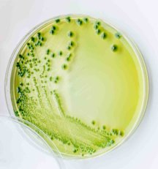
Bacteria​
Examples of infections caused by bacteria could include:​
Strep throat​
Tuberculosis (TB)​
Urinary tract infections​
​
Can you name some others?​
Can these be treated? How?​
Notes:
Some examples of bacterial infections include: STI’s (chlamydia, gonorrhea), pneumonia (chest infections), skin infections (staph/strep), meningitis
**Antibiotics are used to treat bacterial infections not viral infections.
Inappropriate use of antibiotics has created strains of bacteria that are resistant to antibiotic treatment (eg. Methicillin Resistant Staphylococcus Aureus-MRSA).
Methicillin-resistant Staphylococcus aureus (MRSA) infection is caused by a type of staph bacteria that's become resistant to many of the antibiotics used to treat ordinary staph infections.
Most MRSA infections occur in people who've been in hospitals or other health care settings, such as nursing homes and dialysis centers. When it occurs in these settings, it's known as health care-associated MRSA (HA-MRSA). HA-MRSA infections typically are associated with invasive procedures or devices, such as surgeries, intravenous tubing or artificial joints.
Reference:
Mayo Clinic. September 2017. Bacterial vs. viral infections: How do they differ?. Retrieved from https://www.mayoclinic.org/diseases-conditions/infectious-diseases/expert-answers/infectious-disease/faq-20058098
Image retrieved from: \\mlhu.healthunit.com\mlhudata\SHARED\HL\CY\YAT\!Shared\Images-Purchased and Downloaded\Bigstockphoto Purchased Images\SHSM Presentation (bigstock-Vibrio-Parahaemolyticus-Gram—151679732.jpg)

Slide 14
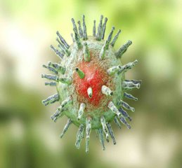
Viruses​
Viruses are smaller than bacteria.​
They require living hosts - such as people, plants or animals to multiply. ​
When a virus enters your body, it invades some of your cells and takes over the cell machinery, redirecting it to produce the virus.​
Notes:
Viruses are even smaller than bacteria.
Unlike bacteria, viruses require living hosts- such as people, plants or animals- to multiply. Otherwise, they can’t survive.
When a virus enters your body, it invades some of your cells and takes over the cell machinery, redirecting it to produce the virus.
Reference:
Mayo Clinic. September 2017. Bacterial vs. viral infections: How do they differ?. Retrieved from: https://www.mayoclinic.org/diseases-conditions/infectious-diseases/expert-answers/infectious-disease/faq-20058098
Image retrieved from: \\mlhu.healthunit.com\mlhudata\SHARED\HL\CY\YAT\!Shared\Images-Purchased and Downloaded\Bigstockphoto Purchased Images\SHSM Presentation (bigstock—165243767.jpg)

Slide 15
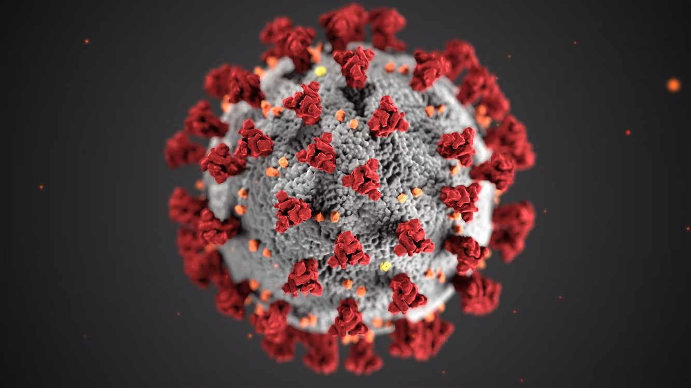
Viruses​
Diseases caused by viruses may include:​
Chickenpox​
Measles​
Common colds​
​
Can you name some others?​
Can these be treated? How?​
Notes:
Other examples: Mumps, Rubella, HPV, Hepatitis, Chicken Pox, Shingles, Herpes, HIV, H1N1, COVID-19
In some cases, it may be difficult to determine whether a bacterium or a virus is causing your symptoms. Many illnesses — such as pneumonia, meningitis and diarrhea — can be caused by either type of microbe.
You can treat symptoms of a virus, but not cure a virus! In some cases the body may be able to cure itself with time (e.g. Common cold, , COVID-19, HPV). Time may allow your body to build natural immunity to fight off infection.
Reference:
Mayo Clinic. September 2017. Bacterial vs. viral infections: How do they differ?. Retrieved from https://www.mayoclinic.org/diseases-conditions/infectious-diseases/expert-answers/infectious-disease/faq-20058098
Image Retrieved from: https://unsplash.com/photos/w9KEokhajKw

Slide 16

Reservoirs – Hiding Places
Any place where an infectious agent can live​
People
Animals
Equipment
Water
Notes:
A reservoir is the place where an infectious agent can live. For example, in or on humans, on objects and surfaces in the environment. Other examples include animals or water.
Have you ever gone to the beach, only to find out that you couldn’t swim in the water? After a storm, we often hear of news advising us to stay out of certain bodies of water. This is because the storm can churn the water, creating a reservoir for bacteria, like e-coli.
Water used for recreation at lakes, ponds, and creeks can get polluted by pathogens, including bacteria, viruses and protozoa. Most of the time these pathogens come from storm water runoff containing waste from farm animals, pets, and wildlife, and sometimes from untreated sewer discharge when a plant’s capacity is exceeded. Water that becomes polluted with pathogens can present a public health risk if used for contact recreation. Most pathogens that are harmful to human health exist in small amounts and are difficult and expensive to test. Testing for indicator bacteria like E.coli identify areas where fecal matter is present, indicating that other more harmful pathogens may also be present.
References:
Center for Disease Control. May 18, 2012. Lesson 1: Introduction to Epidemiology- Section 10 Chain of Infection. Retrieved from: https://www.cdc.gov/csels/dsepd/ss1978/lesson1/section10.html
Public Health Ontario (PHO). 2019. Chain of Infection and Risk Assessment Summary. Retrieved from: https://www.publichealthontario.ca/-/media/documents/I/2019/ipac-core-trainers-cot-summary.pdf
Image retrieved from: \\mlhu.healthunit.com\mlhudata\SHARED\HL\CY\YAT\!Shared\Images-Purchased and Downloaded\Bigstockphoto Purchased Images\SHSM Presentation (bigstock—201466063.jpg)

Slide 17



Fomites
A fomite is any inanimate object that, when contaminated with or
exposed to infectious agents, can transfer disease to a new host.
Some pathogens can survive on surfaces for weeks or even months!
Best advice is to Wash your Hands !
Notes:
Fomite - A fomite is any inanimate object that, when contaminated with or exposed to infectious agents, can transfer disease to a new host. Eg. A water fountain used by many people can become contaminated and serve as a mechanism for transfer of infection from one person to another. Another example is a doorknob, elevator button, handrail, phone, keyboards- all of these inanimate objects can serve as a fomite and transmit disease.
Examples:
Norovirus- Norovirus infection can cause severe vomiting and diarrhea that starts suddenly. Noroviruses are highly contagious. That means the norovirus infection can easily spread to others. Norovirus infection occurs most frequently in closed and crowded environments like long term care homes, hospitals, child care centers, schools and cruise ships. The virus is shed in stool and vomit. You can spread the virus from the time you first have symptoms of illness until several days after you recover. Noroviruses can stay on surfaces and objects for days or weeks and continue to infect people.
You can get norovirus infection by:
Eating contaminated food
Drinking contaminated water
Touching your hand to your mouth after your hand has been in contact with a contaminated surface or object
Being in close contact with a person who has norovirus infection
Noroviruses are difficult to kill because they can withstand hot and cold temperatures and many disinfectants.
Examples of other infections that can be transmitted through fomites -
Sexually transmitted infections (STIs)- E.g. through the use of sex toys or hand-to-genital transmission.
Razors can transmit fungal infections, staph infections, Hepatitis B and C.
How long do specific bacteria/viruses live on surfaces?
e.g. Staphylococcus aureus (including MRSA), or Streptococcus pyogenes, can survive for weeks or months on dry surfaces. (like towels, razors, furniture, and athletic equipment). It can spread infection through a cut, scrape, or open wound.
Candida albicans can survive up to 4 months on surfaces. Can cause yeast infections for example in vagina or mouth.
Herpes viruses, such as CMV or HSV type 1 and 2, have been shown to persist from only a few hours up to 7 days.
Note: fomites were not a primary way that Covid –19 spread from person to person. *People can be infected with SARS-CoV-2 through contact with surfaces. However, based on available epidemiological data and studies of environmental transmission factors, surface transmission was not the main route by which SARS-CoV-2 spread. Risk is low. Main way people were infected was through exposure to respiratory droplets carrying infectious virus. The risk of fomite transmission can be reduced by wearing masks consistently and correctly, practicing hand hygiene, cleaning, and taking other measures to maintain healthy facilities.
Takeaway- Wash your hands! This will be reviewed a bit later in presentation.
References:
Center for Disease Control. June 28, 2022. Fungal Diseases. Retrieved from: https://www.cdc.gov/fungal/diseases/candidiasis/index.html
Center for Disease Control. Norovirus Illness: Key Facts. Retrieved from: https://www.cdc.gov/norovirus/downloads/keyfacts.pdf
Center for Disease Control. April 5, 2021. Science Brief: SARS-CoV-2 and Surface (Fomite) Transmission for Indoor Community Environments. Retrieved from: https://www.cdc.gov/coronavirus/2019-ncov/more/science-and-research/surface-transmission.html#:~:text=Case%20reports%20indicate%20that%20SARS,lower%20risk%20of%20infection%206.%E2%80%8B
Government of Canada. January 27, 2023. Summary of evidence supporting COVID-19 health measures. Retrieved from: https://www.canada.ca/en/public-health/services/diseases/2019-novel-coronavirus-infection/guidance-documents/summary-evidence-supporting-covid-19-public-health-measures.html
Kampf, G., Kramer, A., Schwebke, I. August 16, 2006. How long do nosocomial pathogens persist on inanimate surfaces? A systematic review. Retrieved from: https://www.ncbi.nlm.nih.gov/pmc/articles/PMC1564025/
Mayo Clinic. March 4, 2022. Norovirus Infection. Retrieved from: https://www.mayoclinic.org/diseases-conditions/norovirus/symptoms-causes/syc-20355296
Images Retrieved from:
Cell phone - https://unsplash.com/photos/mw6Onwg4frY
Elevator buttons - https://unsplash.com/photos/-inmwDB0800
Water Fountain - https://unsplash.com/photos/vpl1J43zRWk

Slide 18

Portal of Exit – The Way Out
The way the Infectious Agent leaves the Reservoir​
Nose
Blood
Skin
Urine/Feces
Notes:
The portal of exit represents “the way out”. This is the point in the chain where an infectious agent leaves the reservoir (e.g. person, animal, water, equipment). Infectious agents can leave the reservoir through secretions from our nose or mouth, blood, open or broken skin, urine or feces.
References:
Center for Disease Control. May 18, 2012. Lesson 1: Introduction to Epidemiology- Section 10 Chain of Infection. Retrieved from: https://www.cdc.gov/csels/dsepd/ss1978/lesson1/section10.html
Public Health Ontario. 2019. Chain of Infection and Risk Assessment Summary. Retrieved from: https://www.publichealthontario.ca/-/media/documents/I/2019/ipac-core-trainers-cot-summary.pdf
Image retrieved from: https://pixabay.com/illustrations/coronavirus-virus-spread-flu-4952102/

Slide 19
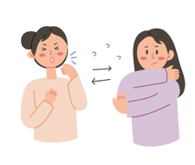
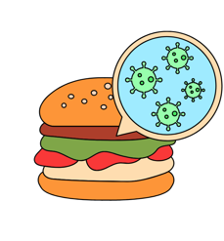

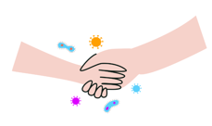
Mode of Transmission- Getting Around​
The way the Infectious Agent gets from the reservoir to the new host​
Contact​
Direct
Indirect
Contaminated Object
and Airborne
Person to Person or Droplet
Notes:
The Mode of Transmission is the way in which the infectious agent gets from the reservoir, through the portal of exit and to the new host.
The different modes of transmission, include: contact, droplet and airborne, vehicle and vector borne routes.
When we think of contact routes, there are both direct and indirect types.
Direct contact could include touching, kissing or other types of sexual contact. (E.g. Mononucleosis, Gonorrhea)
Indirect contact could include sneezing or coughing and sending infectious droplets into the air, contaminated objects (touching an object and then touching your mouth, nose or eyes before washing your hands), food and drinking water, animal to person contact (toxoplasmosis in cat feces), insects bites (mosquito becomes infected, then bites a new host transmitting Malaria or West Nile virus / ticks and Lyme disease).
References:
Center for Disease Control. May 18, 2012. Lesson 1: Introduction to Epidemiology- Section 10 Chain of Infection. Retrieved from: https://www.cdc.gov/csels/dsepd/ss1978/lesson1/section10.html
Healthline. How Are Diseases Transmitted. October 2016. Retrieved from: https://www.healthline.com/health/disease-transmission#takeaway
Images retrieved from:
https://pixabay.com/en/hands-couple-love-hold-handshake-2802891/
https://www.pexels.com/photo/people-hand-iphone-smartphone-3086/

Slide 20


Mode of Transmission ​
Droplet
Airborne
Notes:
Droplets are generated when an infected person coughs, sneezes or talks. They can travel directly from the host to the recipient, usually over short distances.
Airborne transmission occurs by the spread of very small droplets or particles in the air that are breathed in by a recipient. These small droplets or particles contain infectious agents that can remain infective over time and greater distances. A person does not require face-to-face contact with an infected individual in order to become infected. Instead, they could have been in the same room as the infected individual. Preventing the spread of pathogens that are transmitted by the airborne route requires the use of special air handling and ventilation systems. N95 respirator or greater recommended.
E.g.- Measles is highly infectious and spreads rapidly to others through the air. It lingers up to 2 hours in the air and if you are in the same room as another person with measles, you could get it. A case where someone had measles and visited a Value Village- (2014) the Health Unit issued a Media Advisory for anyone who visited the store during a certain time period.
References:
Center for Disease Control. May 18, 2012. Lesson 1: Introduction to Epidemiology- Section 10 Chain of Infection. Retrieved from: https://www.cdc.gov/csels/dsepd/ss1978/lesson1/section10.html
Healthline. How Are Diseases Transmitted. October 2016. Retrieved from: https://www.healthline.com/health/disease-transmission#takeaway
Images retrieved from:
https://pixabay.com/illustrations/man-woman-question-mark-problems-2814937/
https://pixabay.com/vectors/influenza-flu-disease-virus-2833622/

Slide 21
Transmission Examples
Syphilis Outbreak in our community (December 2019)
Sexually transmitted infection.
Direct contact with someone who is infected.
Respiratory Syncytial Virus- (RSV)
Can be spread in multiple ways through droplets from the nose and throat of infected people when they cough and sneeze.
Can also be spread directly (e.g., through kissing) and indirectly
through fomites.
Notes:
References:
Center for Disease Control. November 2022. RSV Transmission. Retrieved from: https://www.cdc.gov/rsv/about/transmission.html
Middlesex London Health Unit. December 2019. Health Unit Declares Community-Wide Syphilis Outbreak. Retrieved from: https://www.healthunit.com/news/community-wide-syphilis-outbreak

Slide 22
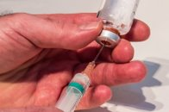
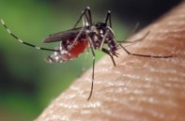
Mode of Transmission
Vehicle​
Contaminated food, water ​
medications, instruments​
​
​
Vector borne​
Mosquitoes, flies, ticks​
Notes:
Other modes of transmission, can include a vehicle, such as: contaminated food, water, medications or instruments or vector borne illnesses which are transmitted through mosquitos, flies and ticks.
Reference:
Center for Disease Control. May 18, 2012. Lesson 1: Introduction to Epidemiology- Section 10 Chain of Infection. Retrieved from: https://www.cdc.gov/csels/dsepd/ss1978/lesson1/section10.html
Images retrieved from:
https://pixabay.com/en/syringe-needle-disposable-syringe-1973129/
https://pixabay.com/en/mosquito-female-aedes-albopictus-1332382/

Slide 23
Transmission​
https://www.youtube.com/watch?v=vJKA3YkVSGo​
​
https://www.youtube.com/watch?v=wrx7OpFEk2E
​
https://www.youtube.com/watch?v=UbQ9Kl9CqUU
​
Notes:
Let’s take a closer look at ‘Modes of Transmission’…
#1 – Journey of the Germ- 2 ½ min.
#2 – Myth Busters- Safest Seeze 4 min.
#3 – Myth Busters how a virus spreads- 9 min.
(Extra) – myth busters – best way to sneeze https://www.youtube.com/watch?v=3vw0hIs2LEg

Slide 24
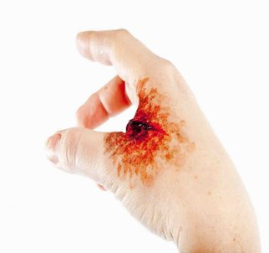

Portal of Entry – The Way In​
The way the Infectious Agent gets into the next host​
Eyes​
Nose​
Mouth​
Open Wound
Notes:
The ‘Portal of Entry’ represents the ‘way in’- it is the way in which an infectious agent gets into the next host. The portal of entry could include our eyes (droplets, splashes), nose (droplets) or mouth (droplets, contaminated food).
The ‘Portal of Entry’ could also include an open wound or damaged skin, such as burns or cuts.
References:
Center for Disease Control. May 18, 2012. Lesson 1: Introduction to Epidemiology- Section 10 Chain of Infection. Retrieved from: https://www.cdc.gov/csels/dsepd/ss1978/lesson1/section10.html
Public Health Ontario. 2019. Chain of Infection and Risk Assessment Summary. Retrieved from: https://www.publichealthontario.ca/-/media/documents/I/2019/ipac-core-trainers-cot-summary.pdf
Images retrieved from: \\mlhu.healthunit.com\mlhudata\SHARED\HL\CY\YAT\!Shared\Images-Purchased and Downloaded\Bigstockphoto Purchased Images\SHSM Presentation (bigstock—Close-up-portrait-of-a-young-h-13218407.jpg; bigstock—171362942.jpg)

Slide 25





Susceptible Host – The Next Sick Person​
Any person who is at risk of getting an infection from the Infectious Agent​
Notes:
The ‘Susceptible Host’ represents the ‘Next Sick Person’. This could include any person who is at risk of infection. A person’s risk of infection can be impacted by their age and ability to fight off illness. For example, babies and young children, pregnant woman, older adults, immunocompromised, people on certain types of medication and people who are already sick or hospitalized are at an increased risk for becoming infected.
People who do not eat well, get enough sleep or are stressed can also have a higher risk for infection.
References:
Center for Disease Control. May 18, 2012. Lesson 1: Introduction to Epidemiology- Section 10 Chain of Infection. Retrieved from: https://www.cdc.gov/csels/dsepd/ss1978/lesson1/section10.html
Public Health Ontario (PHO). 2019. Chain of Infection and Risk Assessment Summary. Retrieved from: https://www.publichealthontario.ca/-/media/documents/I/2019/ipac-core-trainers-cot-summary.pdf
Images retrieved from: \\mlhu.healthunit.com\mlhudata\SHARED\HL\CY\YAT\!Shared\Images-Purchased and Downloaded\Bigstockphoto Purchased Images\SHSM Presentation
(bigstock—171504332.jpg; bigstock—200157862; bigstock—Being-Pregnant-4712380; bigstock—Doctor-treats-female-patient-w-30731786; bigstock—Senior-women-with-carer-enjoyi-31815807)

Slide 26
Don’t Pass it Along!​
Notes:
Don’t pass it along activity. Should take about 20 minutes. See activity instructions. See the link on the MLHU website for the activity card template.

Slide 27

Breaking the Chain of Infection​
Handwashing​
Cleaning & ​
Disinfecting​
PPE​
Immunization​
Notes:
The way to stop germs from spreading is by interrupting the chain of infection at any link. ​ We will be focusing on hand hygiene, cleaning & disinfecting, PPE, and immunization.
​
​
Reference:
Public Health Ontario (PHO). 2019. Chain of Infection and Risk Assessment Summary. Retrieved from: https://www.publichealthontario.ca/-/media/documents/I/2019/ipac-core-trainers-cot-summary.pdf
Image retrieved from: https://pixabay.com/en/chain-broken-link-freedom-297842/

Slide 28
Breaking the Chain through
Hand Hygiene ​
Even if your hands look clean, they can still have germs that can make you sick​
Washing your hands removes these germs and helps to keep you healthy​
Handwashing with soap and water should be done for a minimum of 20 seconds​
Alcohol based hand sanitizer can also be used when hands are not visibly dirty, and soap and water is not available ​
Hand sanitizer should contain 60-90% alcohol​
Notes:
Why Wash your hands? Washing hands prevents illnesses and spread of infections to others.
Handwashing with soap removes germs from hands. This helps prevent infections because:
-People frequently touch their eyes, nose, and mouth without even realizing it. Germs can get into the body through the eyes, nose and mouth and make us sick.
-Germs from unwashed hands can get into foods and drinks while people prepare or consume them. Germs can multiply in some types of foods or drinks, under certain conditions, and make people sick.
-Germs from unwashed hands can be transferred to other objects, like handrails, table tops, or toys, and then transferred to another person’s hands.
-Removing germs through handwashing therefore helps prevent diarrhea and respiratory infections and may even help prevent skin and eye infections.
Handwashing and Hand Sanitizing has almost become a “norm” since the start of the pandemic. Schools, retail stores etc. have hand sanitizer in entranceways.
20 seconds of handwashing = Singing Happy Birthday Twice!
When using alcohol based hand sanitizer (ABHS) there needs to be enough product for your hands to be wet for 15 seconds. Ensure that ABHS is completely rubbed in and dry.
References:
Center for Disease Control. September 2020. Show Me the Science – Why Wash Your Hands? Retrieved from: https://www.cdc.gov/handwashing/why-handwashing.html
Middlesex-London Health Unit. 2015. Hand Hygiene. Retrieved from: https://www.healthunit.com/hand-washing

Slide 29
When Should You Wash Your Hands?
Examples:
Before handling, preparing or serving food​
After using the washroom ​
After sneezing, coughing, or blowing your nose​
Before eating​
Notes:
Have students popcorn out ideas on "When should you wash your hands?"
Possible Responses
Before:
Preparing or eating food.
Caring for someone who is sick.
Treating a cut or wound.
Putting in contact lenses.
After:
Going to the bathroom.
Contact with body fluids such as blood, vomit, or feces.
Changing diapers or helping someone with toileting.
Caring for someone who is sick.
Blowing your nose.
Coughing or sneezing.
Touching an animal or handling their toys or waste.
Handling garbage, trash cans, or drains.
Treating a cut or wound.
Handling raw meat.
Simply put: Clean your hands often, whether they look dirty or not!

Slide 30
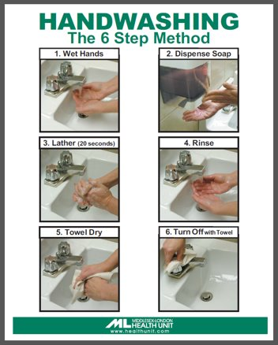
Proper Hand Washing​
Notes:
Proper hand washing technique:
Wet your hands with clean, running water (warm or cold)
Apply soap.
Rub your hands together to make a lather and scrub them well; be sure to scrub the backs of your hands, between your fingers, and under your nails. Continue rubbing your hands for at least 20 seconds. Need a timer? Hum the “Happy Birthday” song from beginning to end twice.
Rinse your hands well under running water.
Dry your hands using a clean towel or air dry them.
Turn off tap.
Reference:
Middlesex-London Health Unit. Handwashing The 6 Step Method. Retrieved from: https://www.healthunit.com/uploads/handwashing-6step-method.pdf

Slide 31
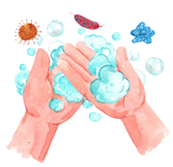
Handwashing Video​
https://youtu.be/fpXh2XHwMmE
https://youtu.be/eZw4Ga3jg3E
Notes:
How does handwashing with soap and water remove germs and chemicals?
Soap and water, worked into a lather, trap and remove germs and chemicals from hands. Wetting your hands with clean water before applying soap helps you get a better lather than applying soap to dry hands. A good lather forms pockets called micelles that trap and remove germs, harmful chemicals, and dirt from your hands.
Lathering with soap and scrubbing your hands for 20 seconds is important to this process because these actions physically destroy germs and remove germs and chemicals from your skin. When you rinse your hands, you wash the germs and chemicals down the drain.
Use plain soap and water to wash your hands. Studies have not found any added health benefit from using antibacterial soap, other than for professionals in healthcare settings.
What if I have water but no soap to wash my hands?
If you don’t have soap and water, use a hand sanitizer with at least 60% alcohol. If you don’t have hand sanitizer or soap, but do have water, rub your hands together under the water and dry them with a clean towel or air dry. Rubbing your hands under water will rinse some germs from your hands, even though it’s not as effective as washing with soap.
Is it better to use warm water or cold water?
Use your preferred water temperature – cold or warm – to wash your hands. Warm and cold water remove the same number of germs from your hands. The water helps create soap lather that removes germs from your skin when you wash your hands. Water itself does not usually kill germs; to kill germs, water would need to be hot enough to scald your hands.
References:
Center for Disease Control. 2016. Fight Germs. Wash Your Hands (Video). Retrieved from: https://www.cdc.gov/cdctv/healthyliving/hygiene/fight-germs-wash-hands.html
Center for Disease Control. 2022. Frequent Questions About Hand Hygiene. Retrieved from: https://www.cdc.gov/handwashing/faqs.html#soap

Slide 32
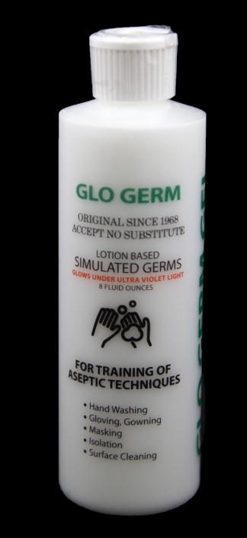

Glo Germ Activity
Glogerm Video: https://www.youtube.com/watch?v=h-O279tiR3s
Notes:
Depending upon time decide between showing the class the glo germ video (approx. 2 ½ minutes) or actually doing the glo germ activity (10-15 minutes). If you decide to do the Glo Germ activity – speak to your school Public Health Nurse about the possibility of borrowing this resource.
If choosing to do the glo germ activity – it can be done with the whole class depending on the number of students and amount of time you have, or ask for 5 or less volunteers. Use this opportunity to educate on proper handwashing and talk about problem areas found in next slide. The activity should take about 10-15 minutes depending on the number of students participating.
Reference:
Glo Germ Company. Handwashing Glo Germ Gel (Video). Retrieved from: https://www.youtube.com/watch?v=h-O279tiR3s
Images retrieved from:
Glogerm - https://www.glogerm.com/mm5/merchant.mvc?Session_ID=d931e3841d3266e81fd869a4ba7549e2&Screen=PROD&Product_Code=K1G2

Slide 33
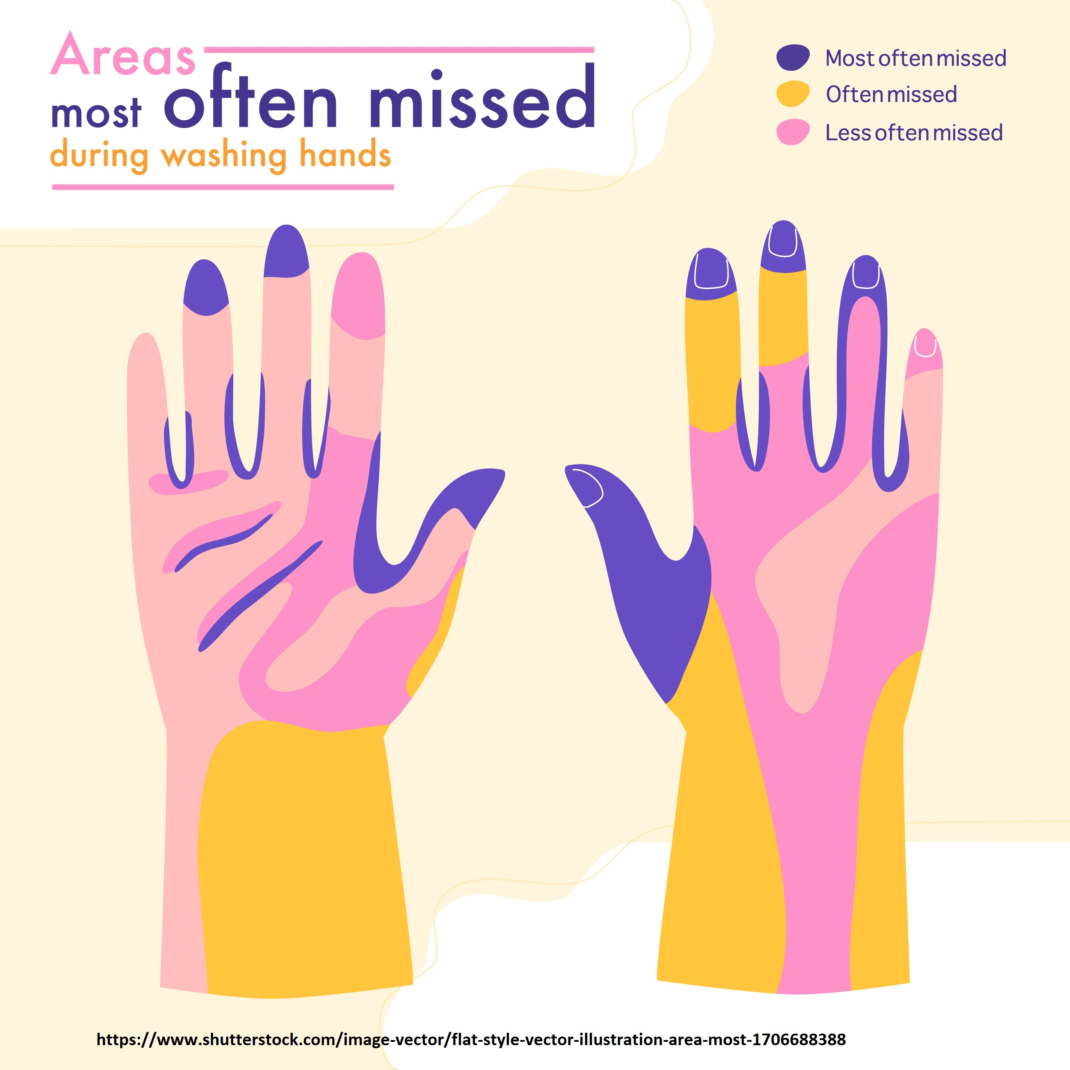
Areas Most Often Missed​
Notes:
In this diagram, the highlighted areas show the parts of the hands that are most often missed when washing our hands.
The purple areas are those that are most frequently missed (fingertips, nailbeds, between fingers, thumbs).
The yellow areas are those often missed (wrists, tops of index and middle fingers).
The pink areas are those that are less often missed.
Do I really need to wash my hands for 20 seconds?
Scientific studies show that you need to scrub for 20 seconds to remove harmful germs and chemicals from your hands. If you wash for a shorter time, you will not remove as many germs. Make sure to scrub all areas of your hands, including your palms, backs of your hands, between your fingers, and under your fingernails.
References:
Center for Disease Control. September 2020. Show Me the Science – Why Wash Your Hands? Retrieved from: https://www.cdc.gov/handwashing/why-handwashing.html
Middlesex-London Health Unit. 2015. Hand Hygiene. Retrieved from: https://www.healthunit.com/hand-washing
Image retrieved from: https://www.shutterstock.com/image-vector/flat-style-vector-illustration-area-most-1706688388

Slide 34


Breaking the Chain of Infection through
Cleaning and Disinfection
Cleaning
Disinfection
Physical removal of foreign material
(dust, soil, blood, secretions, excretions​)
Inactivation of disease-causing microorganisms
How:
water, detergent and mechanical action
How:
chemical disinfectants
Notes:
Cleaning and disinfection is done to: Prevent transmission of microorganisms to individuals.
Cleaning reduces or eliminates the reservoirs of microorganisms.
Cleaning alone will make most surfaces safe for individuals.
Certain organisms may require specific cleaning practices (ie. C. difficile, Norovirus).
Possible discussion points: cleaning home environment vs. restaurant vs. hospital rooms vs. surgical room
Our homes are not surgical rooms however, want to keep them clean. …not sterilized
When working in a health care setting there will be policies and procedures that identify how and what product to use when cleaning isolation rooms, surgical suites, medical equipment, etc.
Reference:
Center for Disease Control. 2021. How To Clean and Disinfect Schools To Help Slow the Spread of Flu. Retrieved from: https://www.cdc.gov/flu/school/cleaning.htm
Image retrieved from: https://pixabay.com/photos/clean-rag-cleaning-rags-household-571679/
Image retrieved from: https://pixabay.com/photos/cleanliness-maid-maintains-cleaning-2799459/

Slide 35

Breaking the Chain using Personal Protective Equipment (PPE) and Practices
Gloves
Gown
Mask
Goggles or face
shield
Notes:
PPE= Personal Protective Equipment
Gloves - Use when touching blood, body fluids, secretions, excretions, contaminated items, touching mucous membranes and non-intact skin
Gowns - Use during procedures and patient care activities when contact of clothing/exposed skin with blood/body fluids, secretions, or excretions is anticipated
Mask and Goggles - Use during patient care activities likely to generate splashes or sprays of blood, body fluids, secretions, or excretions
Some facilities require mandatory training for staff re: N95 masks (eg. Health Unit, Hospitals)
PPE must be worn correctly in order for it to be effective!
Reference:
Center for Disease Control. 2020. Personal Protective Equipment. Retrieved from: https://www.cdc.gov/oralhealth/infectioncontrol/faqs/personal-protective-equipment.html
Image retrieved from: https://unsplash.com/photos/hYcSP6SpoK0

Slide 36
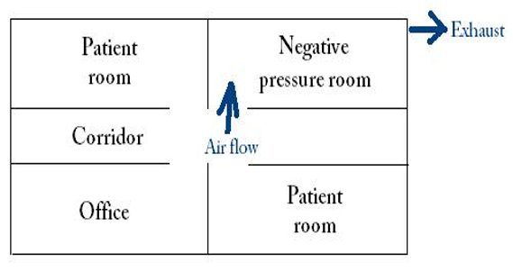
Negative Pressure​ Room
​Optional: Video about Negative Pressure Rooms
https://www.youtube.com/watch?v=4q5KCiH58uI
Notes:
Negative room pressure is an isolation technique used in hospitals and medical centers to prevent cross-contaminations from room to room. It includes a ventilation system that generates negative pressure to allow air to flow INTO the isolation room but not escape from the room. Air will naturally flow from areas with higher pressure to areas with lower pressure, thereby preventing contaminated air from escaping the room. Air is then ventilated to the outdoors though a high-efficiency particulate air (HEPA) filter system to ensure the air is cleaned before it is ventilated to the outdoors.
Hospitals have several negative pressure rooms. These rooms are usually found throughout the hospital including the emergency department and the intensive care units for patients with an airborne infectious disease such as tuberculosis, chicken pox or measles.
If there was ever an outbreak of an airborne infectious disease, including any kind of new infection where we didn’t really understand the mode of transition, then we would put the individuals in a negative pressure room.
Optional Video (approx. 3 minutes) helps to understand negative pressure rooms, and how they work.
References:
American Society of Health Care Engineering. February, 2022. Ventilation and Infection Control Video Series. Retrieved from: https://www.youtube.com/watch?v=4q5KCiH58uI
Center for Disease Control and Prevention. July 2019. Conditioned Air in Occupied Spaces. Retrieved from: https://www.cdc.gov/infectioncontrol/guidelines/environmental/background/air.html
CHT Healthcare. March 18, 2020. COVID-19 and Negative Pressure Rooms in Hospitals. Retrieved from: https://www.chthealthcare.com/blog/negative-pressure-rooms
Image retrieved from:
https://commons.wikimedia.org/wiki/File:Negative_pressure_room.JPG (Public Domain)

Slide 37
Breaking the Chain through
Immunization
What are Vaccines?
Vaccines protect you and the people around you ​
They produce immunity to a specific disease, which means you are protected from that disease​
Most vaccines are given by injection (needle)​
Vaccines work by presenting our body with something that looks like the infection so that our immune system can learn how to produce its own natural protection.​
Notes:
Antibodies (a type of protein) and lymphocytes (special white blood cells) are made by the immune system to destroy specific germs. Vaccines help the body make these important cells and they are stored until the body needs them.
Reference:
Middlesex-London Health Unit. 2020. Vaccine Information. Retrieved from: https://www.healthunit.com/vaccine-information

Slide 38
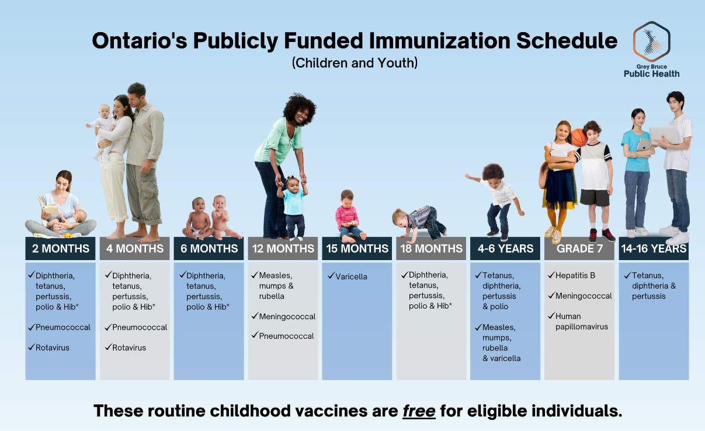
Notes:
You need immunizations throughout the lifespan!
Specific vaccines for adolescents/youth:
Menactra-protects against meningitis (strains ACYW) spread through oral secretions/saliva *Required to attend school*
Hep B-Protects against a serious liver disease spread through blood and body fluids (unprotected sex, drug use, tattoos, piercings).
HPV (Gardasil)-protects against Human Papilloma Virus which causes cervical cancers and genital warts. Both boys and girls can get infected with HPV. We are now giving Gardasil 9 which protects against more strains of HPV. There are many different types of human papillomavirus. HPV9 protects against the same HPV types contained in HPV4, types 6, 11, 16 and 18, plus an additional five types, 31, 33, 45, 52 and 58. HPV4 and HPV9 protect against types 16 and 18, which cause approximately 70% of cervical and anogenital cancers. Immunization with HPV9 can prevent up to an additional 17% of cervical cancers and up to 14% of anogenital cancers caused by the additional five HPV types (31, 33, 45, 52 and 58). Both vaccines can prevent approximately 90 percent of genital warts from types 6 and 11!!!
Tdap-Tetanus, Diphtheria, Pertussis. Need a booster dose every 10 years, usually around 14-16 years of age. *Required to attend school*
Tetanus (lockjaw) is a serious disease caused by the bacteria Clostridium tetani which is commonly found in dust and soil. The tetanus bacteria enters the skin through cuts, scratches, or wounds and produces a toxin which can cause painful tightening of the muscles, usually all over the body. This muscle tightening can cause breathing problems. Even with early treatment, tetanus kills two out of every ten people who get it.
Diphtheria is a serious bacterial disease that spreads from person to person infecting the nose, throat and skin. The infection can cause breathing problems, heart failure, kidney damage, and nerve damage. It can kill one out of every ten people who get the disease, but has become rare because of routine immunizations.
Pertussis also known as "whooping cough" is a serious infection caused by the Bordetella pertussis bacteria. The infection can cause severe coughing spells that can lead to vomiting, and can also cause breathing problems, brain damage and death. The infection is spread by secretions from an infected person. The coughing spells can last for two weeks or more. Pertussis is most severe among young infants.
Adolescents and adults are often the source of pertussis infection for infants and young children. It is estimated that 10% to 20% of adolescents and adults in Canada are at risk of becoming infected with pertussis because protection from childhood vaccinations against pertussis decreases with time.
Flu Shot-annually
COVID-19-as per recommendations
For more information on the Publicly Funded Immunization Schedule for Ontario:
https://www.health.gov.on.ca/en/pro/programs/immunization/docs/Publicly_Funded_ImmunizationSchedule.pdf
https://www.health.gov.on.ca/en/public/programs/immunization/static/immunization_tool.html
Reference:
Ministry of Health and Long Term Care. June 14, 2022. Immunization (Fact Sheets and Patient Tools). Retrieved from: https://www.health.gov.on.ca/en/pro/programs/immunization/resources.aspx
Image retrieved from: https://www.health.gov.on.ca/en/pro/programs/immunization/docs/immunization_poster_lifespan.pdf

Slide 39
Herd Immunity
Also known as Community Immunity
When most people in a community are immune to a disease (through vaccination and/or prior illness), there is less opportunity for the disease to spread from person to person. ​
​
​Protects vulnerable people (those too young to be immunized, people undergoing chemotherapy, elderly and other medical reasons).​
​
https://www.youtube.com/watch?v=UqKP-ETVvrc​
Notes:
Vaccines protect individuals against specific diseases, but they also help those who have not had the vaccine by creating herd immunity, also known as “community immunity”
When most people in a community have been immunized against a disease, the chance of an outbreak of that disease is greatly reduced.
This protects people vulnerable to the disease, such as babies too young to be immunized, people undergoing chemotherapy (immunocompromised), the elderly, and people who cannot be immunized for medical reasons.
Optional Youtube video (approx. 1 minute) – Herd Immunity - https://www.youtube.com/watch?v=UqKP-ETVvrc
References:
Association for Professionals in Infection Control and Epidemiology. 2021. Herd Immunity. Retrieved from https://apic.org/monthly_alerts/herd-immunity/
Columbia: Mailman School of Public Health. January 10, 2023. The Relationship between Vaccines and Herd Immunity. Retrieved from: https://www.publichealth.columbia.edu/public-health-now/news/relationship-between-vaccines-and-herd-immunity
Immunize BC. Herd Immunity (Video). Retrieved from: https://www.youtube.com/watch?v=UqKP-ETVvrc

Slide 40
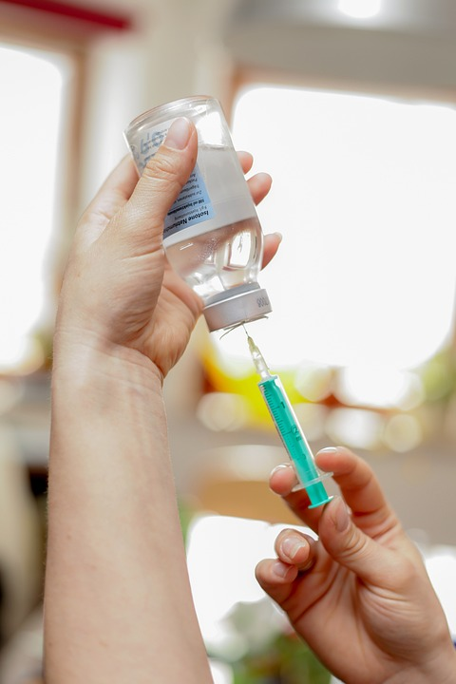
Flu Shot ‘Match’ ​
The flu shot contains 3 or 4 different strains of inactivated influenza (depending on which one you get).​
You want the circulating strains to be similar to those included in the yearly flu shot.​
The strains included in the flu shot change every year… that’s why it’s important to get the shot every year!​
Notes:
Young children, elderly, immunocompromised, and pregnant women are at risk and are considered priority populations for receiving the influenza vaccine.
It takes a couple of weeks to build up antibodies to fight off infection after vaccination.
You can not get the flu from the flu shot.
You can get the flu shot at your doctor’s, the pharmacy, and in certain circumstances through the Health Unit if you do not have a physician.
Reference:
Center for Disease Control and Prevention. March 11, 2022. Selecting Viruses for the Seasonal Influenza Vaccine. Retrieved from: https://www.cdc.gov/flu/prevent/vaccine-selection.htm
Image retrieved from: https://pixabay.com/photos/vaccination-injection-healthcare-2725065/

Slide 41
Questions?​

Slide 42
Quiz

