Slide 1
Mental Health Promotion
Sleep
Created By: School Health Team
Created: May 2017
Revised: September 2022

Slide 2
Sleep Kahoot
Notes:
Optional activity to supplement the presentation. You may need to create a Kahoot account if you do not already have one or can try to continue as a guest.
Purpose: To briefly assess sleep patterns and trends in the class.
Link to Teens and Sleep Poll Kahoot - (or search yatteamkahoot):
https://play.kahoot.it/v2/?quizId=bede6ab2-11c3-4441-bc20-cc3acca27782

Slide 3
Class Overview
Review of:
How much sleep do you need?
Effects of not getting enough sleep
Benefits of getting enough sleep
Causes of a poor sleep
Impact of Caffeine & Nicotine
Tips & Strategies for a better sleep
Sleep Resources

Slide 4
Activity: Sleep Brainstorm
Group 1- What are possible effects of not getting enough sleep?
Group 2- What are the benefits of getting a good night’s sleep?
Group 3- What are the causes of poor sleep?
Group 4- What are some tips for getting a good night’s sleep?
Notes:
Purpose: To establish existing knowledge of sleep and its importance among youth.
Optional interactive activity- Divide students into four groups. Provide chart paper and have the group complete one of the questions. Before reviewing the specific slide linked to the group activity, have groups provide their answers.

Slide 5
How much sleep do you need?
Sleep is very important for teens because the brain is beginning to mature
How much sleep do teens need ?
8-10 hours
Notes:
Ask class how many hours of sleep they are getting a night
Teens aged 14-17 need 8-10 hrs sleep/night
Picture-Pixabay – Minds Under Construction - https://pixabay.com/illustrations/traffic-signs-brain-mind-1280254/

Slide 6
Not Getting Enough Sleep can:
Affect your mood (anxiety/depression)
Make it more challenging to manage stress
Decrease energy levels
Affect concentration, memory and focus
Increase risk for accidents and injuries
→ Slower reaction time and poor decision making
Increase risk for illness and long-term health problems
Notes:
Group 1 - ask students from this group to provide answers to the class then review slide information
Learning- Brain carries out most sophisticated functions during our sleep.
Sleep helps with consolidation of memory, which is essential for learning new information
Mood disorders- Chronic insomnia may increase risk of developing a mood disorders- anxiety/depression
National Sleep Foundation - depression may cause sleep problems and sleep problems may cause or contribute to depressive disorders. People who have a hard time sleeping have a ten-fold risk of developing depression compared with those who sleep well.
Physical Health - Lack of sleep over the long term can lead to heart disease, stroke, diabetes and obesity. Lack of sleep affects our immune system which protects us from getting sick. During sleep we produce the antibodies needed to fight off bacteria and viruses. It is harder to fight off sickness and takes longer to recover when we are sleep deprived. Lack of sleep affects growth hormone. This can impact your growth, and the maintenance of bones and muscles
Injuries. - Poor decision making and impulsivity can lead to injuries. May experience slowed reaction time. Driving sleepy is the same as driving impaired. Increased number of accidents on the road/ or on the job. You can lose the ability to accurately assess situations, plan accordingly and correct behavior.

Slide 7
Benefits Of Getting Enough Sleep
Better mood (happier)
Able to cope better with stress
Increase energy
More alert, better focus, concentration, and memory
More productive and efficient
Fewer accidents and injuries
Decreased risk for illnesses & health problems
Notes:
Group 2 - ask students from this group to provide answers to the class then review slide information

Slide 8
What Causes Poor Sleep?
Notes:
GROUP 3 - ask students from this group to provide answers to the class before reviewing information in the next slide
Image:
https://unsplash.com/photos/PZxFRI4TPl0

Slide 9
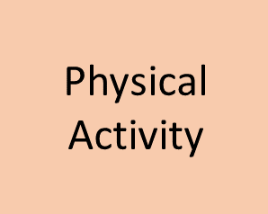
Sleep Routine
Caffeine & Nicotine
(After 3pm)
Phones & Tech Devices
Sleep
Sleep Environment
Large Meal Before Bed
Napping
(> 30 mins)
Stress
Health & Illness
Notes:
Phones & Tech Devices - Blue light is part of the visible light spectrum and is emitted from computer monitors, flat screen tv’s, tablets or phones. The blue light prevents the pineal gland from releasing melatonin, a hormone associated with nighttime. Teens can be especially sensitive to this.
Physical Activity – Too much sitting and not enough physical activity during the day. Also lack of sunlight or fresh air. Avoid strenuous activity 4hrs prior to bed.
Sleep Routine –Sleeping in on weekends- teens stay up very late Friday night knowing there is no school the next day. They may sleep in all morning on Saturday (and sometimes into the afternoon). This may continue with teens staying up late Saturday night and waking up very late on /Sunday. On Sunday night, it may be very difficult to fall asleep because the sleep/wake cycle has been disrupted. Teens who wake up late on the weekends, may have a lot of difficulty waking up early on Monday morning for school. This affects energy levels, concentration and learning.
Caffeine and Nicotine (especially after 3pm) – more to come in next slides
Sleep Environment – temperature, pillow, mattress, environmental disturbances, sharing a room, pets
Napping – longer than 30 minutes
Health & Illness – Physical and Mental Health impact sleep. Mental Health concerns such as anxiety/ depression disrupt the sleep cycle (also poor sleep leads to mood changes). Physical health conditions and medications can also affect sleep.
Stress – worries and emotions
Large Meal Before Bed – while you don’t want to go to be hungry; you don’t want to eat a large meal prior to going to bed. A light snack is recommended.

Slide 10
Changes in the Sleep-Wake Cycle
The hormone melatonin is produced in the brain and helps us fall asleep. Youth release melatonin much later in the evening. This causes a change in the sleep/wake cycle.
Therefore, teens will…
Stay up later because they don’t feel tired
Feel very tired in the morning because they go to bed late
Often sleep in on the weekend
Notes:
Melatonin release may take place much later in the evening compared to younger children so teens may have difficulty falling asleep and have a hard time waking up in the morning.

Slide 11
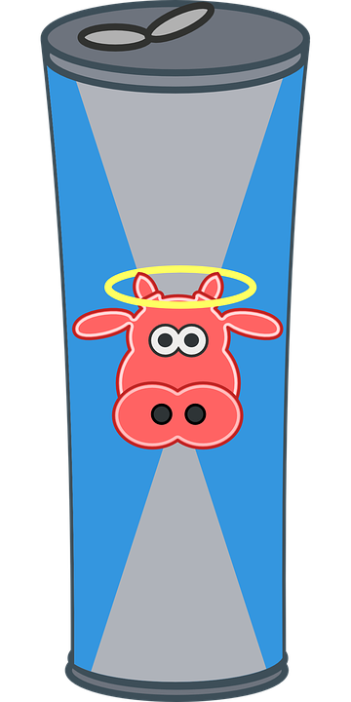
Caffeine and Sleep
Pop/soda, energy drinks, tea, coffee and even chocolate!
Overuse can lead to difficulty falling and staying asleep (insomnia).
Consuming caffeine to stay awake at night may lead to sleeplessness, anxiety, frequent nighttime awakenings, and overall poorer sleep quality.
Caffeine stays in your system for a long time, therefore avoid caffeine at least 6 hours before bed.
Notes:
Coffee is the most potent and most consumed caffeinated beverage. A single eight ounce cup of coffee contains between 95-200mg of caffeine. For comparison, a 12 ounce soda contains 35-45mg, about half the amount of a weaker cup of coffee.
Beverage
Caffeine
8 ounce cup of coffee
95 – 200mg
8 ounce energy drink
70 – 100mg
12 ounce soda
35 – 45mg
8 ounce cup of tea
14 – 60mg
The maximum effects of caffeine usually occur between 30-60 minutes within consumption, although this timing can vary widely among individuals. After being absorbed, caffeine is efficiently distributed throughout the whole body, and it crosses the blood-brain barrier.
Inside the brain, caffeine blocks adenosine receptors. Adenosine is a sleep promoting chemical. It is produced in the brain during our waking hours. Normally, adenosine builds up in the brain the longer we’re awake. The more it builds up, the sleepier we become. When caffeine blocks this process, we remain alert and vigilant.
Research has also shown that caffeine interferes with circadian melatonin rhythms, delaying the onset of sleep if consumed close to bedtime.
The six-hour half-life of a caffeinated beverage you consume in the afternoon could keep you up at night.
One study examined the effects of caffeine intake zero, three, and six hours before bedtime, and found that even caffeine consumed six hours before bed could reduce sleep time by one hour. In addition, study participants reported sleeping problems when consuming caffeine 0-3 hours before bed, but they did not realize their sleep was also disrupted when consuming caffeine six hours before bed. If you have difficulty sleeping, consider limiting any caffeine intake six hours before bed.
Reference - https://www.sleepfoundation.org/nutrition/caffeine-andsleep#:~:text=Can%20Caffeine%20Cause%20Insomnia%3F,and%20overall%20poorer%20sleep%20quality.
Picture Reference - https://pixabay.com/illustrations/coffee-energy-caffeine-cafe-5204209/
Energy drink pic- https://pixabay.com/vectors/beverage-tin-can-drink-drinking-161708/

Slide 12
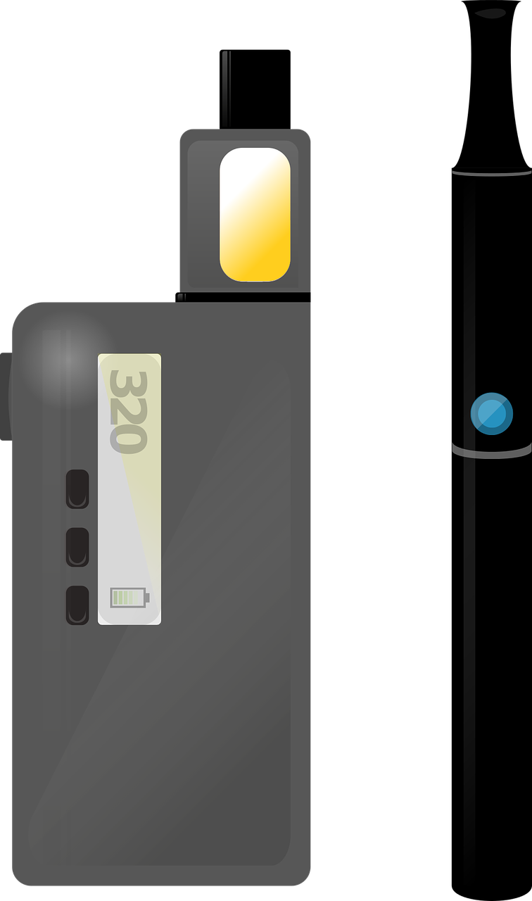
Nicotine and Sleep
Nicotine is a powerful stimulant with similar effect as Caffeine.
Increased Blood Pressure & Heart Rate = More alert and awake.
If you are having trouble with your sleep, it is likely because your body feels energized from the effect of the nicotine in your system.
Notes:
Picture: https://pixabay.com/vectors/vape-vaporiser-vaping-smoke-vapor-3610623/
https://www.henryford.com/blog/2018/03/connection-between-sleep-nicotine#:~:text=While%20you're%20smoking%3A%20Nicotine,feel%20alert%20the%20next%20day.

Slide 13
Make a List &
Plan Ahead
Sleep Environment
Bedtime Routine
Calming Practices
Get Moving
Worries and tasks keeping you awake? Clear your mind. Write it down or make a to do list.
Set your alarm and give yourself enough time to get ready. Organize your bag and make your lunch the night before.
Go to bed and get up around the same time every day even on weekends! This will help your body develop a regular sleep rhythm.
Create a routine (e.g. shower, snack, read).
Your room should be cool and dark. Try using your bed for sleeping only. Watch TV on the couch or read in a chair. This will help your body associate your with sleep.
Try and evening walk, read a book or magazine, stretch, meditation, deep and focused breathing exercises.
Keep your body moving and get some fresh air outdoors. This will help you sleep better at night.
Avoid strenuous exercise within 4hrs of bedtime.
Avoid Nicotine
Avoid Caffeine
Sleep Tips¹
Nicotine is a stimulant that will make it harder to fall asleep and have a restful night. It can also irritate your nose, throat, and lungs which might affect your breathing.
Avoid caffeine 6-8hrs before going to bed.
This includes coffee, tea, pop, energy drinks, chocolate, and some medications.
No Naps!
Keep Bedtime Tech Free
Napping will cause the body to lose its sleep rhythm. If you feel tired, try re-energizing by going outside, taking a walk or doing something active. If you must nap, keep it to no more than 30 minutes.
Food
Track Your Sleep
No Clock Watching!
Turn off your phones, TVs and computers 1 hr before bed. Blue light makes it harder to fall asleep. Use an alarm clock instead of your phone.
Being hungry can prevent a good night’s sleep. Make sure to honour your bodies hunger cues and try a snack before bed.
Use an app or record in a journal. This may help you to discover patterns or factors affecting your sleep.
As tempting as it may be, avoid looking at the clock while falling asleep. It could make you anxious.
1. Centre for Clinical Interventions (2008). Sleep hygiene. Retrieved from http://www.cci.health.wa.gov.au Updated October 2022
Notes:
Group 4- ask students from this group to provide answers to the class before reviewing information in this slide
*Optional question to engage students in discussion about technology use at bedtime:
Question 2 of sleep poll “X” percent of you indicated yes. Do you see this as an issue? What are some strategies or tips that you have so that use you it more wisely so it doesn’t impact your sleep?
Harm Reduction Technology Tips-
1- From Sleep Foundation - https://www.sleepfoundation.org/bedroom-environment/technology-in-the-bedroom
(midway down the article)
2- The Sleep doctor - https://thesleepdoctor.com/technology/
( quarter of the way down it mentions that studies indicate the passive use of technology, such as watching a show or listening to music on a device, has less of an effect on sleep than active use, like playing an interactive game texting or video chatting.)

Slide 14
How to Deal with Stress at Bedtime
Everyone feels stressed or anxious at times. Instead of wondering why you are stressed, allow yourself to concentrate on what you will do about it.
Schedule time during the day to talk with someone you trust- parent, teacher, friend- about what is bothering you.
Keep a journal where you can write down thoughts or stressors.
Create a “to do” list for the next day. You are less likely to stay up all night worrying about what needs to be done.
Listen to relaxing music, take a shower, go for a walk.
Notes:
Discussion: Ask students about their creative ideas. ​
​
Picture: https://pixabay.com/en/checklist-check-list-marker-2077019/

Slide 15
Still not getting a good night’s sleep?
Assess your situation
Try suggestions from this presentation
See your school nurse
Talk with your parent/guardian
See your health care provider for a checkup- mental and physical health- and to talk more about your difficulties with getting a good night’s sleep.
Notes:
Sleep is important. Some teens really struggle to get a good night’s sleep. Chronic lack of sleep can cause many problems as already discussed. If a teen is having difficulties, support is available! They should explore this further with a health care professional.

Slide 16
References
Canadian Pediatric Society. Caring for Kids. Teens and Sleep. Why you need it and how to get enough. (2018) https://www.caringforkids.cps.ca/handouts/teens_and_sleep
Harvard Medical School. Healthy Sleep. Twelve Simple Tips to Improve Your Sleep. (2007) http://healthysleep.med.harvard.edu/healthy/getting/overcoming/tips
Harvard Medical School. Healthy Sleep. Understanding the third of our lives we so often take for granted. A division of sleep medicine from Harvard Medical School. http://healthysleep.med.harvard.edu/healthy/
Suni, E.( 2022) Teens and Sleep. An overview of why teens face unique sleep challenges and tips to help then sleep better. https://www.sleepfoundation.org/teens-and-sleephttps://www.sleepfoundation.org/teens-and-sleep
Sutton, J. (2021) 20 Sleep Hygiene Tips and Worksheets for Kids and Teenagers. https://positivepsychology.com/sleep-hygiene-tips-kids-teenagers/
Teens and Young People from The Sleep Charity. ( UK) https://teensleephub.org.uk/teens-young-people/
Watson, S., and Cherney K., (2021). The effects of sleep deprivation on the body. Healthline Media. http://www.healthline.com/health/sleep-deprivation/effects-on-body
Notes:
Additional Presenter References: ( Updated Aug 2022)
About Kids Health- tips and short video
https://www.aboutkidshealth.ca/Article?contentid=647&language=English
Common Sense Media
http://commonsensemedia.org
Kutcher, S., & Smith, T.E. (2016). Healthy sleeping. TeenMentalHealth.org. Retrieved from
http://teenmentalhealth.org/toolbox/healthy-sleeping/

