Slide 1

Consent and Healthy Relationships
Grade 9-12
Created by: School Health Team
Created: August 2023
Last Reviewed: July 2024

Slide 2
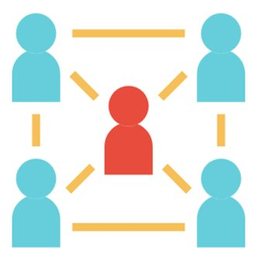


Overview
Activity: The Relationship Game
Relationships
  Look like, Sound Like and Feel Like
Consent

Slide 3
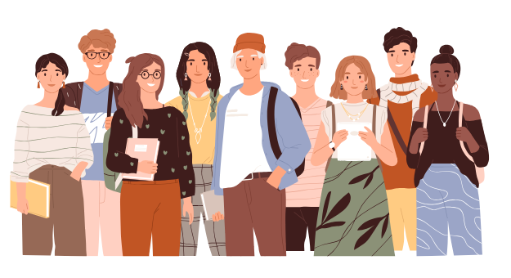
The Relationship Game
Notes:
Now that we have talked about the difference between healthy and unhealthy relationships, we've explored what they look like, sound like and feel like, we've played around with how boundaries feel and change based on individual experiences; we are now going to think about the traits of someone you would be interested in dating or spending time with.
Play the teen mating game: https://www.healthunit.com/healthy-schools-teaching-resources#human-development-and-sexual-health

Slide 4
What are Relationships?
A relationship is a close connection between two people. ​
There are many kinds of relationships. Family, friends, romantic etc.​​
Building trust, having respect and understanding each other's boundaries will help support a healthy relationship.​
Notes:
All relationships are not perfect, its normal to experience some ups and downs.
We all bring our unique pasts into relationships, and it’s everyone’s responsibility to be working on themselves, with the goal of growing together.
Sometimes, relationships end. And that’s okay. At the end of the day, you have the right to be treated with respect.
Every relationship is different, and they rarely look like the ones we see on TV or in the movies… even though there is sometimes a bit of drama along the way!
Reference: https://www.sexfluent.ca/healthy-relationships#share
https://www.collinsdictionary.com/dictionary/english/relationship

Slide 5



Healthy vs. Unhealthy
Notes:
In the next few slides we are going to take some time to discuss the differences between healthy and unhealthy relationships.
Activity from: CAMH Center for Prevention Science; Western University (2015). Healthy Relationships Plus Program; Session 6 Healthy Relationships. Pg. 87

Slide 6
Look Like
What does it look like to be in a healthy relationship?
What does it look like to be in an unhealthy relationship?
Notes:
Let’s take a moment to brainstorm as a group, what does it look like to be in a healthy relationship?
what does it look like to be in a healthy relationship?
Possible Responses: smiling, positive body language, holding hands, friendly appearance, look happy together, look accepting, look proud of each other and supportive.
What does it look like to be in an unhealthy relationship?
Possible responses: mean looks, crying, pushing, grabbing, yelling, physical violence, exclusion, anger, rebelling, often/always under influence of substances in each other's company
Activity from: CAMH Center for Prevention Science; Western University (2015). Healthy Relationships Plus Program; Session 6 Healthy Relationships. Pg. 87

Slide 7
Sound Like
What does it sound like to be in a healthy relationship?
What does it sound like to be in an unhealthy relationship?
Notes:
What does it sound like to be in a healthy relationship?
Possible responses: laughter, positive encouraging comments, positive tone of voice, respectful language
What does it sound like to be in an unhealthy relationship?
Possible responses: yelling, crying, disrespectful language, name calling, threats, inappropriate language, arguing, sounds loud, negative.
Activity from: CAMH Center for Prevention Science; Western University (2015). Healthy Relationships Plus Program; Session 6 Healthy Relationships. Pg. 87

Slide 8
Feel Like
What does a healthy relationship feel like?
What does an unhealthy relationship feel like?
Notes:
What does it feel like to be in a healthy relationship?
Possible responses: Safe, trusted, caring, comfortable, independent, thoughtful, can be yourself, secure, happy.
What does it feel like to be in an unhealthy relationship?
Possible responses: fear, confusion, pain, sadness, frustration, loneliness, feel trapped.
Activity from: CAMH Center for Prevention Science; Western University (2015). Healthy Relationships Plus Program; Session 6 Healthy Relationships. Pg. 87

Slide 9
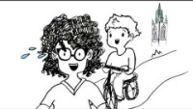
Consent
Notes:
Video Source: https://www.youtube.com/watch?v=-JwlKjRaUaw

Slide 10
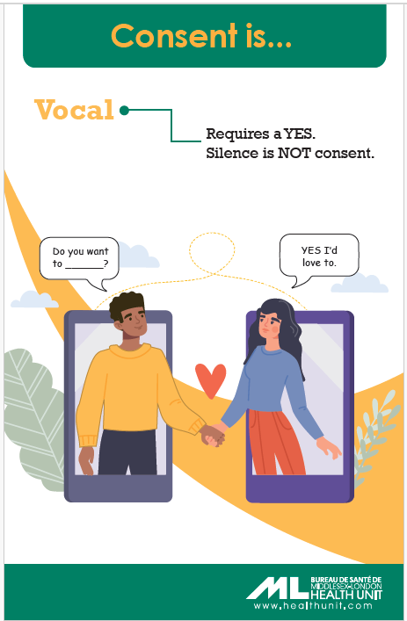
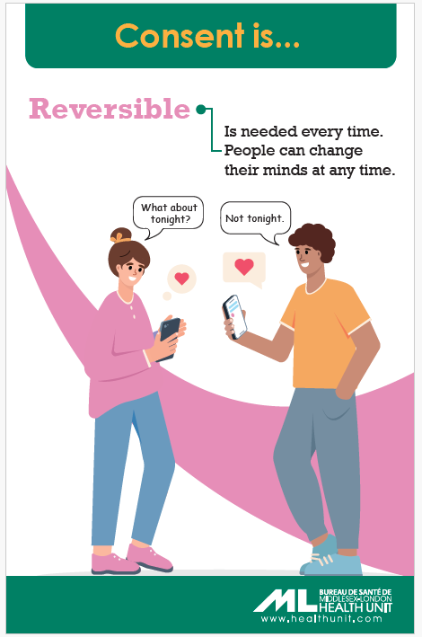
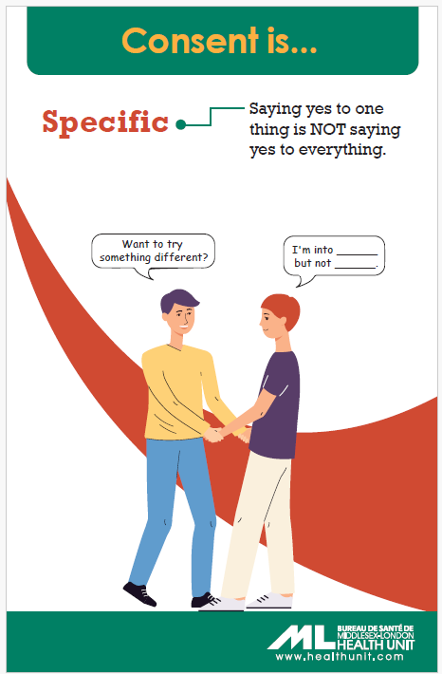
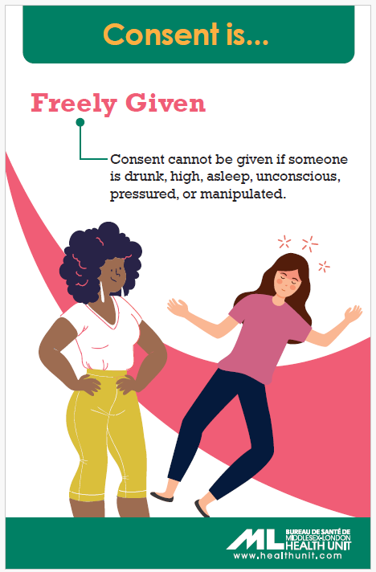

Slide 11


When in life do we use consent?
Notes:
As a toddler/child who is giving or receiving a hug
As a teenager who wants to hold hands/kiss/hug
A parent who wants to come in your room to talk
A partner who wants to have an intimate relationship (touch, kiss, have sex)
Online – taking photos, posting photos, using photos of other people in group chats.

