Slide 1





Online Training Module
E-learning Training Module
Creation Date: Jan 2020
Notes:
Welcome. This webinar is an overview of the Let’s Get Cookin’ program and is designed to provide the important information you require to facilitate the Program.
This program was carefully designed considering evidence, best practice in nutrition education, consultation with Public Health Inspectors around food safety and so it needs to be implemented as closely to the training manual as possible to ensure fidelity.
To successfully complete this training, you must submit the quiz as directed at the end of the webinar.

Slide 2
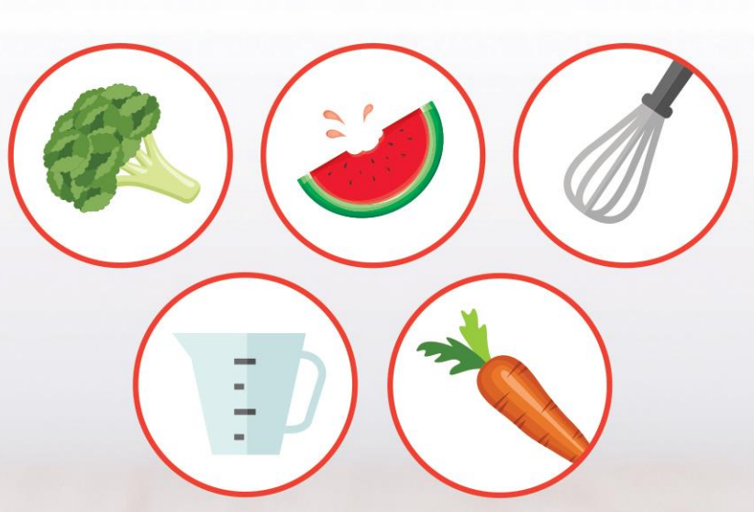
Training
Agenda
Program Rationale, Goals & Values
Program Format
Before you Begin
Safety in the Kitchen (Basic knife and Food Safety)
Participant Orientation
Cooking Sessions
Test your Knowledge
Notes:
Several topics will be discussed in detail to give you the necessary information to facilitate the Program. You will complete a short quiz at the end of the webinar to test your knowledge.

Slide 3
Program Rationale
Canada’s Food Guide recommends a variety of vegetables and fruit, whole grains, and protein foods with an emphasis on plant-based proteins to support health and well-being.
Each recipe includes a vegetable and/or fruit.​
Participants learn to make tasty recipes that increase vegetable and/or fruit intake.
​​
There is a focus on plant-based proteins. ​
Notes:
Canada’s Food Guide recommends a variety of vegetables and fruit, whole grains, and protein foods with an emphasis on plant-based proteins to support health and well-being. Each recipe includes a vegetable and/or fruit. Participants learn to make tasty recipes that increase vegetable and/or fruit intake.
The program also focuses on whole grains and plant-based proteins like beans and legumes to align with Canada’s Food Guide. Therefore, participants are learning important cooking skills and using ingredients that support Canada’s Food Guide.

Slide 4
Canada’s Food Guide suggests cooking more often and eating with others to help children and youth develop positive eating habits.
Eating well is more than the foods we eat; food is social and there are many benefits to eating together
Students are encouraged to sit and eat the food prepared together as part of the program
Cooking from scratch is associated with improved intake of vegetables, fruit and whole grains
Teaching children and youth cooking skills fosters the development of basic life skills that they can continue to develop overtime. ​
Program Rationale
Notes:
Canada’s Food Guide suggests cooking more often and eating with others to help children and youth develop positive eating habits.
Eating well is more than the foods we eat, food is social and there are many benefits to eating together
Students are encouraged to sit and eat the food prepared together as part of the program
Cooking from scratch is associated with improved intake of vegetables, fruit and whole grains
Teaching children and youth cooking skills fosters the development of basic life skills that they can continue to develop overtime.

Slide 5
Program Rationale
Cooking has many cross curricular connections. Revised Sci and Tech Curriculum has incorporated food literacy
  Math
  Literacy
  Science
  Critical thinking
Notes:
Cooking has many cross curricular connections such as:
Math (learning about fractions, measurement and budgeting).
Literacy (reading a recipe, meaning of cooking terms).
Science (how different ingredients work e.g., baking soda as a leavening agent).
Critical thinking (reading the recipe, following the steps and manually doing them, problem solving and teamwork).

Slide 6
Program
Values
Allergies
Facilitators can’t promise or control an allergen-free environment.
Body weight, shape, or size should not be a topic of discussion.
Goal of the program is to encourage skill building related to cooking and to foster a positive relationship with food.
Focus on food rather than nutrition
Focus discussions about cooking and food rather than on nutrition and healthy eating.
Notes:
When establishing your program please consider the following two factors:
Allergies – As a facilitator it is difficult to ensure or control for an allergen-free environment or ingredients. Share recipes/ingredients with caregivers who have children with allergies ahead of time for them to decide if they are comfortable participating.
Building cooking skills is one of the major goals of the program therefore, weight or calories should not become a topic of discussion. Weight is a sensitive topic and not the focus of Let’s Get Cookin’. The focus is learning basic cooking skills to support healthy eating practices and a positive relationship with food. Healthy eating as a way to control, maintain or lose weight should not be discussed.
Focus on food rather than nutrition: Focus discussions about cooking and food rather than on nutrition and healthy eating.

Slide 7

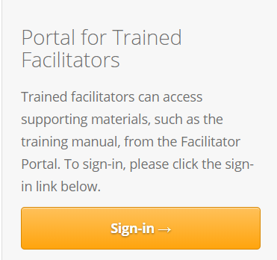
Let’s Get
Cookin’ Portal
The portal provides all the details, resources and recipes you will need to facilitate the program.
Portal login and password provided at in-person training
Important to facilitate all 7 sessions and use the included recipes as they are laid out on the portal.
https://www.healthunit.com/lets-get-cookin
Notes:
Let’s Get Cookin’ has an online portal. The portal provides all the details, resources and recipes that are needed to co-facilitate the LGC program. The person who attended the in-person training at MLHU will have the login and password to the portal.
When facilitating the LGC Program we ask you that you facilitate all 7 sessions, using the recipes included and in the way the are they are laid out on the portal.

Slide 8
Before you Begin
Equipment cost: ~ $300.
Groceries: $20 - $30/session.
6 cooking sessions + orientation = ~ $150 - $ 200.
List for staple ingredients to facilitate the program is available on the portal and should be purchased prior to starting the program.
*Calculated cost based on 2 cooking stations.
Notes:
Before you begin the program, the following slides highlight details of what you need to consider to run the program effectively.
The Equipment List details the equipment needed to run the program and the cost is approximately $300. This is based on purchasing items on sale.
The calculated costs are based on setting up for 2 cooking stations. If you intend to double the recipes to accommodate a larger group, more cooking equipment may be required and therefore costs will be higher.
Groceries are estimated to cost about $20- $ 30 per session. Therefore, the 6 cooking sessions plus the orientation with cost will be approximately $150 - $200.
A list of staple ingredients that you will need to facilitate the program is available on the portal. It’s recommended that these staple items are purchased before you start the program. This may make your first grocery trip a little more expensive, but you will be using these items throughout the program.

Slide 9
Before you Begin
Potential funding sources:
Parent council
Local businesses
Charitable organizations
Grants
Notes:
If cost is a barrier, funding or grants can be explored. If you are in a school, consider approaching parent council to see if they have any funds to assist. Local businesses and charitable organizations may also be willing to support the program. Your school nurse may have additional funding ideas.

Slide 10
Before you Begin
Recruitment strategy:
Discuss with principal or manager. This could be an opportunity to engage youth who may be less connected in the school.
Poster and newsletter insert available on the portal.
Provide information about the program at staff meeting and discuss recruitment strategy.
Notes:
When recruiting youth for the program, there are different strategies to consider:
Speak with the principal or manager at your location to discuss which youth would benefit from the program or strategies to recruit participants.
A recruitment poster is available on the portal. The poster can be easily modified to reflect the time, date and location that the program will be offered at.
Discuss recruitment at a staff meeting.

Slide 11
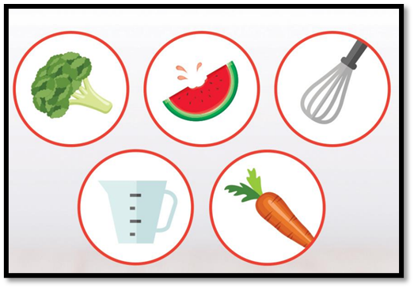
Before you Begin
Timing:
Will your program run during school hours or after school?
Each session takes about 1 hour plus set-up
Location Needs:
Nearby sink/refrigerator
Electrical outlets
Adequate ventilation
Handwashing stations
Enough space to work safely
Notes:
Each session will take about 1 hour to facilitate plus set-up time, which includes cleaning, sanitizing and setting up the room. Before you begin the LGC program, consider what time of day the program will be held, and the location of the program.
When choosing the room location consider the following factors:
There should be a sink and refrigerator close by
Ensure there are enough electrical outlets
Ensure the room is adequately ventilated so that steam from a skillet will not set off the fire alarm.
Consider how and where the participants will wash their hands. For example, is there a need to set up a portable handwashing station?
Finally, ensure there is adequate space in the room so that all participants can work safely.

Slide 12
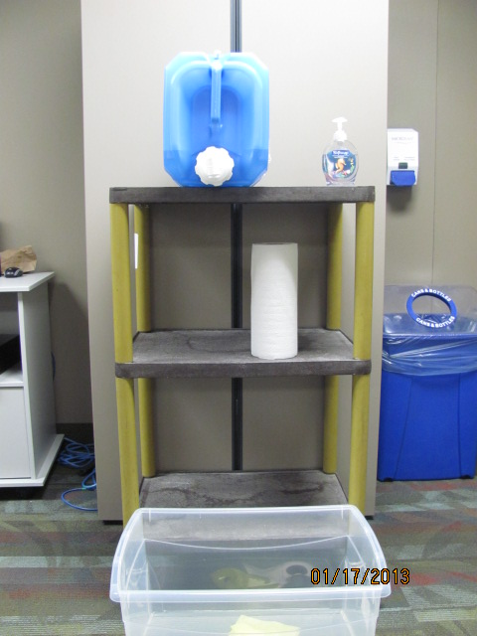
Before you Begin
Water Jug
Hand Soap
Paper Towels for Drying Hands
Catch Basin
Notes:
If a handwashing sink is not close to the room you are cooking in, a portable handwashing station can be set up like the one shown in the slide. It can be set up using a portable water jug filled with hot water, a table or cart to set it on, a plastic bin or catch basin, hand soap and paper towels. After using the portable water jug ensure that it is properly drained and aired after each use.

Slide 13
Before you Begin
Collect Participant Consent Forms
Collect signed consent form participants’ parent/guardian (sample available on portal)
Check with principal or manager to ensure consent form is appropriate for your location.
Ensure permission form is stored according to school/agency policy as they contain private information.
Notes:
Before beginning the program, a signed consent must be obtained from each participant’s parent or guardian. A sample consent is available on the portal. This is a sample only so be sure to check with your school principal or manager to ensure that the consent form is appropriate for your location.
Once the signed consent forms are returned be sure to properly store them according to school or agency policy as they contain personal information. Talk with your school principal or manager to find out where confidential records are stored.

Slide 14
Before you Begin
Room Set-Up
Clean and sanitize all tables where food preparation will occur
Equipment, utensils, dishes should be clean and sanitized
Set up two cooking stations (one for each recipe)
Divide the participants into even groups
Ingredients shared by both recipes can be placed on a common table (in middle of room)
At each station include: a couple of copies of the recipe, and all the equipment and ingredients that are noted on the recipes
Notes:
The first two steps to setting up the room are to:
1. clean and sanitize all tables, surface areas, equipment and dishes with soap and water and a properly diluted food grade sanitizer.
2. Next, set up the two cooking stations for each of the session recipes. If you have more than 10 participants, you will need to set up additional cooking stations.
At each station include: a couple of copies of the recipe, and all the equipment and ingredients that are listed on the recipe sheets. If the recipes that are being prepared that day share the same ingredients, a common ingredient area can be set up in a convenient location in the room where each group can easily access the ingredients.

Slide 15
Before you Begin
More than 4 million food poisoning cases each year.
Handwashing and general food safety practices are important to decrease the risk of food poisoning.
Ensuring that food is safe is a program priority.
(Government of Canada, 2017)
Notes:
Keeping all participants safe is a key objective. Incorrect handling or cooking of food can result in food poisoning. Handwashing and general food safety practices are important practices when facilitating the program.

Slide 16
Before you Begin
Safe Food Handling:
Food handler certification recommended
Increases knowledge about food safety and safe food handling practices.
Certification valid for 5 years.
Check your health unit website to find out how to get certified
  MLHU: www.healthunit.com
  SWPH: Food Handler Certification
Notes:
While this is not mandatory, the Food Handler Certification program is a course that may be considered to increase knowledge related to food safety and safe food handling practices. Upon successful completion of the course, a food safety certificate will be issued and is valid for 5 years. More information about this is available on your Health Unit website. Online options may be available.

Slide 17
Participant Orientation
Principals of safe food handling
Food poisoning can be life-threatening.
Principals of safe food handling:
    Personal hygiene
    Hand-washing
    Cleaning and sanitizing
    Temperature control
    Proper storage and holding of food
Participant Orientation
Notes:
It is important to teach the basic principals of food safety with participants during the orientation and review them throughout the series. The topics to cover include: personal hygiene; hand washing; cleaning and sanitizing; safe food handling and temperature control, and proper storage and holding of food.

Slide 18
Participant Orientation
Personal hygiene practices:
Tie long hair back
Remove dangling jewelry, watches and rings
Do not cook when unwell.
Cover cuts and wounds with a Band-Aid and gloves.
  Unless a glove is being used to cover a cut it is not needed. Gloves can compromise food safety.
Notes:
Teach participants in the program the importance of practicing proper personal hygiene when cooking
Before cooking participants should:
Tie back long hair. It can be helpful to have some extra hair ties on hand for this!
Remove any dangling jewelry, rings or watches and store them in a safe place.
If a participant isn’t feeling well it is best if they don’t cook that day. A sample of the food prepared can always be safely set aside for them to try.
If a participant has a cut or wound, the hand and wound should be washed, covered with a band-aid and a glove should be worn on that hand.
Unless a glove is being used to cover a cut, it is not needed. Frequent handwashing while cooking is the best way to prevent the spread of bacteria. Gloves can increase the chances of contamination (or compromise food safety) if they are not used properly and changed often.

Slide 19
Participant Orientation
Handwashing:
The most effective way to stop the spread of illness
Handwashing is recommended over alcohol-based hand cleansers.
Hands should be washed:
  before starting to cook;
  after touching hair or face;
  after using the washroom;
  after handling raw meat, poultry, or eggs;
  After switching food preparation tasks or handling the garbage or dirty dishes.
Wearing gloves does not replace handwashing
Participant Orientation
Notes:
The best method for stopping the spread of illness is handwashing. Handwashing is recommended over alcohol-based hand cleansers. Examples of times when you should wash your hands include:
before starting to cook
after touching hair or face
after using the washroom
After handling the garbage or dirty dishes.
After handling raw food like meat, poultry or eggs or switching food preparation tasks

Slide 20
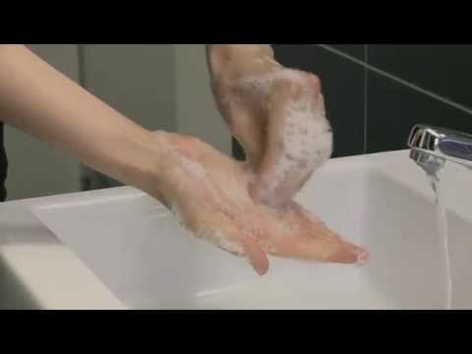
Proper Handwashing Technique
Participant Orientation
World Health Organization: How to handwash? With soap and water
https://www.youtube.com/watch?v=3PmVJQUCm4E
Notes:
This video demonstrates how to effectively wash hands.

Slide 21
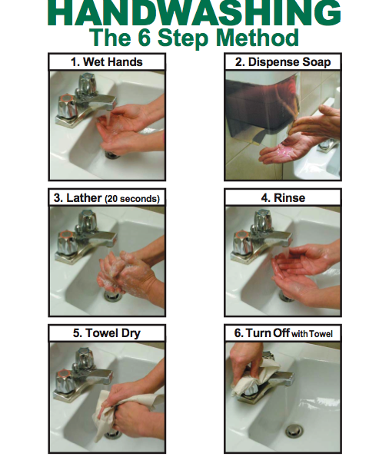
Participant Orientation
Notes:
This poster illustrates the 6 steps involved in handwashing. A copy of the poster is available on the portal and can printed and displayed as a reminder in the room where the cooking sessions will be conducted.

Slide 22
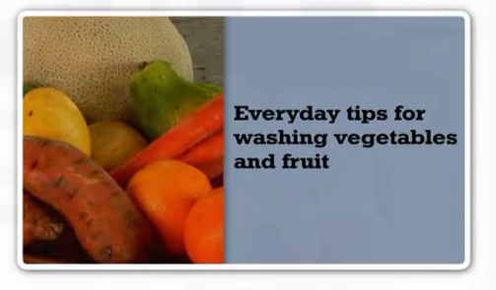
Participant Orientation
Safe food handling: Vegetables and Fruit
Wash your hands before handling
Thoroughly wash vegetables and fruits prior to preparation/ cooking
Use a separate cutting board for produce
Notes:
In terms of safe food handling, ensure all vegetables and fruits are thoroughly washed prior to any food preparation or cooking.
:https://www.canada.ca/en/health-canada/services/general-food-safety-tips/produce-safety.html
Shopping
-Buy cold or frozen food at the end of your shopping trip.
-Examine fruits and vegetables carefully and avoid buying items that are bruised or damaged.
-If buying pre-cut or ready-to-eat fruits and vegetables be sure they have been properly refrigerated at 4°C or below. This means they should be displayed in a refrigerated container and not just sitting on top of ice.
-Separate fresh fruits and vegetables from meat, poultry and seafood products in the shopping cart and bags.
-Wash your reusable grocery bags frequently.
Cleaning
-Wash your hands with soap and warm water for at least 20 seconds.
Cut away any bruised or damaged areas on fruits and vegetables, since harmful bacteria can thrive in these areas. Be sure to clean your knife with hot water and soap before using it again.
Wash fruits and vegetables thoroughly under fresh, cool, running water, even if you plan to peel them. This helps prevent the spread of any bacteria that may be present. (This is a general safety tip that may not always apply. For example, you do not need to wash a banana before peeling it.
Use a clean produce brush to scrub items that have firm surfaces (e.g., oranges, melons, potatoes, carrots, etc.). It is not necessary to use produce cleansers to wash fresh fruits and vegetables.
Ready-to-eat, bagged, pre-washed leafy greens do not need to be washed again before eating. However, pre-cut or pre-washed leafy greens sold in open bags or containers should be washed before eating.
Use one cutting board for produce, and a separate one for raw meat, poultry, fish and seafood.

Slide 23
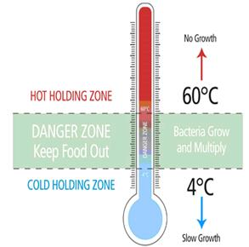
Participant Orientation
Safe food handling: Danger Zone
Temperature zone where bacteria grow most rapidly ​
Between 4°C and 60°C (40°F and 140°F) ​
Keep refrigerated, frozen and cooked food out of this zone ​
Foods in this zone for more than 2 hours are not safe to eat
Keep cold food at or below 4°C and hot foods above 60°C for holding purposes ​
How would you help to keep foods out of the ‘danger zone’?​
​
Notes:
Temperature zone where bacteria grow most rapidly ​
Between 4°C and 60°C (40°F and140°F) ​
Keep refrigerated, frozen and cooked food out of this zone ​
Foods in this zone for more than 2 hours are not safe to eat ​
Keep cold food at or below 4°C and hot foods above 60°C for holding purposes ​
How would you help to keep foods out of the ‘danger zone’?​
​

Slide 24

Participant Orientation
Safe food handling: eggs:
Choose Grade A, refrigerated eggs with clean, un-cracked shells
Store in the coldest part of the refrigerator
Wash hands before and after handling eggs
Cook eggs thoroughly until both the yolk and white are firm and not runny (internal temperature of at least 74°C/165°F).
Follow proper cleaning and sanitizing techniques to avoid cross-contamination.
Use warm water, soap, and food grade sanitizer to thoroughly wash and sanitize all utensils, countertops, and cutting boards after handling raw eggs.
Notes:
Low risk food ingredients are mostly used in the LGC Program. However, eggs are used and can potentially carry the bacteria Salmonella.
When eggs are in a recipe, it is recommended to use grade A raw whole eggs.
When handling eggs, here are some tips to follow:
Store eggs in the coldest part of the refrigerator
Properly wash hands before and after handling eggs (warm water and sopa for 20 seconds)
Cook eggs thoroughly until both the yolk and white are firm and not runny.
Follow proper cleaning and sanitizing techniques to avoid cross-contamination
Use warm water and soap and food grade sanitizer to thoroughly wash and sanitize all utensils, countertops, and cutting boards after handling raw eggs.

Slide 25
Participant Orientation
Cleaning & sanitizing, dishes, pots, and equipment:
By machine:
Use a commercial grade dishwasher that meets the Ontario Food Premises Regulation (O. Reg 493/17)
Notes:
In order to properly clean and sanitize equipment in a dishwasher, it must be commercial grade and meet the Ontario Food Premises Regulation. Usually commercial dishwashers have the temperature gauge located on the outside of the dishwasher. This code sets out the minimum standards that each food premises must meet.

Slide 26
Participant Orientation
Cleaning & sanitizing: dishes, pots & equipment
Handwashing dishes:
Three compartment sink (or bins) for washing dishes by hand is required
Notes:
Many locations do not have a commercial dishwasher, in these cases, dishes will need to be handwashed using the three compartment sink method. The next two slides will cover these topics in more depth.
.

Slide 27
Participant Orientation
Notes:
When using the three-sink method to wash dishes follow these steps:
Scrape off any excess food and rinse the dishes before starting to wash
Ensure all sinks are clean. Fill the first sink with warm water and dish soap. Dishes will be washed in this sink
Fill the second sink with clean water, temperature no less than 43 Celsius or 110 Fahrenheit. This is the sink that dishes will be rinsed in. Note if you don’t have 3 sinks clean bins can be used.
The third sink is where the dishes are sanitized using a food grade sanitizing solution like chlorine, ammonia, or iodine.
The final step of this process is to air dry the dishes or, dry with paper towels, and store the dishes in a safe, clean and secure place

Slide 28
Participant Orientation
Sanitizing solutions:
Buckeye Sani-Q² is an example of a food grade quaternary compound that can be purchased to sanitize.
Participant Orientation
Notes:
Check with your school administration or agency to determine the type of food grade sanitizer that should be used. If you are looking for a quaternary compound sanitizer it can be sourced from can be SEMCO on 893 Dundas street it is called Buckeye Sani-Q. In Woodstock you can source sanitizer from Easy Way Cleaning at 11 Houser's Lane.
Watch the following video to learn how to use a quaternary compound sanitizing solution

Slide 29
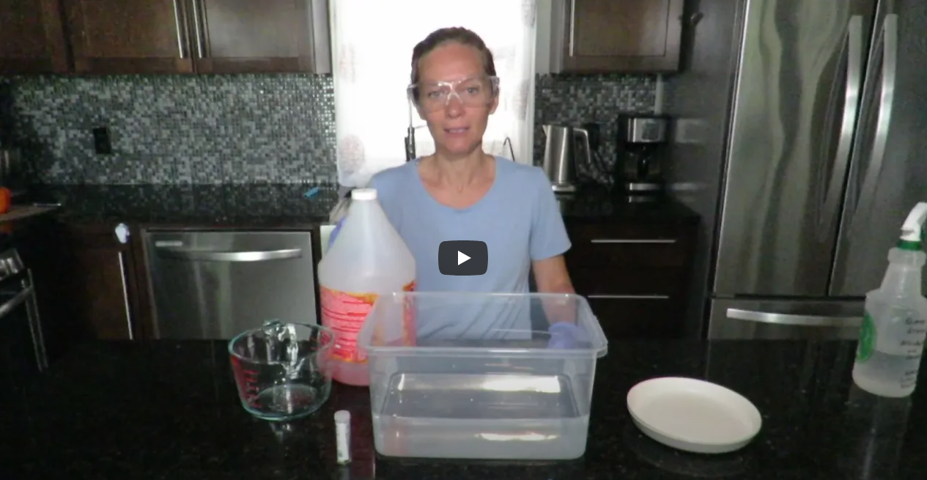
Participant Orientation
Using quaternary compound
sanitizing solution
Watch on YouTube: https://www.youtube.com/watch?v=1KmGnVG5p2o
Notes:
This demonstration will show how to dilute and use a quaternary compound food grade sanitizing solution. The diluted sanitizing solution is used to sanitize cooking surfaces before and after use, and also used to sanitize the dishes after they have been washed and rinsed. All dishes and equipment needed for the cooking sessions should always be washed, rinsed and sanitized before using.
To sanitize the cooking surfaces, dilute the sanitizing solution to the proper concentration and put into a spray bottle like this one. It is also important to label the spray bottle according to WHMIS requirements.
To sanitize dishes or equipment, use a clean sink or bin such as this one. Fill the bin with hot water at least 24 degrees Celsius or 75 degrees Fahrenheit and dilute to the sanitizing solution to the proper concentration.
Here are the steps to follow when diluting the food grade sanitizer to the proper dilution:
Before you begin, be sure to read the instructions on the product label to identify any type of protective equipment to be worn when using the sanitizer and to be aware of other important safety information.
For this demonstration, Buckeye Sani Q will be used. It is a type of food grade sanitizing solution. When using this particular sanitizer it is recommended that goggles and gloves are worn as protective equipment.
Quaternary Ammonium sanitizers such as this one should be diluted to a concertation of 200 ppm. The dilution ratio of Sani-Q to hot water is 1 teaspoon of sanitizer to 1 liter of hot water.
This is a clean bucket with 4 litres of hot water in it, therefore, to get to a concentration of 200 ppm 4 tsp of the sanitizer solution will need to be added. Once added stir with a large spoon. Then test the solution to ensure it is at 200 ppm.
To test the concentration, take a piece of sanitizer test strip, which you will need to buy when purchasing the food grade sanitizer. Make sure it is for quaternary ammonium. Dip the test strip into the solution in the bucket. Keep the test strip in the water for 10 seconds. Remove the test strip from the solution and check the test strip against the colour indicator on the test strip container. The test strip should be similar in color to the colour indicator for 200 parts per million.
Before sanitizing any dishes, transfer some of the solution into a labelled spray bottle which then can be used to sanitize cooking surfaces. The label on the spray bottle should include information such as: product name, concentration, information for the safe handling of the product and statement that the Material Safety Data Sheet is available.

Slide 30

Knife Safety
Participant Orientation
Notes:
Since knives will be used extensively in the cooking program, participants will need instruction and practice with safe knife handling. The following are important tips to communicate and demonstrate to participants to help ensure safety when using a knife.
When carrying a knife, it is important to hold it so that the tip of the blade faces downwards or towards the floor.
If a knife falls never try to catch it as an injury may result. Call out to others that a knife is falling and to move back. Let it fall to the ground and then safely pick it up.
Sharp knives are safer to use compared to ones that are dull. When a knife is dull it can result in pressing harder which could result in a slip with the knife.
When cutting, hold the knife by the handle and always cut away from the body and not towards it.
Never try to cut something while holding it.
Always use a cutting board to cut on. Stabilize the cutting board using a clean wet cloth or paper towel to act as a traction between the cutting board and the countertop. This will ensure safety when chopping.
There is a knife safety poster on the portal with all of this information. I am also going to show a video next which reviews proper knife handling.
Image source: https://pixabay.com/photos/paprika-yellow-to-cut-knife-cook-4044059/

Slide 31
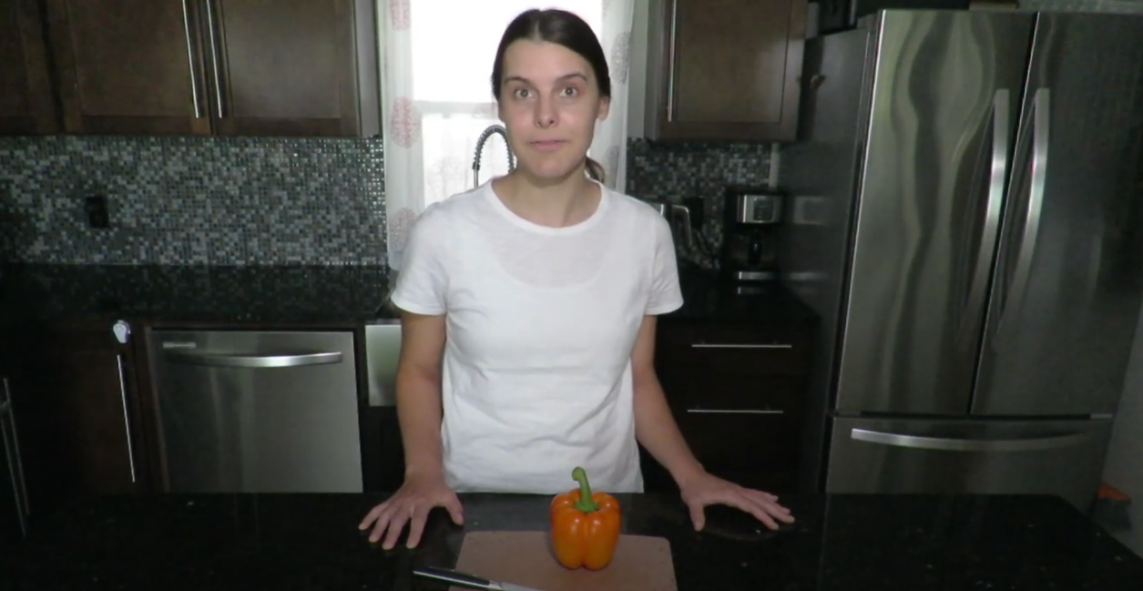
Knife Safety
Participant Orientation
Watch on YouTube: https://www.youtube.com/watch?v=L3z9YmARd20
Notes:
Since knives will be used extensively in the cooking program, participants will need instruction and practice with safe knife handling. The following are important tips to communicate and demonstrate to participants to help ensure safety when using a knife.
When carrying a knife, it is important to hold it so that the tip of the blade faces downwards or towards the floor.
If a knife falls never try to catch it as an injury may result. Call out to others that a knife is falling and to move back. Let it fall to the ground and then safely pick it up.
Sharp knives are safer to use compared to ones that are dull. When a knife is dull it can result in pressing harder which could result in a slip with the knife.
When cutting, hold the knife by the handle and always cut away from the body and not towards it.
Never try to cut something while holding it.
Always use a cutting board to cut on. Stabilize the cutting board using a clean wet cloth or paper towel to act as a traction between the cutting board and the countertop. This will ensure safety when chopping.
There is a knife safety poster on the portal with all of this information. I am also going to show a video next which reviews proper knife handling.

Slide 32
Participant Orientation
General kitchen safety:
Preventing Burns:
Always use oven mitts to lift hot items
Ask for help when carrying hot items that are too heavy
Preventing Shocks:
Hands must be dry when plugging in electrical equipment to an outlet
Turn off appliance before plugging it in
Notes:
To prevent burns, always use oven mitts to lift hot items and always tell participants to ask for help if the equipment is too heavy.
To prevent shocks, hands must be dry when plugging in electrical equipment to an outlet. Also make sure that the equipment you are using is turned off before plugging it in.

Slide 33
Participant Orientation
Handling injuries:
A first aid trained staff member must be available at all times when the program is running
Know where the first aid station is located
If a participant cuts themselves, clean the wound and apply a sterile Band-Aid
Contact the first aid trained staff member
Notes:
First aid training is not a requirement of facilitators; however, someone from your location with first aid training must be present and available when the program is running.
If a participant cuts their hand or finger, clean the wound and apply a sterile band aid. The participant must then wear a glove on the injured hand to continue participating in the program. Any food or equipment that comes in to contact directly with the wound should be discarded and the equipment cleaned and sanitized respectively.

Slide 34
Program
Format
Program consists of 7 sessions in total:
Session One: orientation (mandatory)
  Food, kitchen, and knife safety
  Participants prepare and taste one recipe
  Additional Sessions:
6 themed cooking sessions
Each session includes 2 recipes for participants to prepare and taste
Ratio of 1 facilitator to 5 participants is recommended for safety reasons
Notes:
The Let’s Get Cookin’ Program consists of 7 sessions in total. The first session is the orientation session and is mandatory. During this session you will review important information such as food safety, kitchen safety, and knife skills with the participants. In addition, the participants will be making one recipe.
Following the orientation session there are 6 themed cooking sessions. Each cooking session includes 2 recipes.
A ratio of 1 facilitator to 5 students is recommended for all cooking sessions for safety reasons.

Slide 35
Participant Orientation
Orientation layout:
Collect consent forms
Complete attendance form
Provide overview of program
Set ground rules
Review food and kitchen safety
Notes:
Let’s focus on the layout of the orientation session.
At the beginning of the first session, you can collect the consent forms signed by parents or guardians. During this session, participants will learn about food safety, safe knife handling and set the ground rules. Participants will have an opportunity to practice their knife skills with one of the recipes found in the orientation recipe section.
Attendance forms are also available on the portal to track attendance at each session.

Slide 36
Cooking Sessions
Two recipes (stations) per session:
Recipes are themed, contain either a vegetable or fruit, and are easy to prepare in minimal time
Limited equipment required - no oven needed
For each recipe:
  Shopping lists included
  Equipment lists included
Notes:
Following the orientation session, the cooking sessions will begin!
Every cooking session is themed and involves making two recipes. Each recipe takes approximately 30 minutes to prepare, some recipes may take a bit longer. The recipes either do not require cooking or use a skillet. Both a shopping and equipment list is provided for each recipe and all of this is available on the portal.

Slide 37
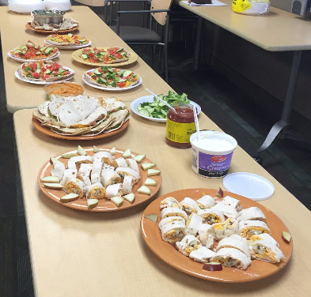
Cooking Sessions
Six themed cooking sessions:
Begin with Breakfast
Versatile Veggies
Dinner Delights
Spice it Up!
Winning Weekends
Fabulous Fruit
Notes:
As mentioned, each cooking session is themed such as Begin with Breakfast, Dinner Delights and Spice it up!. It is important to follow the recipes. The portal offers suggestions for minor substitutions in the event an ingredient can’t be sourced or is expensive

Slide 38
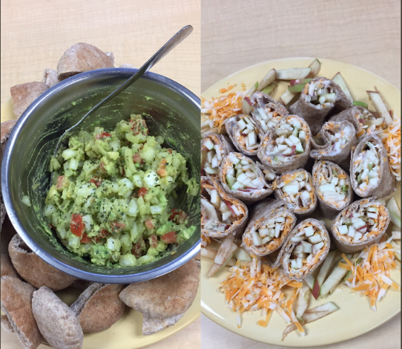
Cooking Sessions
Sampling:
Participants can try food once it’s all prepared
Allow participants to decide whether or not they want to taste the food
Create a positive tasting/eating environment:
  Have participants plate food in an appealing way
  Set up tasting table to look attractive (e.g., tablecloth, sampling plates/bowls, cutlery, etc.)
  Provide a water pitcher when sampling foods
Notes:
At the end of each cooking session, participants can sample the food prepared. Encourage participants to plate their recipes in an attractive way. Participants should not be pressured to try the foods prepared or to taste "just one bite" as this can create a negative experience.
If possible, have the group sit down and eat together. Remember, it is up to the participant whether or not they want to try a certain food and it is your responsibility to create a positive environment where everyone can come together to socialize and enjoy some delicious tasting food!

Slide 39

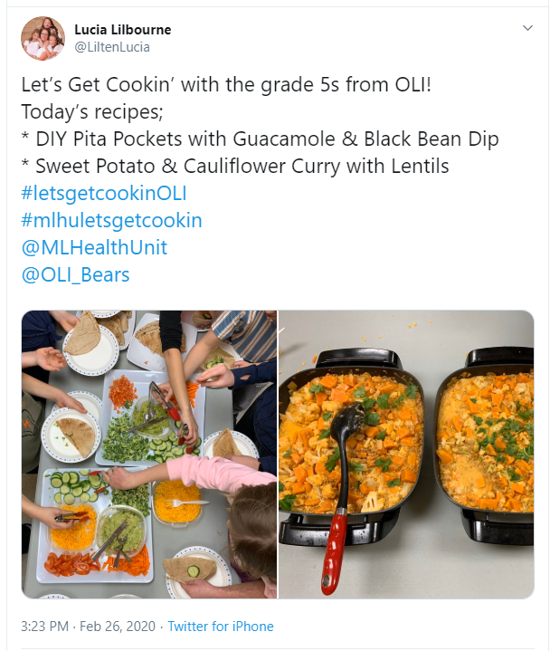

Share with
us!
Follow us on Twitter: @ML_SchoolHealth & @SWPHSchoolTeam
Share photos from your Let’s Get Cookin’ sessions using #getcookinML #getcookinSWPH
Notes:
We encourage you to follow us on Twitter @MLSchoolHealth and share your photos using the #getcookinML . This helps to validate our program and feature some of your students’ creations!
Please remember that all photos taken should have appropriate consent if pictures are taken of students or participants.

Slide 40

Congratulations!
You have completed the online training module!
Please click the link below to access the quiz:
https://chkmkt.com/letsgetcookintestyourknowledge
For additional questions, please contact us at:
Letsgetcookin@mlhu.on.ca or
healthyeating@swpublichealth.ca
Notes:
Congratulations! You have now completed the webinar. Your only step now to be able to facilitate it in your organization is to complete a short online quiz to test your knowledge and understanding of the program. Please access the quiz by clicking the link under the training module
Once you have completed the quiz you will receive conformation from us via email and then you are able to run the Let's Get Cookin' program in your school/community. Happy Cooking!

