Slide 2
Healthy Lunches
Creation date: 2014
Revision date: May 29, 2019

Slide 3
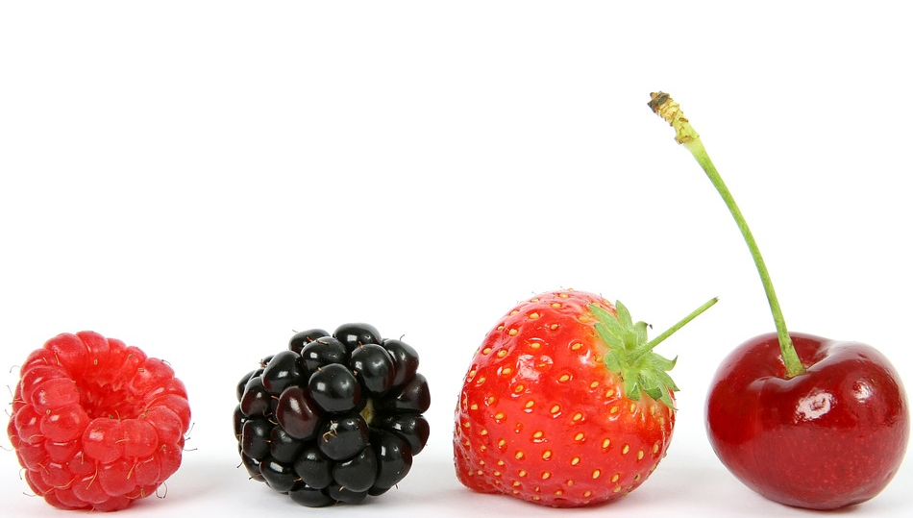
Healthy Eating Helps Children:
Be healthy
Think and learn at school
Have energy to grow and play
Notes:
https://pixabay.com/static/uploads/photo/2016/03/05/19/02/berry-1238249_960_720.jpg

Slide 4
Canada’s Food Guide
Canada’s Food Guide (CFG) helps us to plan and choose food and drinks for healthy meals and snacks
CFG emphasizes choosing vegetables and fruit, whole grains and protein foods, and making water your drink of choice.
Notes:
Can you name the three food categories?

Slide 5
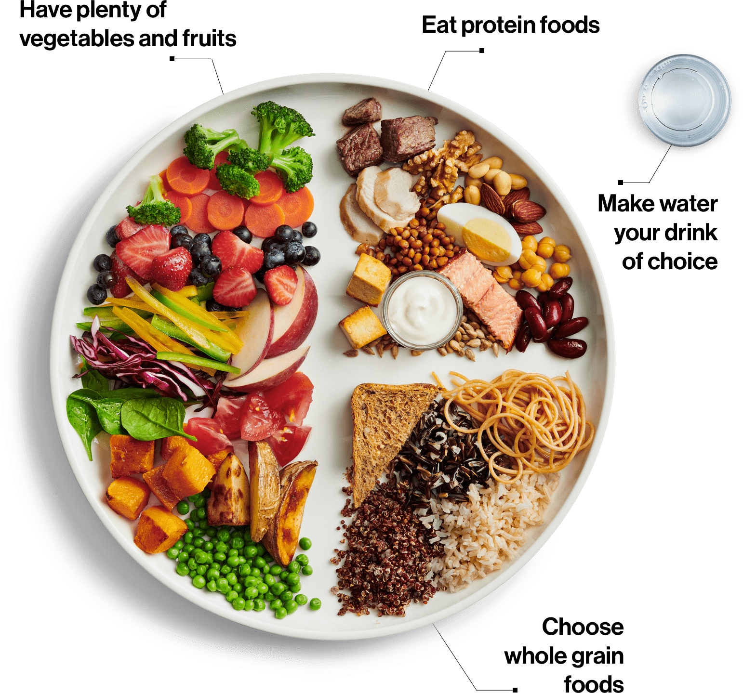
Nutritious Foods
Vegetables and Fruits
Whole Grain Foods
Protein Foods
Eating a variety of healthy foods helps to ensure your body is getting the important nutrients it needs to be healthy, grow, and to have energy to think and learn.
Notes:
Question to ask students:
Which Food Group represents the portion of the plate? Why?
- Vegetables and Fruit.
-We need the most servings from this group to fuel our bodies. Generally children and adults don’t eat adequate amounts of vegetables and fruit

Slide 6
Everyday vs. Sometimes Foods
Everyday foods are:
Foods that we eat everyday from CFG
Packed with nutrients
The foods to eat daily and pack in lunches everyday
Sometimes foods are:
Foods that don’t provide many nutrients
Can often be higher in fat, sugar and/or salt
Foods and drinks to choose less often
These are foods that we can enjoy some of the time
Notes:
Prompt:
Name an everyday food and the food category to which it belongs (have a few students provide examples)

Slide 7
Examples of “Everyday” Foods
Vegetables: Broccoli, peas, carrots, etc.
Fruits: Melon, strawberries, bananas etc.
Whole Grain Foods: Whole grain bread, cereals, pasta etc.
Protein Foods: Beans and legumes, tofu, eggs, fish, chicken, beef, white unsweetened milk, yogurt, cheese, unsweetened fortified soy beverage, etc.
For a more comprehensive list of foods for each grouping visit:https://food-guide.canada.ca/en/
Notes:
For examples: refer to the food guide
Ice cream, butter, cream cheese – are not part of the protein foods grouping as they do not contain enough calcium

Slide 8
Examples of “Sometimes” Foods
Cakes and pastries/pies
Chocolate, candies, fruit roll ups
Cookies
Ice cream and frozen desserts
Doughnuts and muffins
French fries
Juice and fruit flavoured drinks
Pop

Slide 9
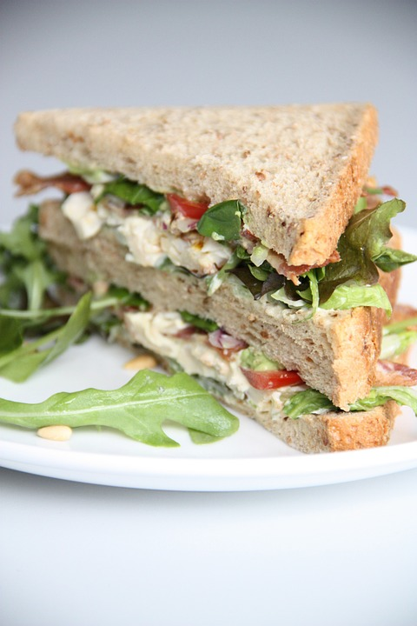
Lunch Time Matters!
Packing a healthy lunch for school will help students:
Get the energy and nutrients needed to take on the second half of the day.
Energy and nutrients to think, learn, be active and play!
Notes:
https://pixabay.com/static/uploads/photo/2015/08/17/21/43/salad-892995_960_720.jpg

Slide 10
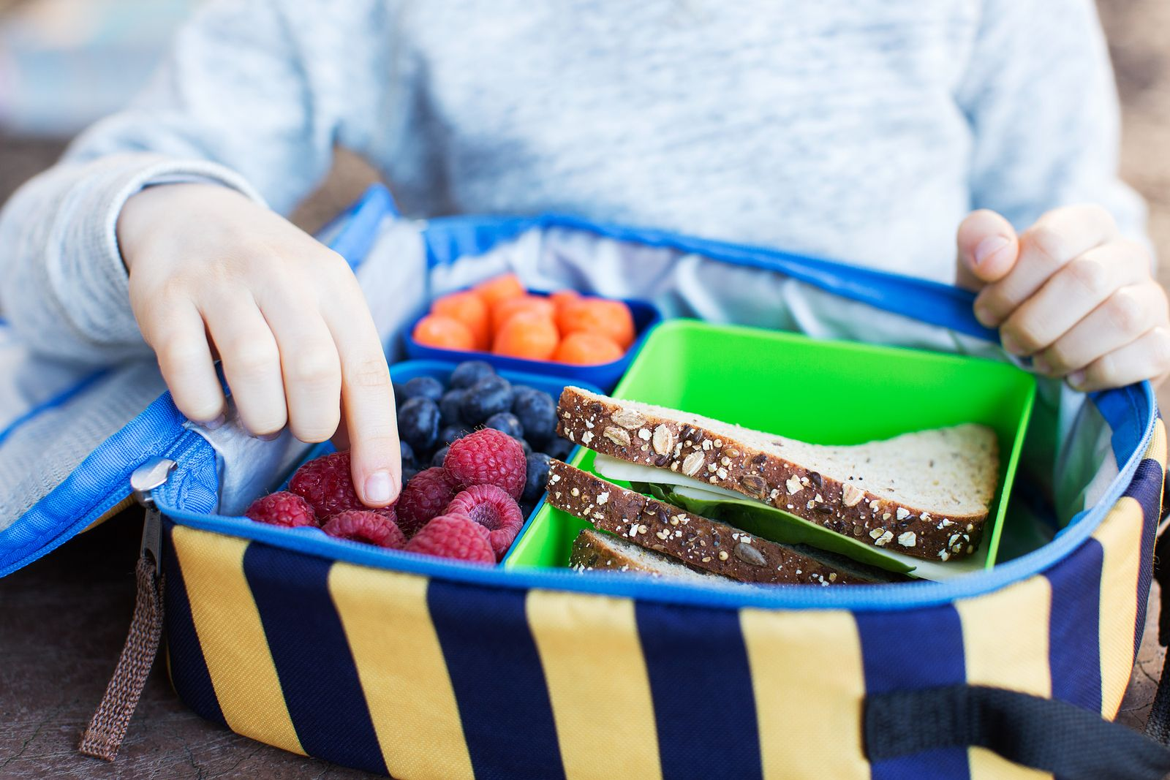
Healthy School Lunches
What to Include:
Fill half the lunch pail with vegetables and fruits
Complete the meal with whole grains (e.g., rolls, bread, quinoa etc.) and protein (cheese, plain yogurt foods, salmon, legumes etc.)

Slide 11
Start with a Whole Grain Food
A Whole Grain Food: Whole grain bread, crackers, buns or pita bread
Notes:
https://pixabay.com/static/uploads/photo/2016/03/05/22/21/appetite-1239259_960_720.jpg

Slide 12
Add Protein Food
For Example:
Black beans or chickpeas
Bean dip e.g., hummus
Lean meat (chicken, turkey)
Hard boiled egg
Salmon or tuna
White milk or unsweetened
fortified soy beverage
Yogurt
Cheese
Notes:
https://pixabay.com/static/uploads/photo/2016/07/27/04/33/fried-1544557_960_720.jpg

Slide 13
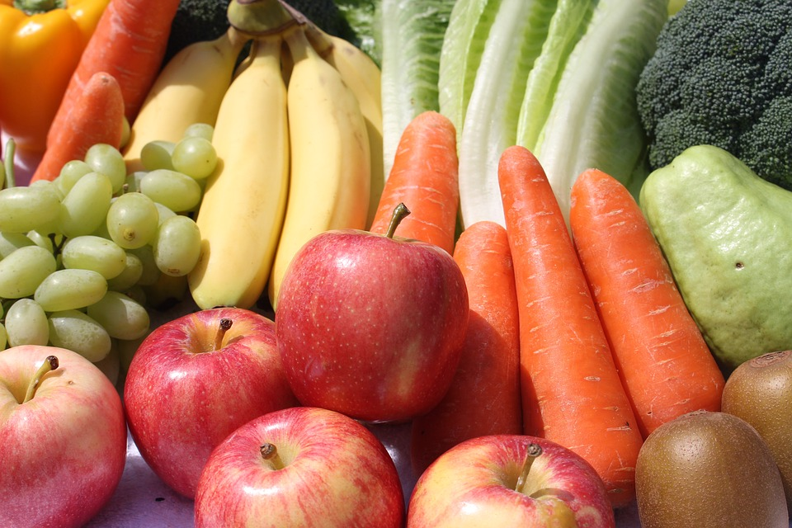
Don’t Forget to Add Your “FAV”! (Fruits and Vegetables)
For example:
Add vegetables to your sandwich (e.g. pepper strips, romaine lettuce)
Have them on the side or in a salad (e.g., carrot sticks, broccoli or cauliflower pieces)
Pack your favourite fruit (seasonal, or canned or frozen without sugar are good!
Notes:
https://pixabay.com/static/uploads/photo/2014/09/30/15/25/pepper-467270_960_720.jpg

Slide 14
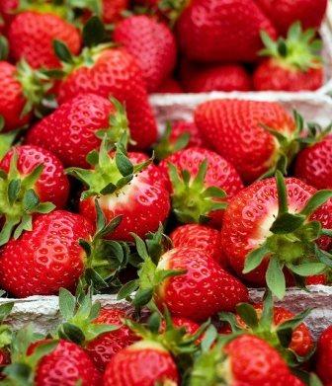
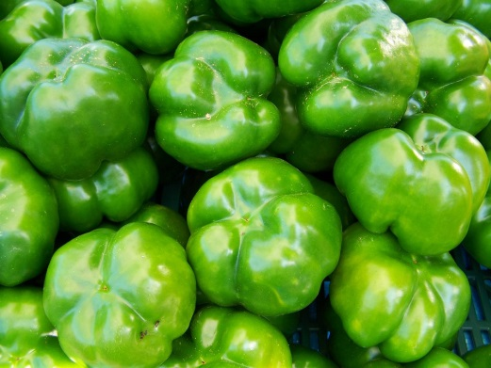
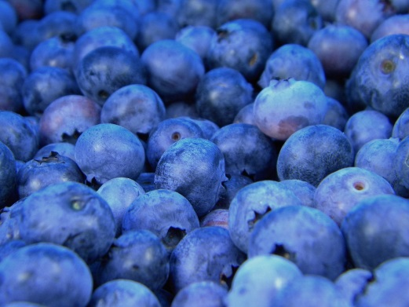
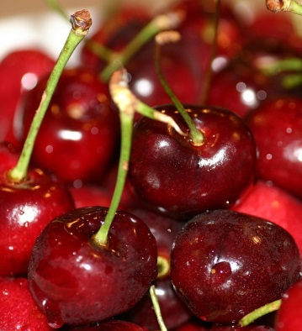
Colour Your Plate
Notes:
Questions for Students: What foods are the most colourful on your plate or in your lunch bag?
Can you name different vegetables and fruits that match the colour of the rainbow?
https://pixabay.com/static/uploads/photo/2014/05/18/00/27/cloud-346706_960_720.png
https://pixabay.com/static/uploads/photo/2016/05/16/17/59/strawberries-1396330_960_720.jpg
https://pixabay.com/static/uploads/photo/2012/02/19/18/07/orange-15047_960_720.jpg
https://pixabay.com/static/uploads/photo/2016/01/03/17/59/bananas-1119790_960_720.jpg
https://pixabay.com/static/uploads/photo/2016/07/27/13/31/pepper-1545314_960_720.jpg
https://pixabay.com/static/uploads/photo/2016/03/09/09/19/blueberries-1245724_960_720.jpg
https://pixabay.com/static/uploads/photo/2016/06/01/08/39/berries-1428568_960_720.jpg

Slide 15
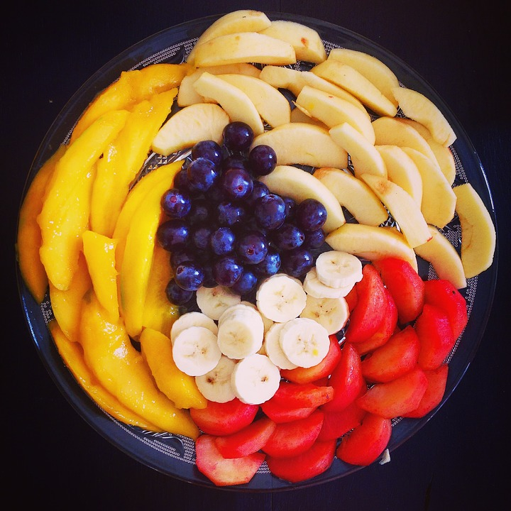
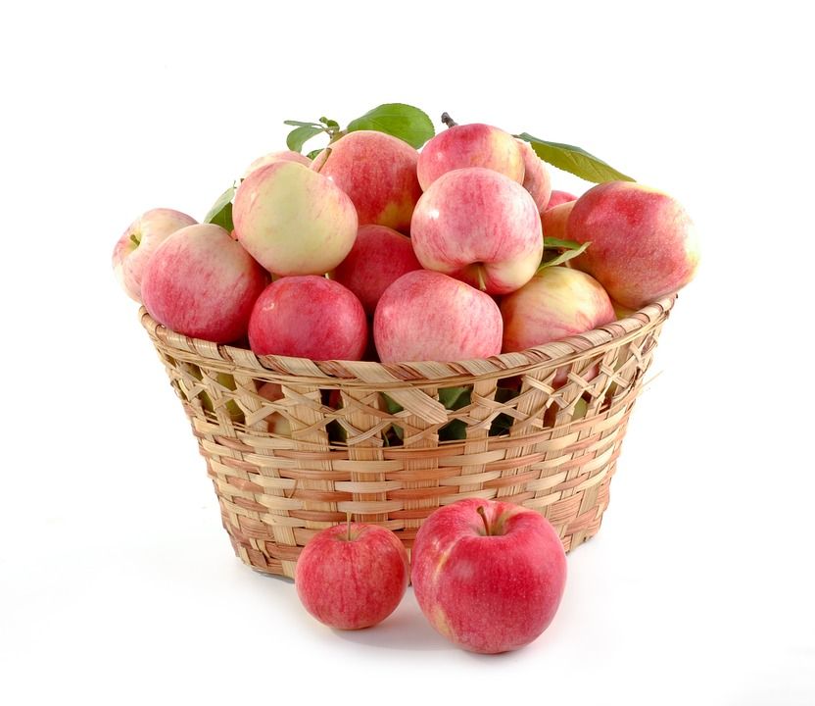
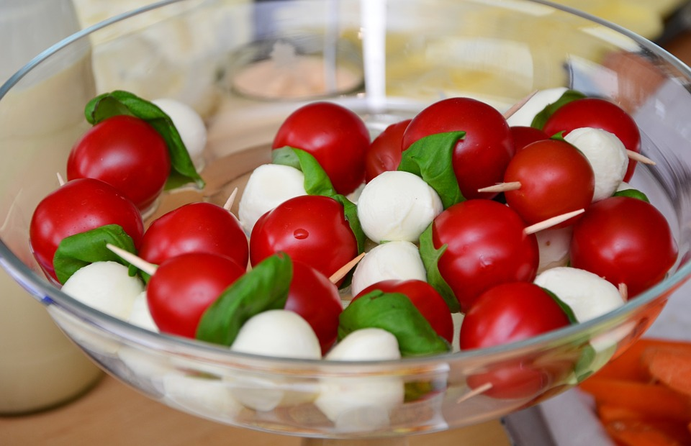
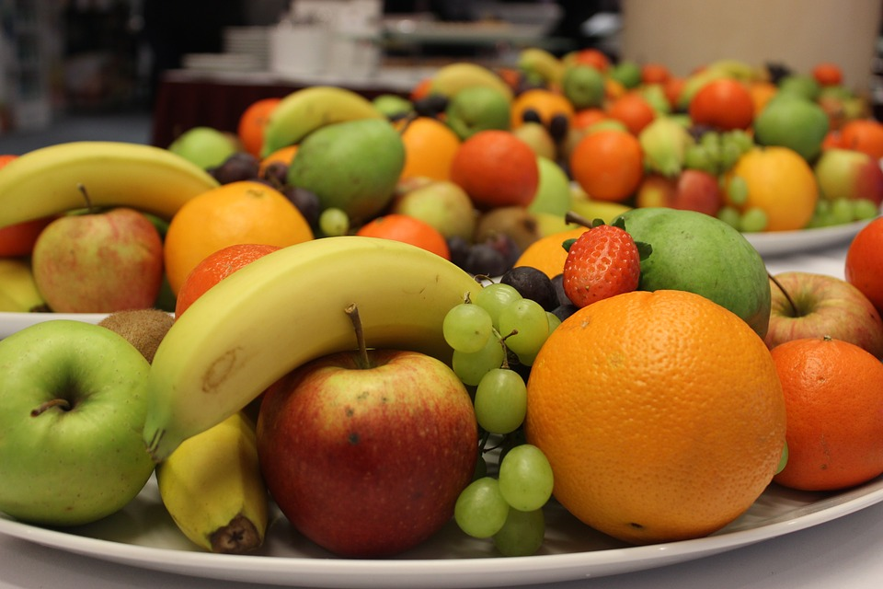
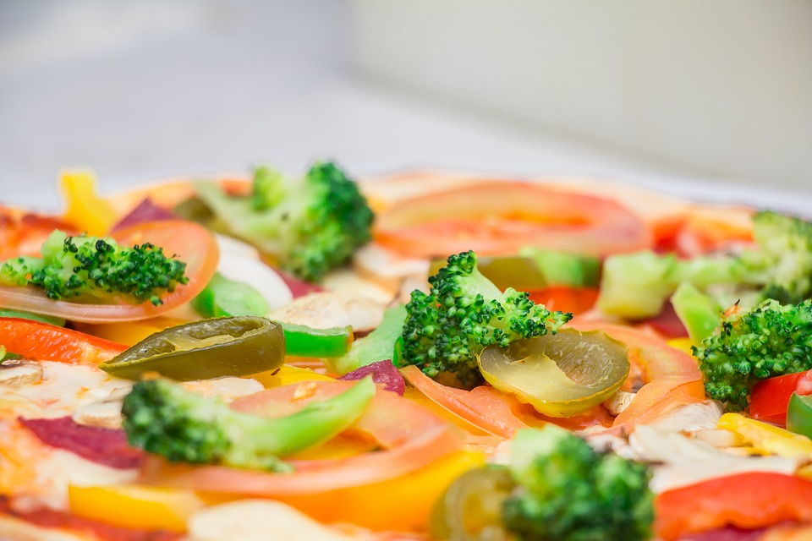
Some FAVourites!
Notes:
: What are your FAVourite ways to eat Fruits And Vegetables?
Do you have favourites ways to add them to your lunch?
Here are some examples:
Veggies and dip
Fruit bowls
Flavourful appetizers and salads
Fresh veggies on pizza or sandwiches
In season fruit
Cut up fruit possibly with yogurt dip
https://pixabay.com/static/uploads/photo/2016/02/04/16/15/vegetable-plate-1179401_960_720.jpg
https://pixabay.com/static/uploads/photo/2015/09/28/15/49/fruit-962279_960_720.jpg
https://pixabay.com/static/uploads/photo/2015/06/10/19/56/apples-805124_960_720.jpg
https://pixabay.com/static/uploads/photo/2015/02/28/17/28/tomato-mozzarella-653838_960_720.jpg
https://pixabay.com/static/uploads/photo/2014/05/18/11/25/pizza-346985_960_720.jpg
https://pixabay.com/static/uploads/photo/2016/08/11/18/36/fruit-1586490_960_720.jpg

Slide 16
Include a Healthy Drink
Drinks that make your lunch even healthier:
Water
White Milk
Including milk with your lunch helps you to meet your daily calcium needs
Unsweetened Fortified Plant-Based Beverage (e.g., soy, almond, pea beverage etc.)
Notes:
To further illustrate the point about healthy drink choices the sugary drink kit can be used
Flavoured milks and flavoured fortified plant-based beverages - these contain some vitamin and minerals, however, are higher in added sugar and therefore are categorized as a sometimes food.
https://pixabay.com/static/uploads/photo/2015/03/05/08/40/water-bottle-660024_960_720.jpg

Slide 17
What About 100% Fruit Juice?
100% juice is more nutritious than sweetened fruit drinks and soft drinks, but it can be just as high in sugar as pop and is very low in fibre
It is better to eat whole fruit or vegetables vs. drinking juice
Eating whole fruit and vegetables allows you to get the added benefit of the fibre in the vegetables and fruit
Notes:
100% fruit juice should also be a “sometimes” food
https://pixabay.com/en/juice-fruit-apple-box-beverage-31728/

Slide 18
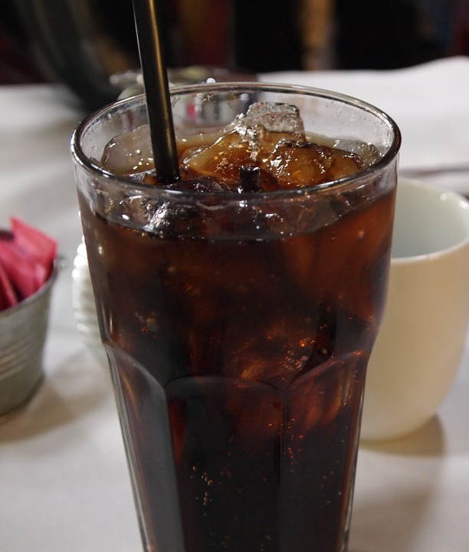
Drinks to Avoid
Drinks that provide mostly sugar and very little in the way of nutrition include:
Pop
100% juice, fruit-flavoured beverages, punches and drinks
Iced tea
Sports drinks
Drinks like the ones listed can be filling and leave
little room for healthy foods
Notes:
https://pixabay.com/static/uploads/photo/2014/05/10/21/25/drink-341489_960_720.jpg

Slide 19
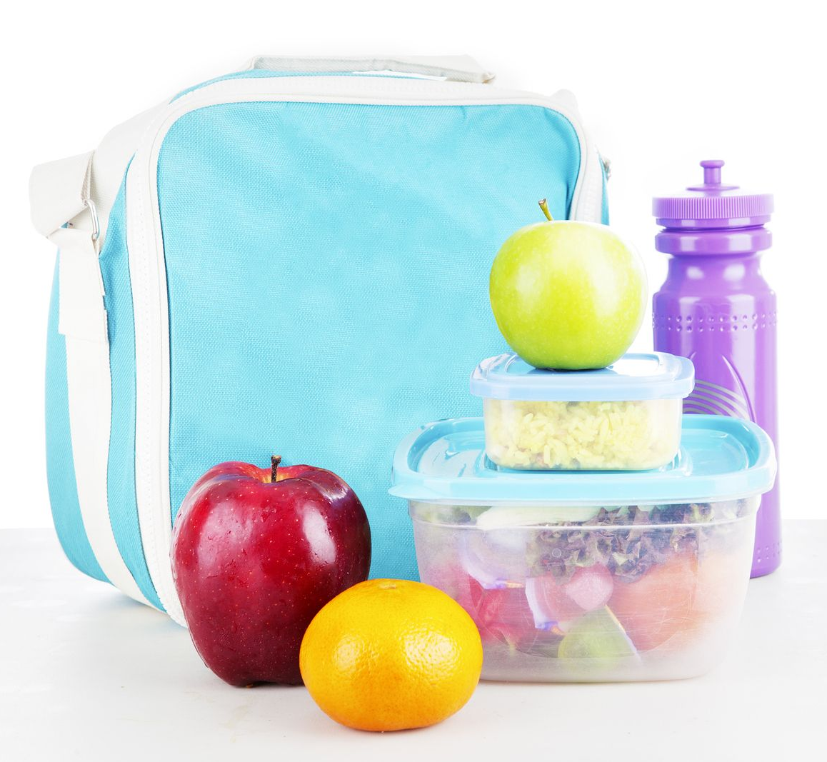
Food Safety
Pack lunches in an insulated lunch bag
Use ice packs to keep cold foods cold
Use a thermos to keep hot foods hot
Take containers and your water bottle home everyday to be washed
Wash out your lunch pail regularly

Slide 20
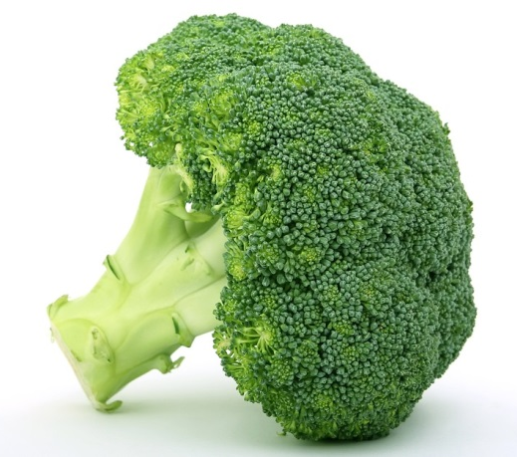
Make Healthy Lunches Happen
Get involved in planning and making your lunch:
Plan lunch menus with your parents
Make a list of healthy food choices you enjoy eating at lunch
Help make the grocery list based on your ideas
Help with grocery shopping
Pack enough food to satisfy your appetite
When planning also consider:
Cost of the food, the environment (waste), and of course … making healthy choices
Your favorite traditional food
Notes:
Question: What can you do to get involved in menu planning and making lunch?
Menu Planning
Choose everyday foods you like
Include vegetables and fruit
Make the grocery list
based on the menu planning
Grocery shop
Go along to help pick out the foods from the list
Cost:
Consider using beans or legumes a few times a week instead of meat
Prepare or bake your own soups or muffins (Health Canada: http://www.hc-sc.gc.ca/fn-an/food-guide-aliment/using-utiliser/shopping-epicerie-eng.php)
Question: What are some traditional food you eat?
https://pixabay.com/static/uploads/photo/2016/03/05/19/02/appetite-1238251_960_720.jpg

Slide 21
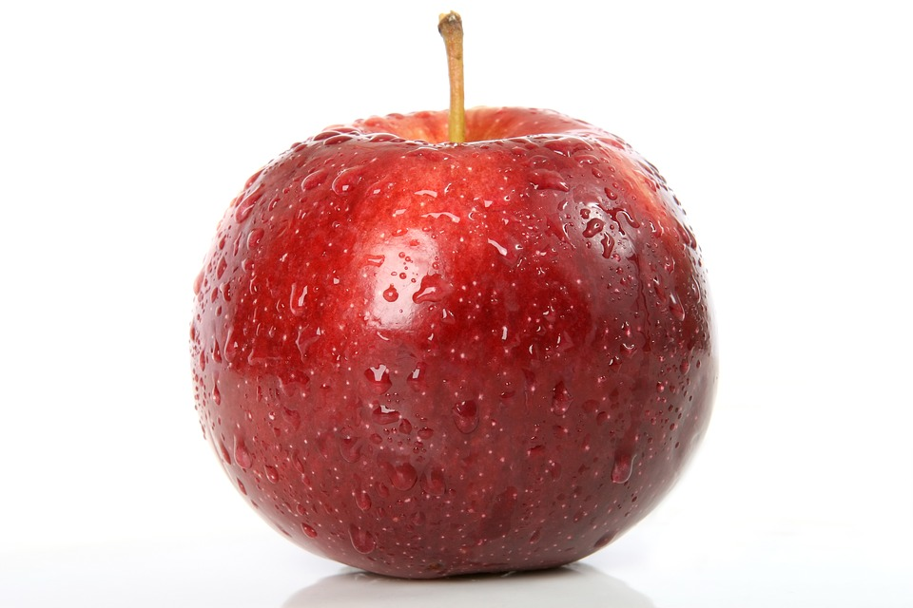
Menu Makeover
Fruit punch
Plain bagel with cream cheese
Apple
Cereal bar
Chips
Water or white milk
Whole grain bagel with cheddar and tomato
Apple
Homemade whole grain muffin
Carrot sticks
Notes:
How could you make over this menu?
Take 2 minutes and plan out your menu makeover
https://pixabay.com/static/uploads/photo/2016/03/05/21/43/appetite-1239060_960_720.jpg

Slide 22
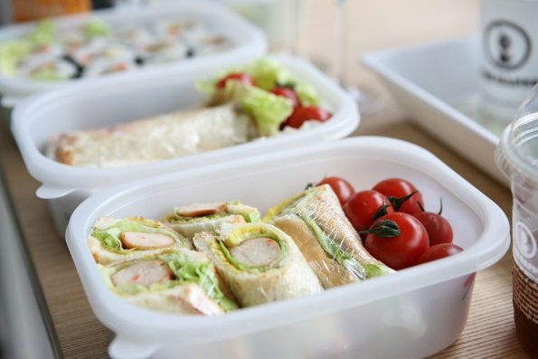
Menu Makeover
Make your own bento box:
Whole grain crackers, cheese cubes, homemade baked chicken fingers with dip
Fresh fruit with yogurt-based dip
Homemade cookie
Water
Store bought prepackaged lunch:
Kielbasa, crackers, processed cheese, chocolate bar
Pop
Notes:
Question for students: How would you makeover this lunchbag?
Here is how we made it over:
Make your own bento box – mix and match favs
Whole grain crackers, cheese cubes, homemade baked chicken fingers with dip
Fresh fruit with yogurt-based dip
Homemade cookie
Water
https://pixabay.com/static/uploads/photo/2016/08/11/16/32/mason-jar-1586107_960_720.jpg

Slide 23
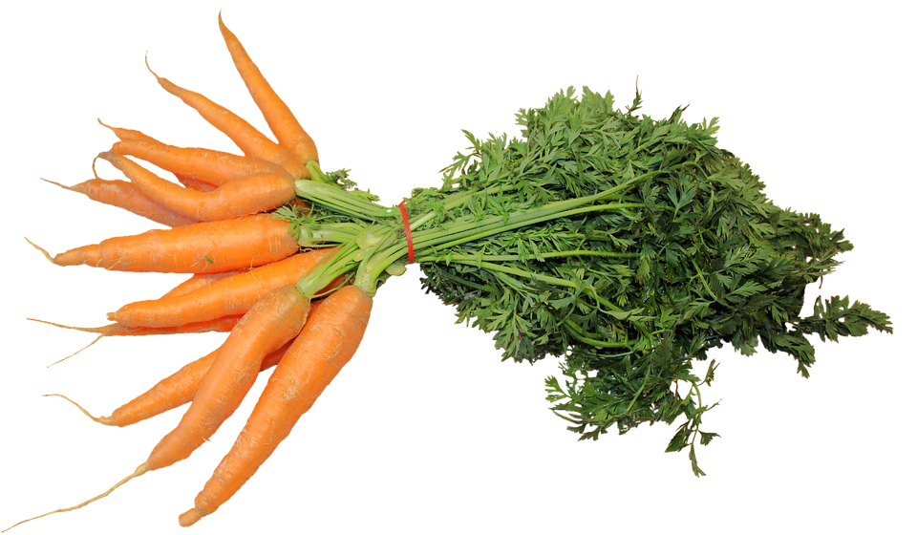
Menu Makeover
Bologna sandwich on white bread
Carrot sticks
Prepackaged cookie
Iced tea
Cheezies
Leftover roast meat on a whole grain bun with lettuce and tomato
with hummus dip
Trail Mix
Water or white milk
Your favourite fruit
Notes:
How would you makeover this lunch?
Leftover roast meat on whole grain bun with lettuce and tomato
Carrots with Hummus dip
Trail Mix (Consider whether this should be nut-free)
Milk or water
Fruit
https://pixabay.com/static/uploads/photo/2015/12/08/16/10/federal-carrots-1083235_960_720.png

Slide 24
Resources
Unlock Food
www.unlockfood.ca
Dietitians of Canada
www.dietitians.ca/eatwell
Healthy Living
www.healthylivinginfo.ca
Canada’s Food Guide
https://food-guide.canada.ca/en/
Middlesex London Health Unit- Curriculum Teaching and Learning Resources and Toolkits https://www.healthunit.com/healthy-schools-teaching-resources#healthy-eating
Notes:
https://pixabay.com/static/uploads/photo/2016/06/26/17/19/heart-1480779_960_720.png

Slide 25
What did you learn?
Notes:
https://pixabay.com/static/uploads/photo/2012/02/25/19/02/apple-16890_960_720.jpg

