Slide 1

Birth Control Methods (Contraception)
Recommended for: Grade 9-12
Created by: School Health Team
Created: June 2022
Last Reviewed: July 2024
Notes:
To provide an inclusive environment for all students, regardless of their gender identity, we use the names of body parts and hormones to discuss physical differences rather than the use of gender.

Slide 2
Class Overview
Consent
Review of anatomy and the menstrual cycle
Birth control methods (Contraception)
  Abstinence
  Hormonal Methods
  Non-hormonal Methods
  Surgical Methods

Slide 3

Consent

Slide 4
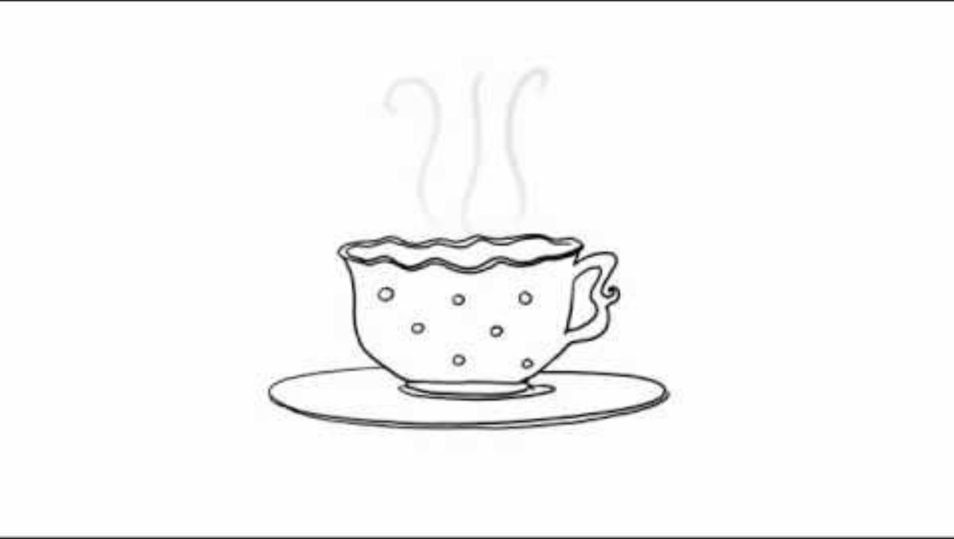
Consent

Slide 5
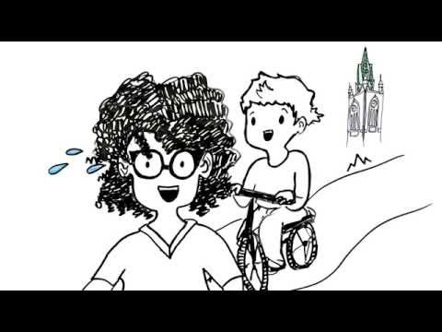
Consent
https://www.youtube.com/watch?v=-JwlKjRaUaw
Notes:
https://www.youtube.com/watch?v=-JwlKjRaUaw

Slide 6





Slide 7

Anatomy
Review

Slide 8
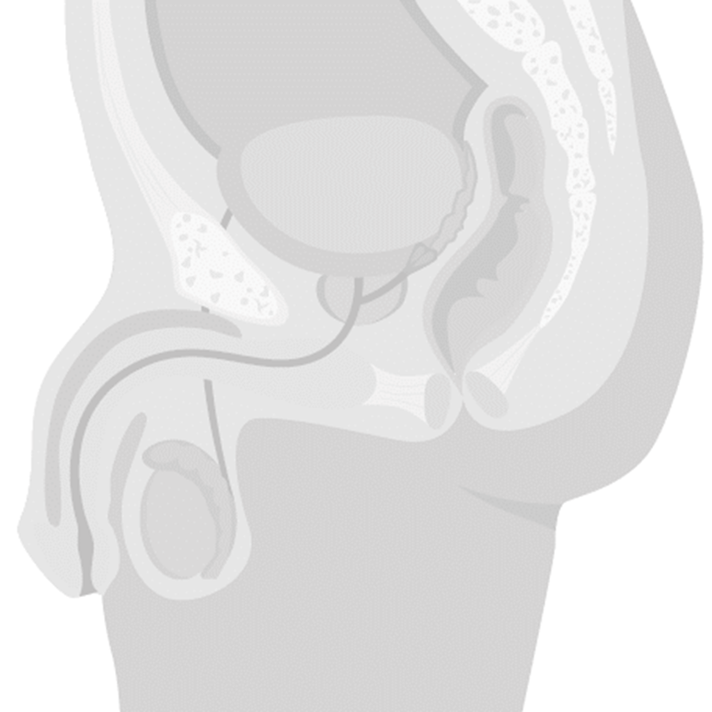

Person with a penis
Bladder
Seminal vesicle
Prostate gland
Vas deferens
Urethra
Epididymis
Testicle
Scrotum
Notes:
Penis – It is a spongy, muscular organ that becomes enlarged and erect when sexually aroused.
Scrotum – The sac of skin which holds the pair of testes.
Testicles (testes) – The male sex glands which produce sperm and testosterone (a male hormone).
Epididymis – A tube on the surface of each testicle which stores and transports sperm to the vas deferens.
Vas deferens- A tube that transports sperm from the testicle to the seminal vesicle
Seminal vesicles – Pair of glands which add a nourishing fluid to the sperm
Prostate gland – Gland which adds a milky fluid to the semen. Once sperm is combined with the fluid from the seminal vesicles and prostate gland it is called semen
Bladder – A bag-shaped organ which holds the urine until it is discharged.
Urethra – The tube that goes through the penis, through which urine and semen leave the body.
Image Source: Adobe Stock-purchased

Slide 9
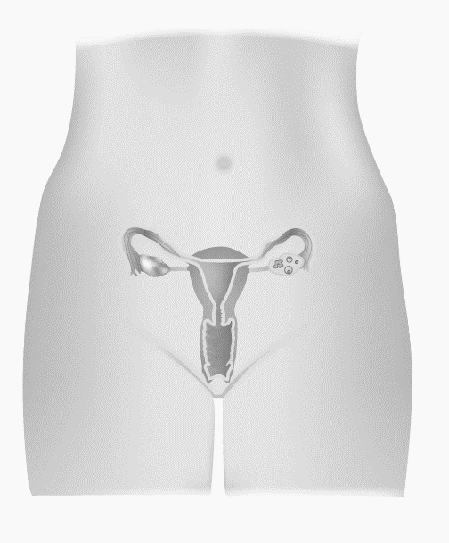
Person with a vulva
Fallopian tubes
Ovaries
Uterus
Cervix
Vagina
Notes:
Vulva – The name for the external genitalia
Ovary – Releases egg cells and produces hormones (estrogen and progesterone) on a monthly cycle.
Fallopian Tubes – Tubes leading from the ovary to the top of the uterus, with finger-like projections that surround an ovary.
Uterus – Pear-shaped organ which nourishes and holds a developing fetus. It prepares for a pregnancy each month by forming a blood and tissue lining.
Cervix – The narrow inner end of the vagina, which leads to the uterus.
Vagina – A muscular tube which expands to fit the penis during intercourse or a baby during birth.
Image Source: Adobe Stock-purchased

Slide 10
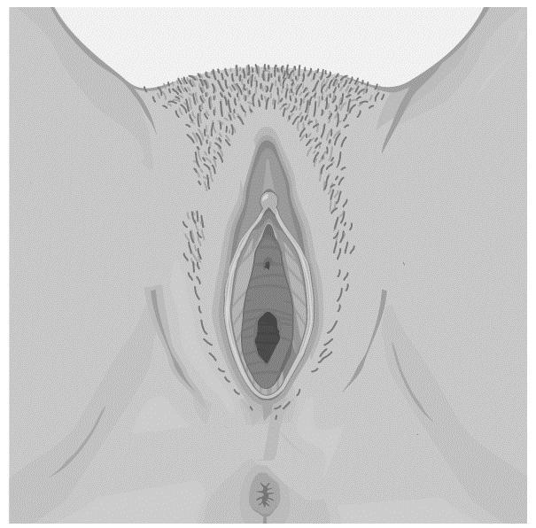
Person with a vulva
Clitoris
Labia
Urethral Opening
Vaginal Opening
Anus
Notes:
Labia – Folds of skin (inner and outer) which protect the internal reproduction organs.
Urethral Opening – Opening of the urethra, the tube that connects to the bladder and releases urine
Clitoris – a highly sensitive organ above the urinary opening which may provide pleasure when stimulated.
Anus – Opening of the rectum, where feces is released
Image Source: Adobe Stock-purchased

Slide 11
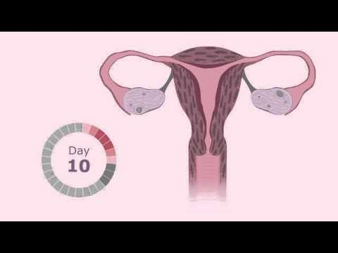
The Menstrual Cycle
https://www.youtube.com/watch?v=vXrQ_FhZmos
Notes:
https://www.youtube.com/watch?v=vXrQ_FhZmos
*Note to teachers: This video includes the use of gendered language (woman, girl, her) in the explanation of menstruation. In this presentation we endeavour to be more inclusive in our education, recognizing that not all youth identify with a specific gender.

Slide 12
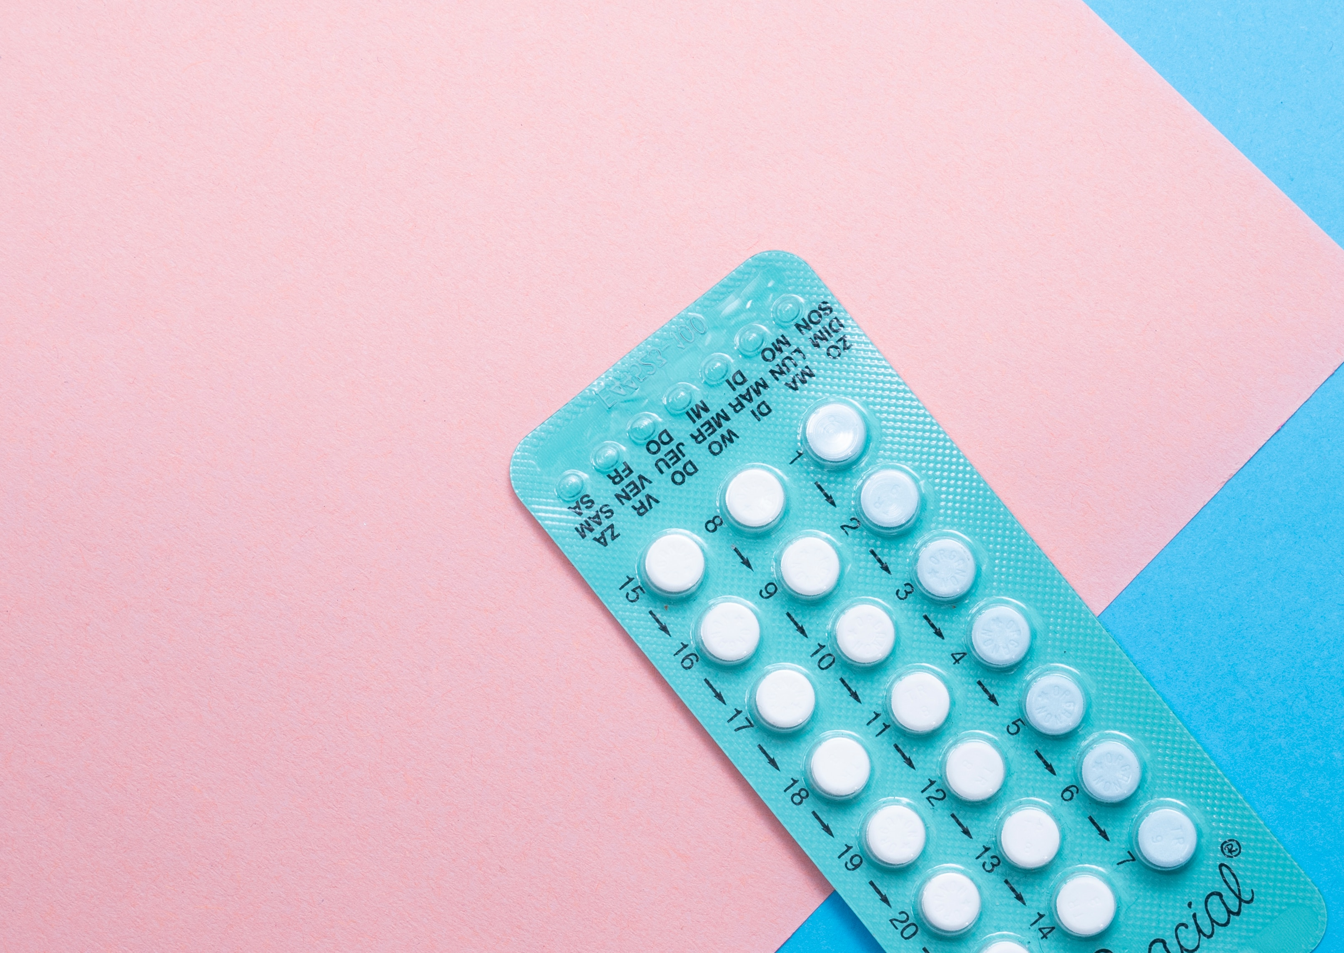
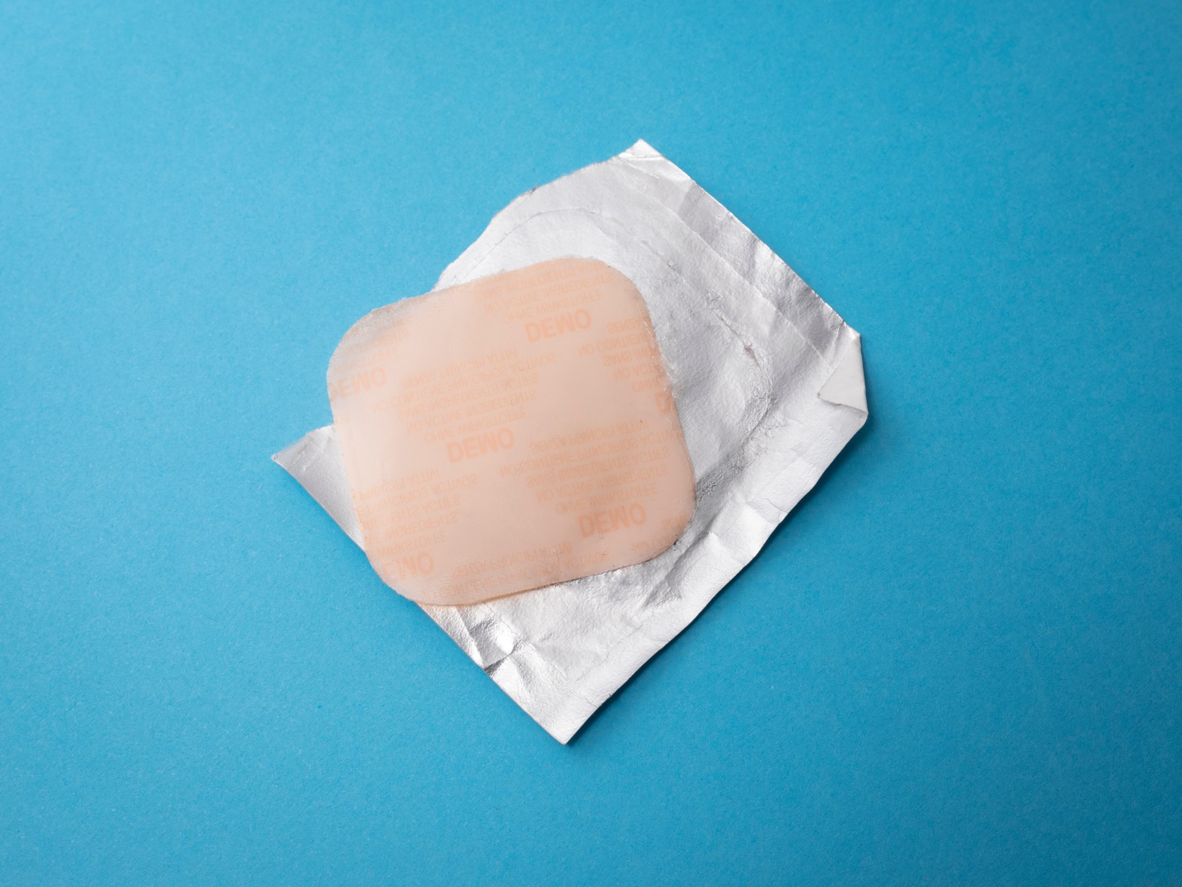
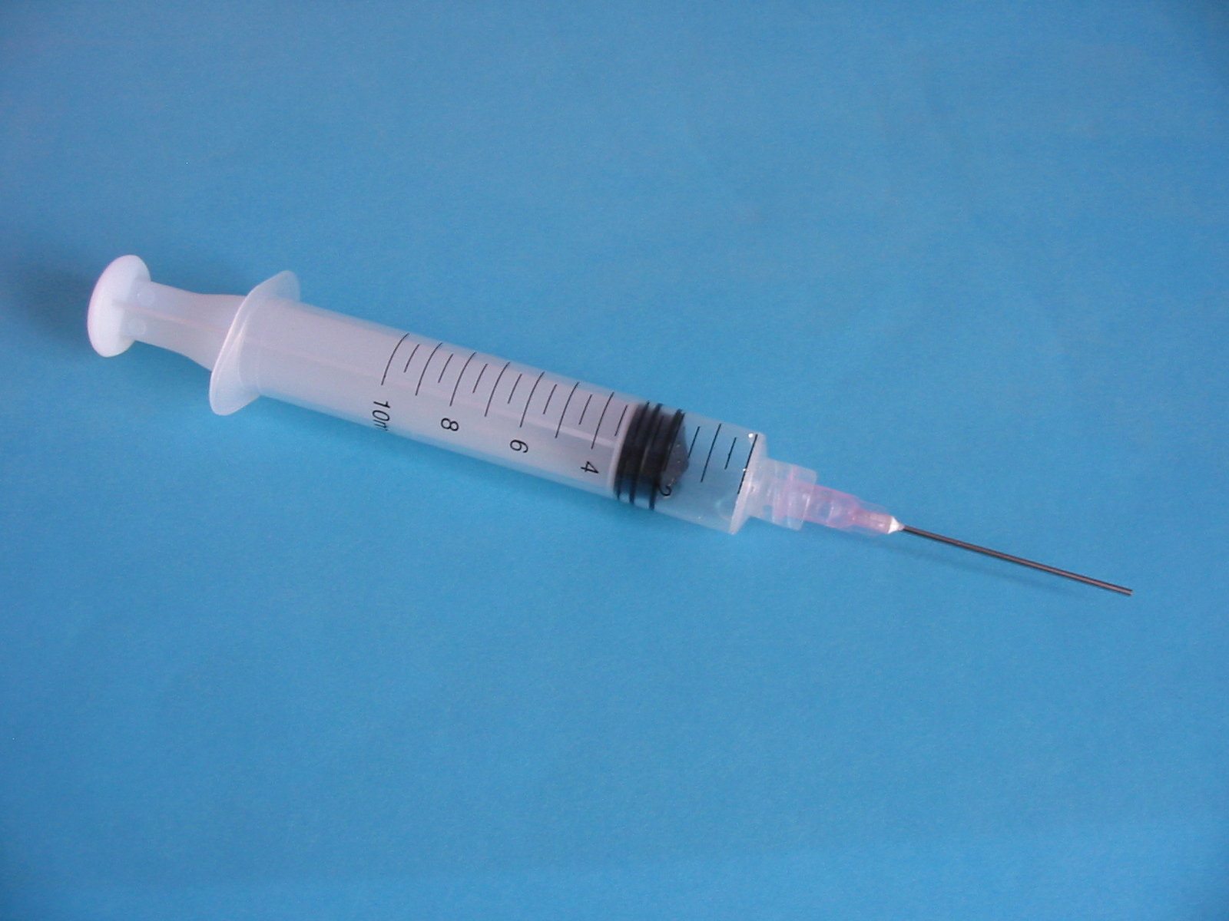
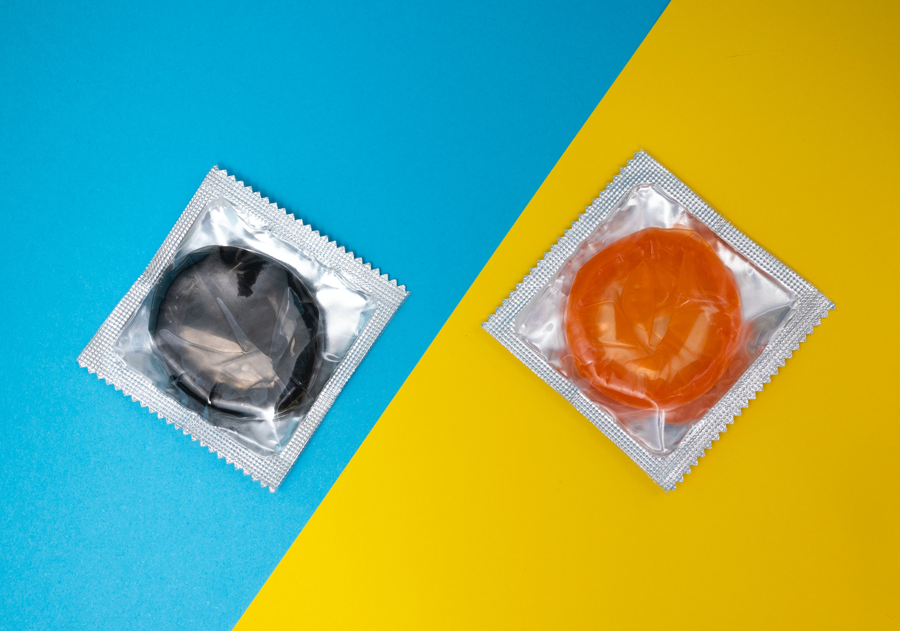

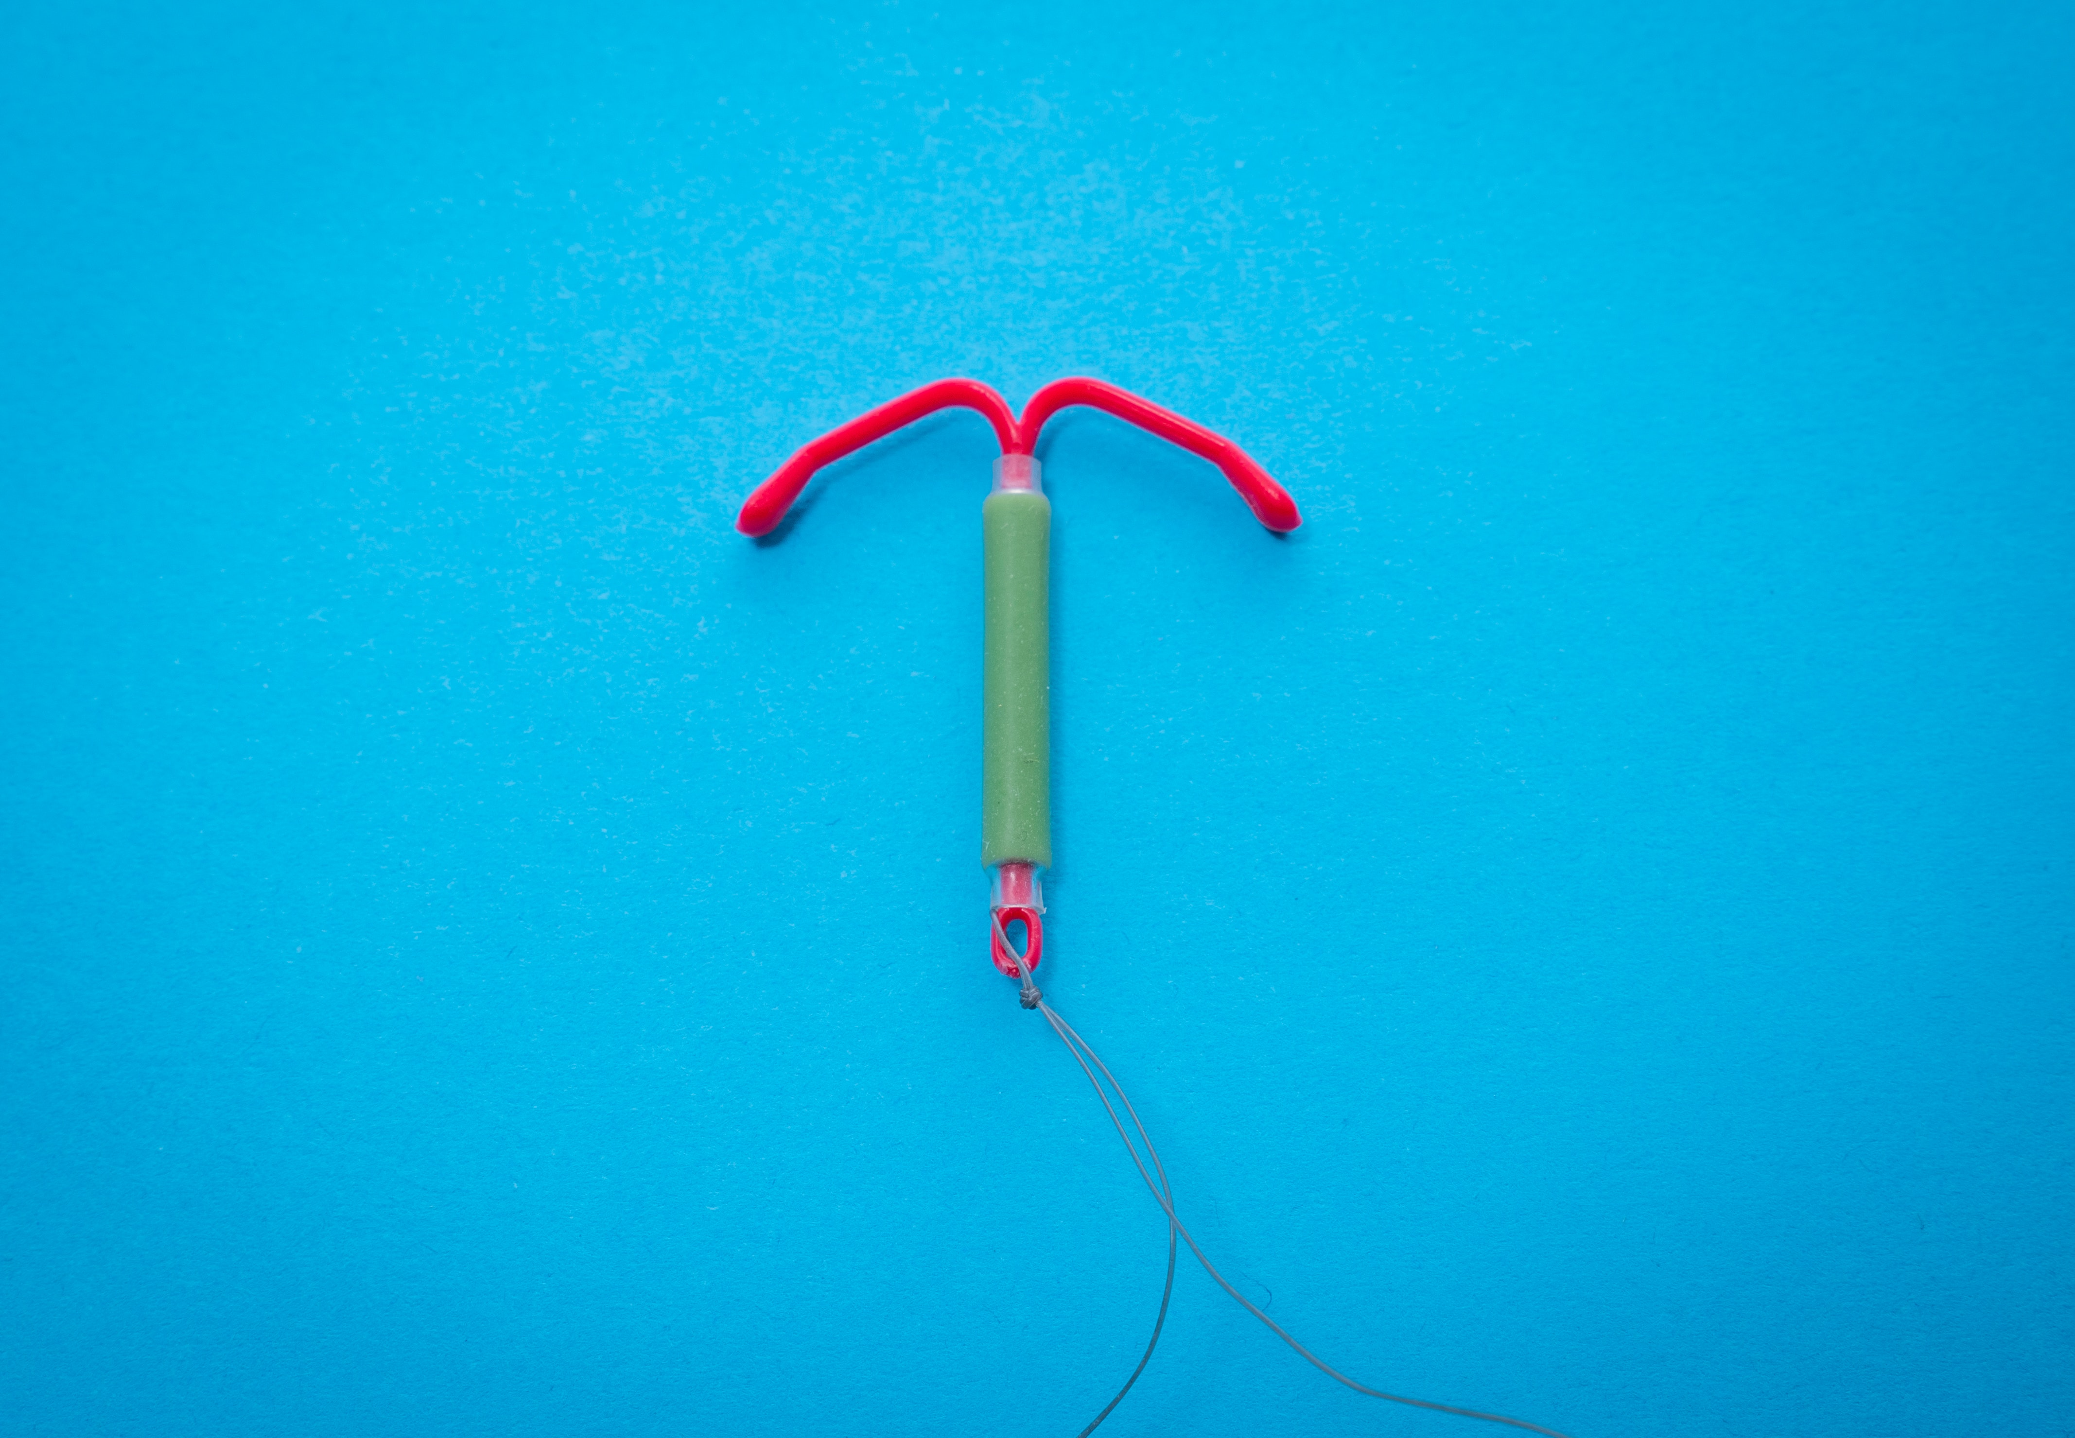
Contraception
Preventing pregnancy, also known as birth control
Abstinence
Hormonal Methods
Non-Hormonal (Barrier) Methods
Surgical Methods

Slide 13
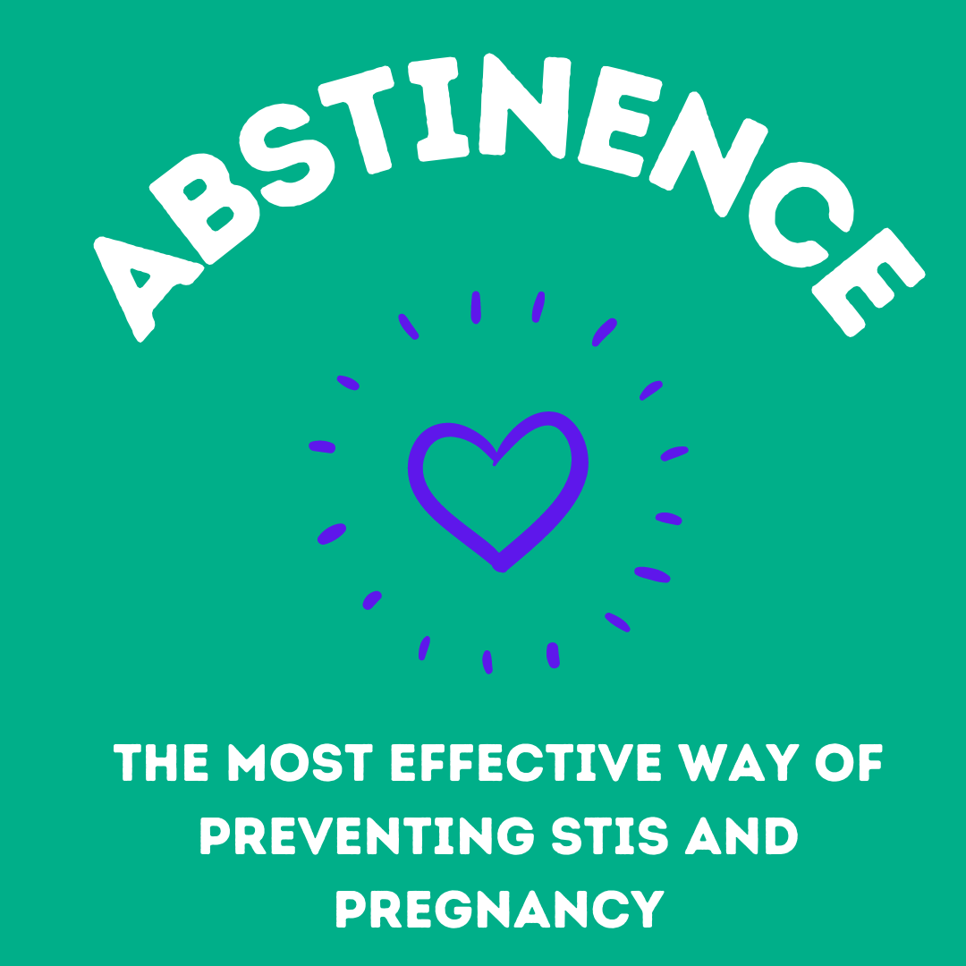
Notes:
Abstinence is the only 100% effective method against STIs and pregnancy if there is no vaginal, anal, oral sex or skin to skin contact.
Ask the class what other ways two people can be intimate if they are practicing abstinence. (e.g. hugging, holding hands, kissing)
“No one should feel pressured to engage in sexual activity” (Ontario Curriculum, Grades 1-8; Health and Physical Education 2019)
What should students consider when setting personal limits on physical intimacy? e.g. family and personal values, religious beliefs, risks and how to reduce risks
Image source: canva.com

Slide 14
What is Abstinence?
Abstinence means to not do something
Sexual abstinence means to abstain from different levels of sexual activity
Possible choices for sexual abstinence could be:
  Avoiding vaginal and anal intercourse
  Avoiding oral-genital contact
  Avoiding genital contact
Notes:
Ensure that the students note that:
. there is confusion, even among adults, about whether having sex includes only intercourse
. Canadian young people are experimenting with different levels of sexual activity
. oral sex is not free of STI and other risks
. abstaining at lower levels of sexual activity (outercourse) can eliminate risk of pregnancy and STI
Abstaining is not necessarily forever, and it is not only for virgins.

Slide 15
Hormonal Methods of Birth Control
Contain estrogen, or estrogen and progesterone
Can prevent pregnancy by:
  Stopping the release of a mature egg
  Thickening cervical mucous
  Changing the lining of the uterus
DO NOT protect against Sexually Transmitted Infections (STIs)
Notes:
Estrogen and progesterone are the hormones produced in the ovaries.
* Please note the effectiveness rates on the following slides are based on "typical" use. *

Slide 16
The Pill
Must be taken consistently every day
91% effective
Notes:
There are combination pills that contain estrogen and progestin and progestin-only pills.
To be fully effective at preventing pregnancy, the pill needs to be taken at the same time every day for a full cycle (28 days), before intercourse.
A prescription from a healthcare provider is needed.
The pill does not protect against sexually transmitted and blood-borne infections, using a condom as well as being on the pill will provide additional protection.
The combination pill may decrease acne, improve period symptoms such as cramping, and regulate the menstrual cycle.
The pill is reversible, when someone stops taking it, they can get pregnant.
References:
https://www.sexandu.ca/contraception/hormonal-contraception/#tc1
https://sexualhealthontario.ca/en/reproductive-health#birth-control
Image Source: https://unsplash.com/photos/fgqLiOKNjU8

Slide 17
Transdermal Patch
Releases hormones through the skin.
Patch is replaced weekly, 3 times each month.
91% effective
Notes:
The patch contains estrogen and progestin and is absorbed through the skin.
It is adhesive and can be placed on the buttocks, upper outer arms, lower abdomen, or upper torso excluding the breast
A new patch is applied once a week and the old patch is removed.
To be fully effective at preventing pregnancy, patches need to be worn for a full cycle before intercourse.
A prescription from a healthcare provider is needed.
The patch does not protect against sexually transmitted and blood-borne infections, using a condom as well as using the patch will provide additional protection.
The patch may improve period symptoms such as cramping and regulate the menstrual cycle.
The patch is reversible, when someone stops using it, they can get pregnant.
References:
https://www.sexandu.ca/contraception/hormonal-contraception/#tc1
https://sexualhealthontario.ca/en/reproductive-health#birth-control
Image Source: https://unsplash.com/photos/lR1eWq2nl-Y

Slide 18
Vaginal Ring
Brand name: Nuva Ring
Flexible ring inserted into the vagina once a month
91% effective
Notes:
The vaginal ring contains estrogen and progestin and is absorbed through the vagina.
It is inserted and removed by the user into the vagina once a month, the walls of the vagina hold it in place and usually cannot be felt.
To be fully effective at preventing pregnancy, the vaginal ring needs to be used for a full cycle before intercourse.
A prescription from a healthcare provider is needed.
The vaginal ring does not protect against sexually transmitted and blood-borne infections, using a condom in addition to the ring will provide additional protection.
The vaginal ring may improve period symptoms such as cramping and regulate the menstrual cycle.
The vaginal ring is reversible, when someone stops using it, they can get pregnant.
References:
https://www.sexandu.ca/contraception/hormonal-contraception/#tc1
https://sexualhealthontario.ca/en/reproductive-health#birth-control
Image Source: https://unsplash.com/photos/utxGYPso0ZM

Slide 19
Intrauterine System – IUS
Brand name: Kyleena and Mirena
T-shaped device inserted in the uterus by a healthcare professional.
The IUS is a hormonal birth control method.
Decreases or eliminates your period.
Can remain in place for 5 years.
99% effective
Notes:
All IUSs require a prescription and need to be inserted by a healthcare provider
IUSs can remain in place for 5 years.
IUSs do not protect against sexually transmitted and blood-borne infections, using a condom as well as having an IUS will provide additional protection.
There are 2 types of Intrauterine Contraception (IUC):
-the levonorgestrel-releasing intrauterine system (contains a progestin hormone), also known as LNG-IUS
-decreases or eliminates periods
-the copper intrauterine device (no hormone), also known as CU-IUD – More on this in the next section (Non-hormonal methods)
Reference: https://www.sexandu.ca/contraception/hormonal-contraception/#tc4 and https://www.sexandu.ca/contraception/non-hormonal-contraception/#tc9
References:
https://www.sexandu.ca/contraception/hormonal-contraception/#tc1
https://sexualhealthontario.ca/en/reproductive-health#birth-control
Image Sources: https://unsplash.com/photos/rI0Uc7BPExo
reproductive-health-supplies-coalition-cHrcHdg2H9E-unsplash.jpg

Slide 20
Injectable Contraceptive
Brand name: Depo Provera
Injection of progestin administered every 12-13 weeks
94% effective
Notes:
Also known as the birth control shot
The shot (Depo Provera) contains progestin and is injected into the muscle by a healthcare provider
The shot is given once every 12-13 weeks
A prescription from a healthcare provider is needed.
The shot does not protect against sexually transmitted and blood-borne infections, using a condom as well as being on Depo Provera will provide additional protection.
The shot decreases or eliminates periods and may be suitable for individuals who cannot take estrogen.
The shot is reversible, when someone stops using it, they can get pregnant.
References:
https://www.sexandu.ca/contraception/hormonal-contraception/#tc1
https://sexualhealthontario.ca/en/reproductive-health#birth-control
Image Source: https://upload.wikimedia.org/wikipedia/commons/1/1d/Syringe2.jpg

Slide 21
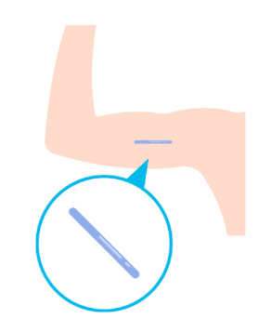
Contraceptive Implant
Brand name: Nexplanon
Flexible Rod that sits just below the skin of your inner arm.
Lasts up to three years
Over
99% effective
Notes:
The contraceptive implant is a contraceptive method that was approved for use in Canada in May 2020. It has been used in many other countries, including the United States, for many years. It is a 4 cm long and 2 mm wide flexible rod that sits just below the skin and continuously releases a progestin hormone into the bloodstream. It is inserted in the office by a health care provider using local anesthetic to numb the skin and provides reversible and highly effective birth control for up to three years by preventing ovulation.
Over 99% effective, which means less than 1 women out of 1000 will get pregnant while using the implant.
Source: https://www.sexandu.ca/contraception/hormonal-contraception/#tc6
https://www.nexplanon.com/effectiveness/
Image: Canva

Slide 22
Side Effects of Hormonal Methods
During the first few months of being on hormonal contraception, people can experience:
  irregular bleeding, spotting
  nausea
  mood swings
  bloating
  breast tenderness
  headaches
Notes:
Reason:
The body is getting used to birth control
Fluctuating hormone levels when birth control is started
When will it stop?
Most symptoms are normal and will decrease or stop in the first 2-3 months.
If they bother you or don’t get better:
Talk to your healthcare provider
There might be a method that’s better suited for you.

Slide 23
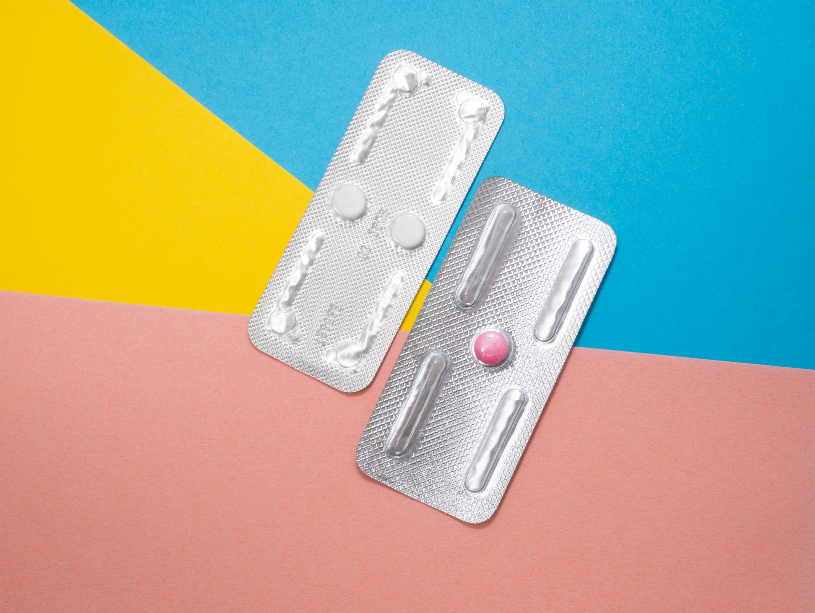
Emergency Contraception
(the morning after pill)
Can be taken up to 5 days after intercourse
Delays or prevents the release of an egg
May prevent implantation of a fertilized egg
The sooner it is taken, the better it works
Occasional use only, not intended to be used as a primary method of birth control
Notes:
Also known as the “morning after pill”
A pill or pills taken after intercourse where other pregnancy prevention methods were not in place or have failed.
e.g. condom breakage, a missed pill, patch or injection
Emergency contraception is
95% effective if taken within 24 hours of intercourse
85% effective if taken 25-48 hours after intercourse
58% effective if taken 49-72 hours after intercourse
Some brands of morning after pill are available at a pharmacy without a prescription. It is important to read the packaging or speak to the pharmacist to ensure it is taken correctly and appropriately.
Some brands of morning after pill are available with a prescription from a healthcare provider.
Insertion of a copper IUD by a healthcare provider up to seven days after unprotected sex can also be used an emergency contraception
Reference: https://www.sexandu.ca/contraception/emergency-contraception/
Image Source: https://unsplash.com/photos/F2bTuiboieg

Slide 24
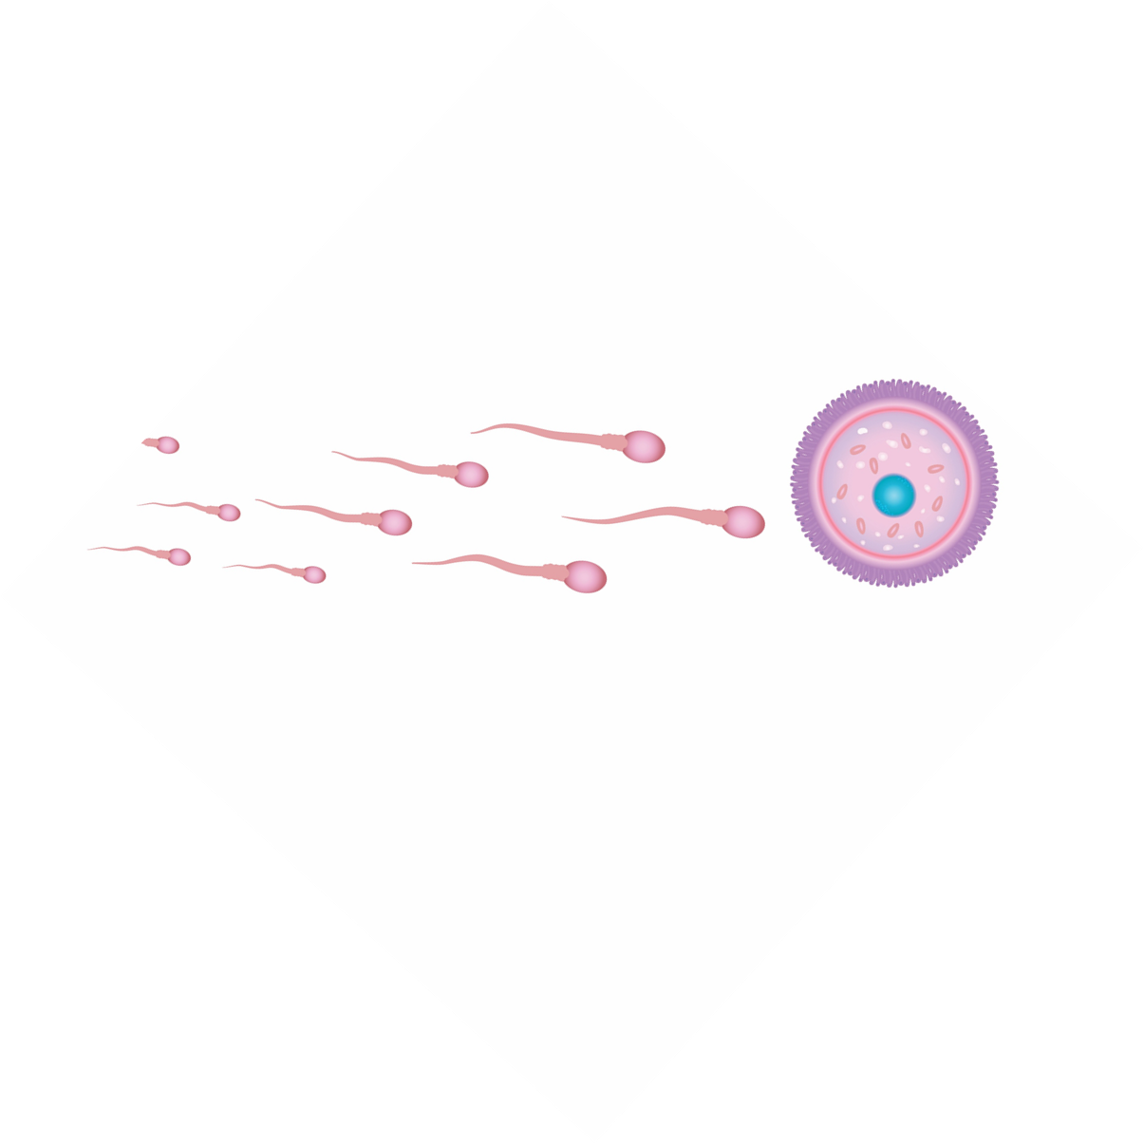
Non-Hormonal Methods
Prevents sperm and egg from meeting

Slide 25
Condom
Worn on an erect penis to catch sperm during ejaculation
82% effective
Condom Demonstration Video (YouTube sign in required)
Notes:
Condom Demonstration: (may choose to demonstrate with a real condom while showing the slides)
https://teachingsexualhealth.ca/teachers/resource/using-a-condom-video/
Condoms are widely available at low or no cost and no prescription is required
Condoms catch sperm during ejaculation, preventing it from fertilizing an egg.
Made of thin latex or polyurethane
Condoms reduce the risk of spreading sexually transmitted and blood-borne infections and can be used in addition to other birth control methods for greatest protection.
Condoms need to be put on an erect penis before any skin to skin contact and removed and thrown away after ejaculation.
A new condom is needed with every act of intercourse.
Condoms have an expiry date and need to be stored correctly to reduce the risk of breaking.
Reference: https://www.sexandu.ca/contraception/non-hormonal-contraception/
Image Source: h ttps://unsplash.com/photos/Wb-rLP27Gvo

Slide 26
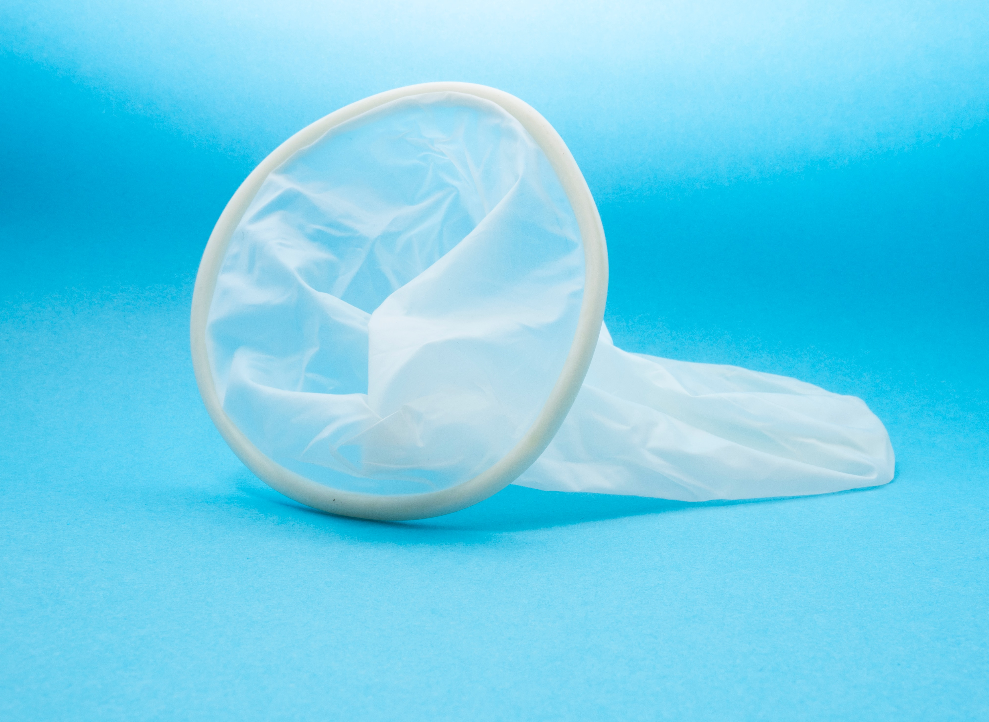
Internal Condom
Polyurethane sheath inserted into the vagina before sex
82% effective
Notes:
Provides a physical barrier to prevent sperm from entering cervical canal. Sperm is trapped in the condom which is thrown away after use.
Made of polyurethane, may be suitable for folks with an allergy to latex
Smaller flexible ring is inserted in the vagina and the larger ring sits outside of the vagina
Reduces the risk of spreading sexually transmitted and blood-borne infections and can be used in addition to other birth control methods for greatest protection.
A new condom is needed with every act of intercourse.
Available without a prescription at some pharmacies
Note: Also referred to as ‘female’ condom
Reference: https://www.sexandu.ca/contraception/non-hormonal-contraception/#tc2
Image Source: https://unsplash.com/photos/13TFAniXyKI

Slide 27
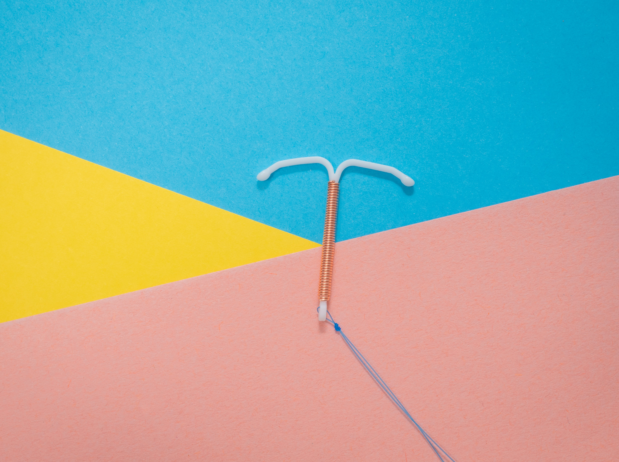
Intrauterine Device – IUD
T-shaped device inserted in the uterus by a healthcare professional
The IUD is a non-hormonal form of birth control that can remain in place for 5-10 years.
Also used as a form of emergency contraceptive up to 7 days after unprotected intercourse.
99% effective
Notes:
-the copper intrauterine device (no hormone), also known as CU-IUD
-Can be inserted up to 2 weeks following unprotected intercourse as an effective form of Emergency contraceptive.
Reference: https://www.sexandu.ca/contraception/hormonal-contraception/#tc4 and https://www.sexandu.ca/contraception/non-hormonal-contraception/#tc9
https://sexualhealthontario.ca/en/reproductive-health#birth-control
Image Sources: https://unsplash.com/photos/rI0Uc7BPExo
reproductive-health-supplies-coalition-cHrcHdg2H9E-unsplash.jpg

Slide 28
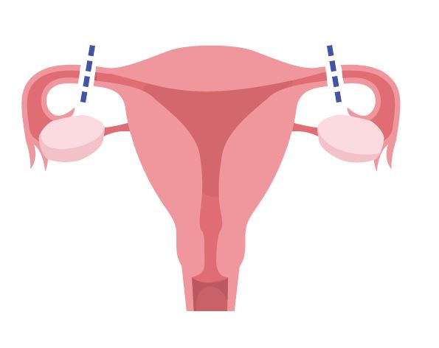
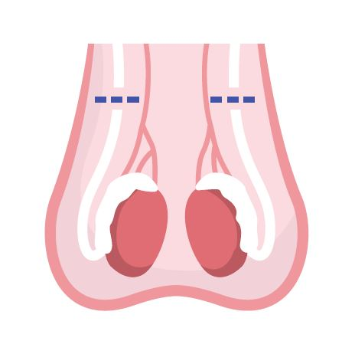
Surgical Methods
Tubal Ligation: A surgical procedure to close or block the fallopian tubes ensuring sperm and egg do not meet
Vasectomy: A surgical procedure to close or block the vas deferens
Notes:
Sterilization – Person with a Vulva= Tubal Ligation
Permanent; only for people who are absolutely sure their family is complete or they do not want to have any children themselves
Abdominal surgery
Sterilization – Person with a Penis = Vasectomy
How does it work?
• The vas deferens are closed so that no sperm is released to fertilize the egg
• Common techniques include:
• Conventional vasectomy – one or two incision are made in the scrotum to reach the vas deferens
• No-scalpel vasectomy – a puncture opening is made in the scrotum
• Vas deferens are closed by:
• Electric current (cauterization)
• A mechanical method, such as a clip
• Removal of a small segment of each tube
• Another form of contraception is required until a semen analysis shows no sperm
What are the advantages?
1. No contraceptive routine required; nothing to remember
2. Private
3. Does not interfere with intercourse
4. No significant long-term side effects
5. Simple procedure
6. Less invasive and more cost-effective than tubal ligation
What are the disadvantages?
1. Difficult to have reversed
2. Possible post-sterilization regret
3. Possible short-term surgery-related complications: pain and swelling; vasovagal reaction; infection at the incision site
4. Does not protect against STIs
5. Not effective immediately. Must do a follow-up sperm analysis that shows no sperm are present in the semen
Typical effectiveness is 98%
Image source: purchased Adobe stock

Slide 29
Who to talk to
Partner
Parents or other family members
Other trusted adults (teachers)
Health professionals (Your school public health nurse)
Notes:
Partner: Having a discussion about contraception before being sexually active allows individuals to consider their personal values and options before being in the moment. Many contraceptive options require an appointment with a healthcare provider and time to become effective.

Slide 30
Where to get more information
www.healthunit.com/birth-control-methods
www.sexandu.ca/contraception
www.itsaplan.ca

Slide 31
Birth Control Clinics
Middlesex-London Health Unit
2 locations: Citi Plaza in London and 51 Front St. in Strathroy
Birth control counselling and prescriptions
STI testing and treatment
Inexpensive birth control and emergency contraception
Free Condoms
Call 519-663-5317 to book an appointment
Notes:
At the Birth Control Clinic in London, we offer birth control, pregnancy testing and birth control counselling, emergency contraception, and Pap tests to individuals under 50 years of age. Clients are counselled about birth control options, most of which can be purchased at the clinic at an affordable price. Appointments are required and you must bring a valid health card to each visit.
Birth Control Counselling
Low cost birth control
Low cost emergency contraception
Pregnancy testing (*based on assessment)
Cervical Cancer Screening
STI/infection checks/Pelvic Pain
IUD consultation
IUD insertion
Free condoms

