Slide 1
Menstruation and Self Care
Created by: School Health Team
Created: March 2023
Last Reviewed: October 2023
Notes:
This presentation addresses topic areas of the Human Development and Sexual Health section D1.3 and D1.4 of the Grade 5 Ontario Health and Physical Education Curriculum.
To provide an inclusive environment for all students, regardless of their gender identity, we use the names of body parts and hormones to discuss physical differences rather than the use of gender.

Slide 2
Class Guidelines
Giggling is okay
Be respectful
Everyone is learning, ask questions!
Discuss puberty topics responsibly outside the classroom
Notes:
Ask students to contribute ideas to add to the guidelines

Slide 3
What is puberty?
Time of change from child to adult
Physical changes
Emotional changes
The body becomes fertile
Notes:
There are 3 major growth spurts: 1-the development of a baby before birth, 2-birth to one year old, 3-PUBERTY
Fertile-The body is starting to produce the cells that are necessary to make a baby
Consider asking the class about ceremonies or celebrations that might be celebrated in their families related to puberty

Slide 4
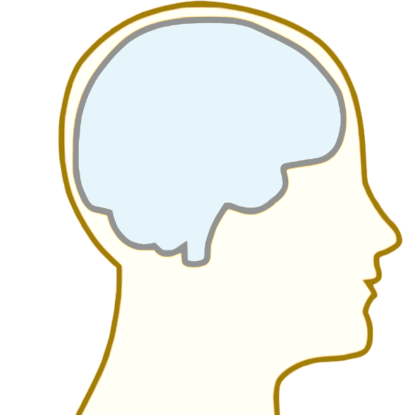
When does puberty start and why?
Puberty begins when youth are between 8-15 years old
The brain sends a signal to the reproductive organs to produce hormones
Notes:
Everyone’s body is different. For example, people are different heights and have different hair colour, it is normal that not everyone looks the same.
When puberty starts and how long the process takes can vary greatly from one person to the other, which is something we don’t have control over and is completely okay.
Image source: https://pixabay.com/vectors/brain-anatomy-man-mind-people-154297/

Slide 5
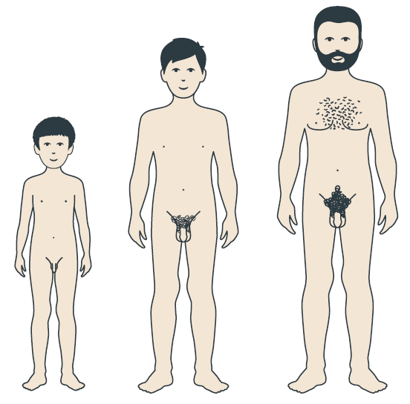
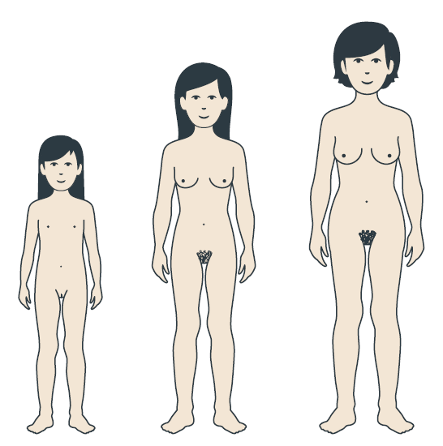
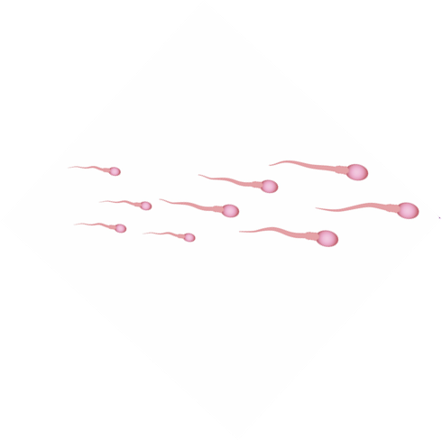
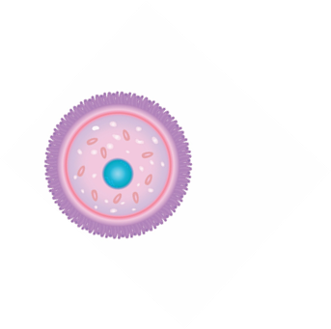
Person with a penis
Person with a vulva
Testosterone
Estrogen
Notes:
During puberty the body is starting to produce the cells that are necessary to make a baby
A person with a penis will start producing sperm in the testicles
A person with a vulva will start having eggs mature in the ovaries
Image Sources: https://www.secca.org.au/ with permission

Slide 6
Person with a vulva
Clitoris
Labia
Urethral Opening
Vaginal Opening
Anus
Notes:
Vulva - The external part of the female reproductive organs is called the vulva, which means covering. Located between the legs, the vulva covers the opening to the vagina and other reproductive organs inside the body.
Labia – Folds of skin (inner and outer) which protect the internal reproduction organs.
Urethral Opening – Opening of the urethra, the tube that connects to the bladder and releases urine
Clitoris – a highly sensitive organ above the urinary opening which may provide pleasure when stimulated.
Anus – Opening of the rectum, where feces is released
Image Source: Adobe Stock-purchased

Slide 7
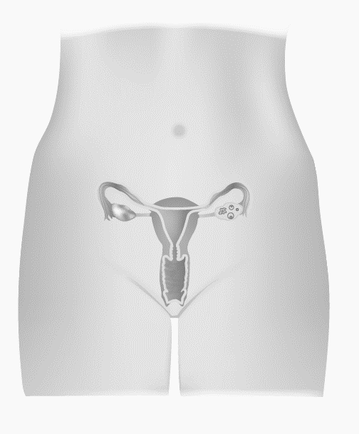
Person with a vulva
Fallopian tubes
Ovaries
Uterus
Cervix
Vagina
Notes:
Vulva – The name for the external genitalia
Ovary – Releases egg cells and produces hormones (estrogen and progesterone) on a monthly cycle.
Fallopian Tubes – Tubes leading from the ovary to the top of the uterus, with finger-like projections that surround an ovary.
Uterus – Pear-shaped organ which nourishes and holds a developing fetus. It prepares for a pregnancy each month by forming a blood and tissue lining.
Cervix – The narrow inner end of the vagina, which leads to the uterus.
Vagina – A muscular tube which expands to fit the penis during intercourse or a baby during birth.
Image Source: Adobe Stock-purchased

Slide 8
What changes can happen to a person with a vulva?
Estrogen causes:
Breasts and nipples to get larger
Hips to get wider and more curvy
Menstruation (period) to start

Slide 9
What is menstruation (a period)?
A person who has a vulva and a uterus will begin to get a period
Blood and tissue leave the body through the vagina
Happens about every month
Lasts 5-7 days
Notes:
-Menstruation starts during puberty, may not happen every month at first (every 21-45 days)
(For more detailed information on the menstrual cycle and a diagram of the uterus, see our Puberty and Reproduction presentation)

Slide 10
Person with a vulva
Menstruation Video
https://www.youtube.com/watch?v=vXrQ_FhZmos
Notes:
https://www.youtube.com/watch?v=vXrQ_FhZmos
*Note to teachers: This video includes the use of gendered language (woman, girl, her) in the explanation of menstruation. In this presentation we endeavour to be more inclusive in our education, recognizing that not all youth identify with a specific gender.

Slide 11
When do most periods start?
Periods start for most people with a vulva and a uterus when they are between 10-15 years old
Every body has its own schedule
Some clues that it will start soon:
Often periods start about 2 years after breasts start to develop
Some people have vaginal discharge (sort of like mucus) that can be seen or felt on the underwear. This discharge usually begins about 6 months to a year before the first period starts.
Notes:
-Menstruation starts during puberty, may not happen every month at first (every 21-45 days)
(For more detailed information on the menstrual cycle and a diagram of the uterus, see our Puberty and Reproduction presentation)

Slide 12
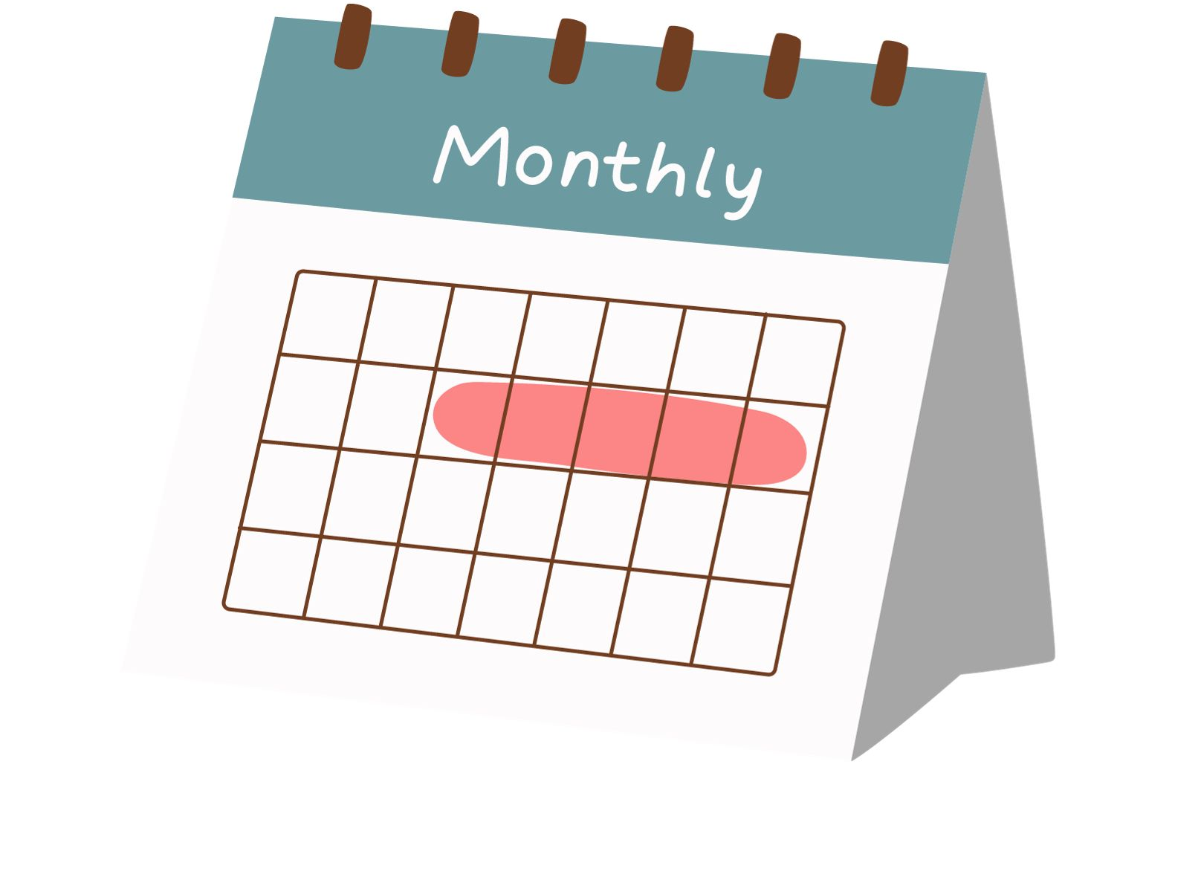
How often do periods come?
Periods may not come on a predictable schedule when they begin
After 2-3 years, periods come more regularly, they should come every 3-5 weeks
Notes:
Image source, canva.com

Slide 13
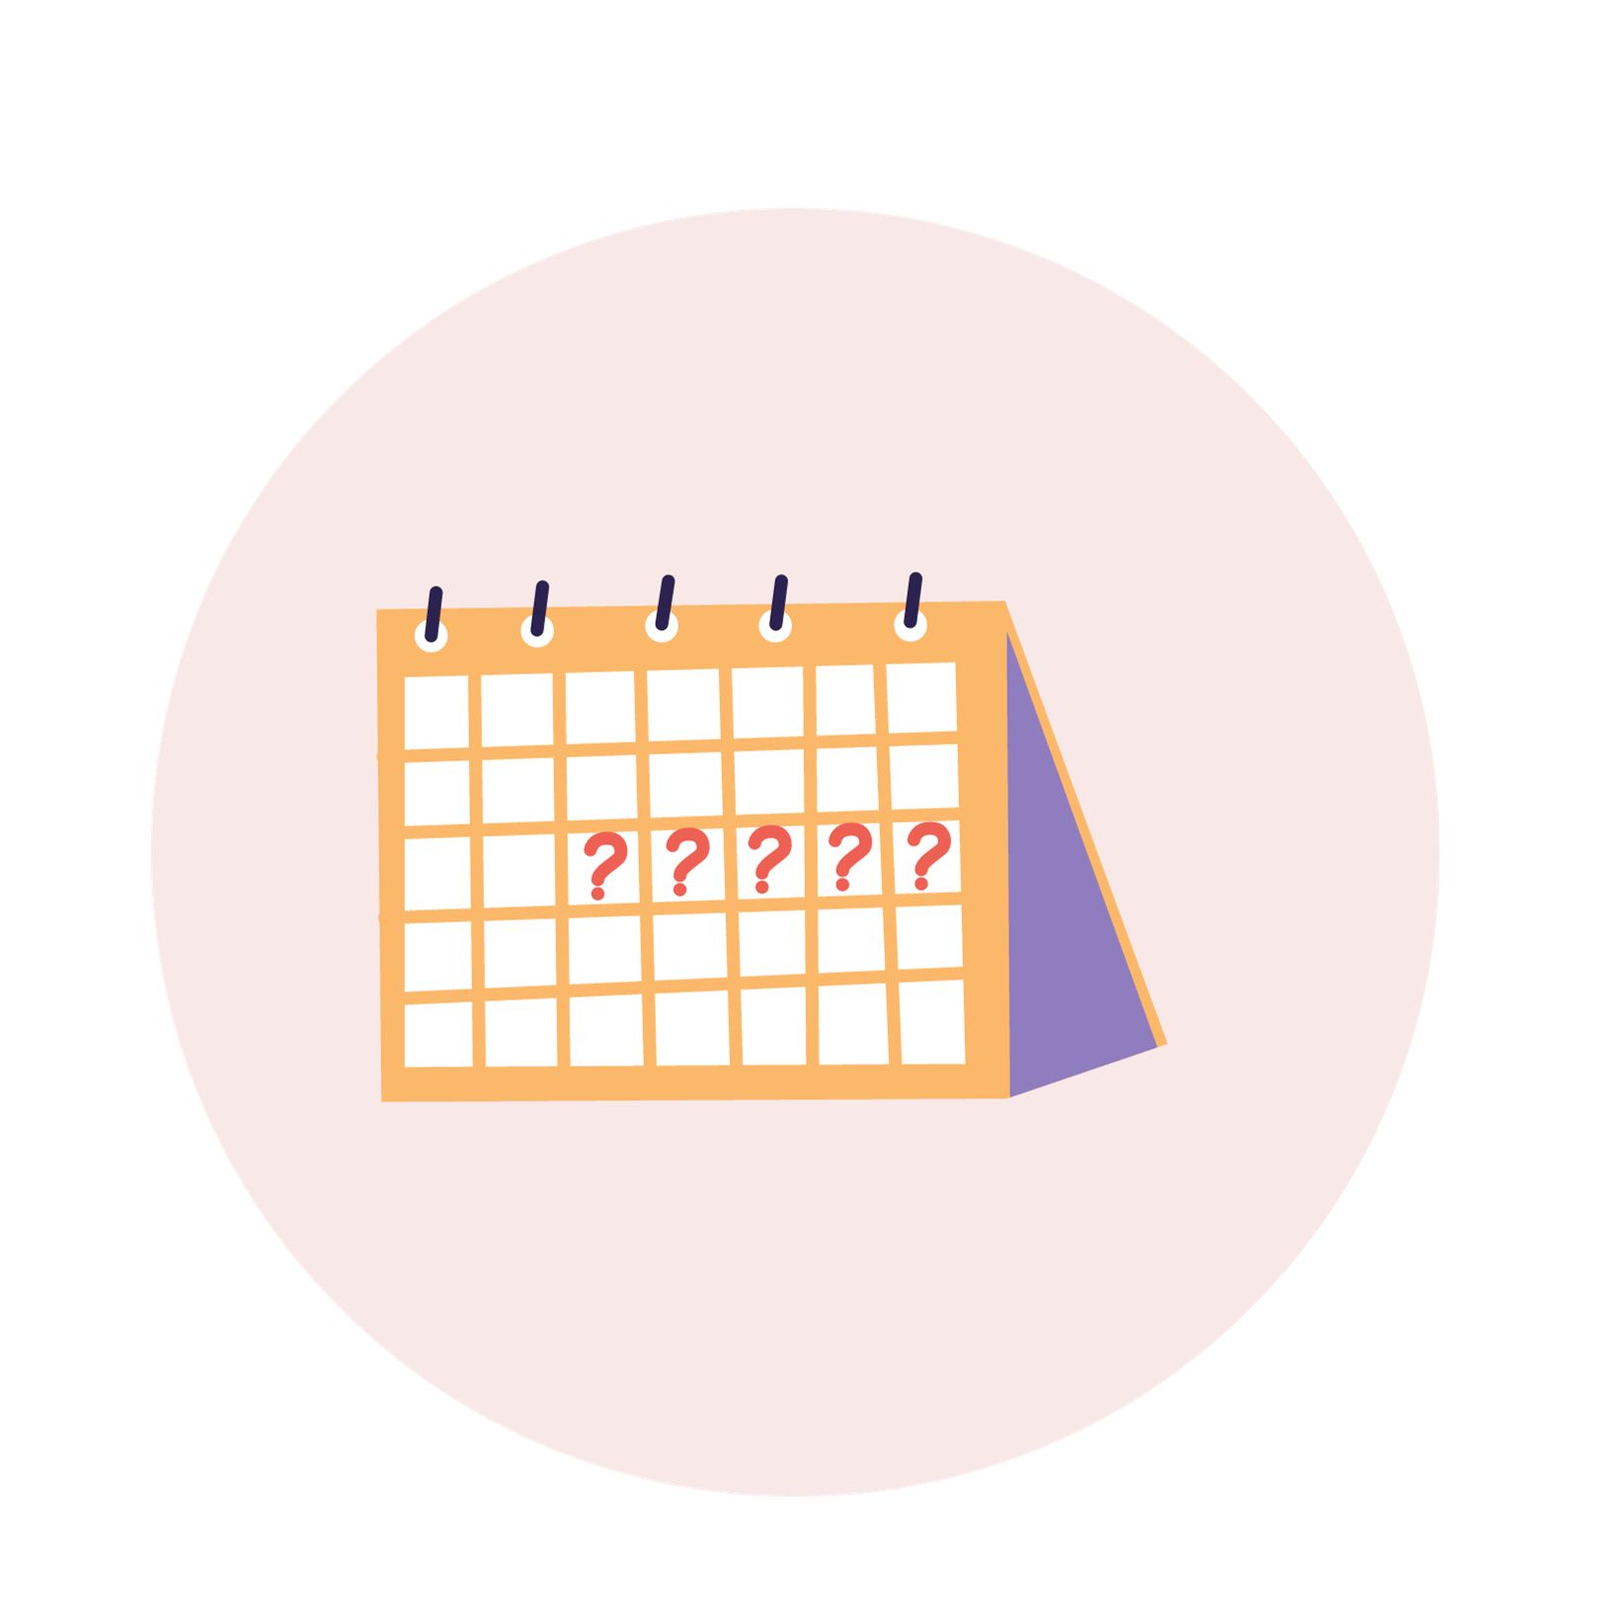
How long do periods last?
Periods usually last 5-7 days
Sometimes they are shorter or can last longer
Notes:
-Stress can affect period cycles.
Image source, canva.com

Slide 14
Period Tracking
Apps can track when your period starts and ends
Tracking can help predict when your period is going to come
Examples:
Flo
Clue
Femm
Notes:
Image source, canva.com

Slide 15
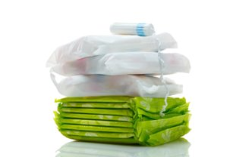
Menstrual Products
Used to catch blood and discharge keeping underwear clean
Pantyliners/Menstrual pads
Tampons
Menstrual cups
Menstrual underwear
Notes:
The type of menstrual product used is a personal choice.
Image source: adobe stock-purchased

Slide 16
Menstrual Products
All menstrual products need to be changed every couple hours to prevent infections
Notes:
Pantyliner: thin pad used for discharge or when expecting period
Menstrual pad: sticks to inside of underwear during a period
Tampon: inserted in the vagina to catch blood and discharge, can be helpful during sports and swimming
Menstrual cup: reusable, flexible cup that is placed inside the vagina to catch blood and discharge, emptied every 4-12 hours, comes in different sizes. Cups need to be cleaned and sanitized regularly
Menstrual underwear: reusable, absorbent underwear used in addition to or instead of other menstrual products, it is important to wash menstrual underwear regularly and thoroughly, according to the manufacturers instructions
The type of menstrual product used is a personal choice.
Images source: canva.com

Slide 17
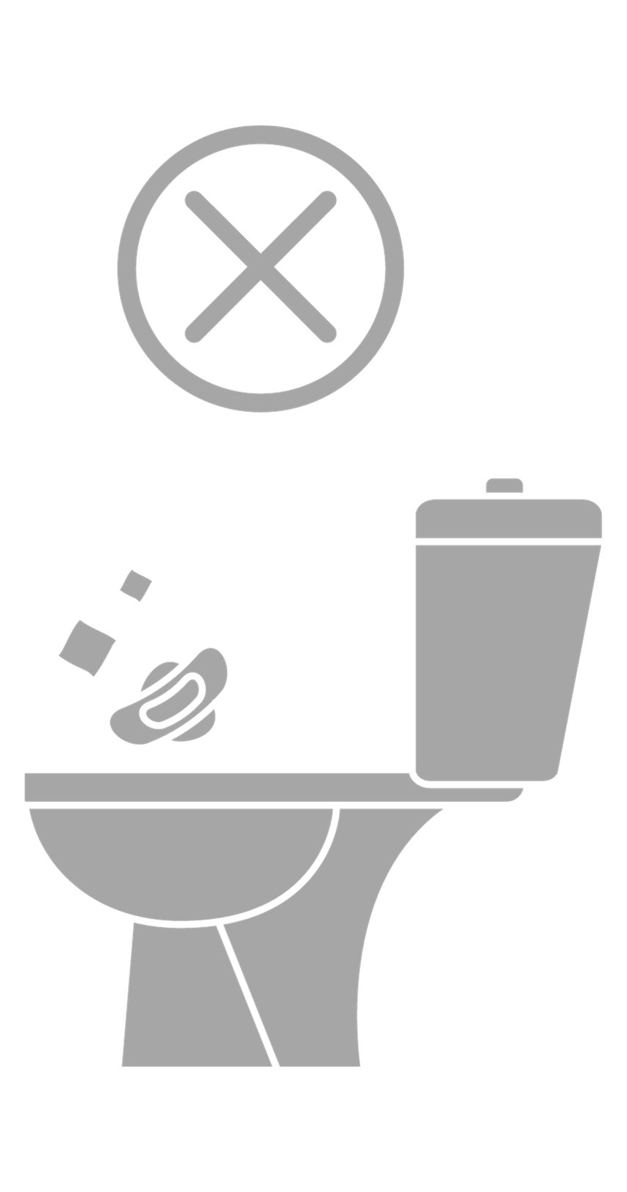
Disposing of Menstrual products
Wrap soiled tampons or pads in toilet paper before placing in the garbage
Never flush tampons, pads or applicators down the toilet
Look for small garbage containers in the bathroom stall
Notes:
Flushing sanitary products down the toilet can harm drainage pipes and the environment.
Most restaurants, schools workplaces etc. will have paper bags near the toilet where you can place your pad/tampon and then throw it in a small garbage receptacle near the toilet.
Menstrual cups are reusable- they need to be cleaned.
Period pants need to be changed regularly and washed well

Slide 18
How much blood is there?
Usually only a few tablespoons of blood and discharge is released during a period
A pad or tampon usually needs to be changed 3-6 times per day
The heaviness of period flow varies from person to person
Notes:
Menstrual cups and underwear are designed to be changed less often

Slide 19
Will I have periods for the rest of my life?
Periods usually stop around age 45-early 50’s. After periods stop, this is called menopause.
Periods do not occur during pregnancy.

Slide 20
Periods may cause:
Breast tenderness or pain​
Period Cramps​
Aches or cramps in the lower part of your belly​
Backache​
Ache along your inner thigh​
Pre-Menstrual Syndrome(PMS) ​- not everyone experiences this
Feeling swollen, headaches, acne, abdominal cramps, tired, sad, and irritable
Notes:
Breasts- due to the level of hormones before and during your period breasts may hurt or feel tender . This is caused from a change in hormone level which causes a build up of fluid in the breast. ​
Period Cramps - This can include aches or cramps in the lower part of your belly, backache and ache along your inner thigh.. This does not happen to everyone but is common. ​
Pre-Menstrual Syndrome(PMS)- the name given to symptoms which one might experience 1-14 days before your period begins. Symptoms include breast tenderness, feeling swollen or bloated, changes in appetite, headaches, constipation or diarrhea, abdominal cramps , feeling sad, tired, irritable and clumsy. ​
Everyone experiences a different combination of symptoms.

Slide 21
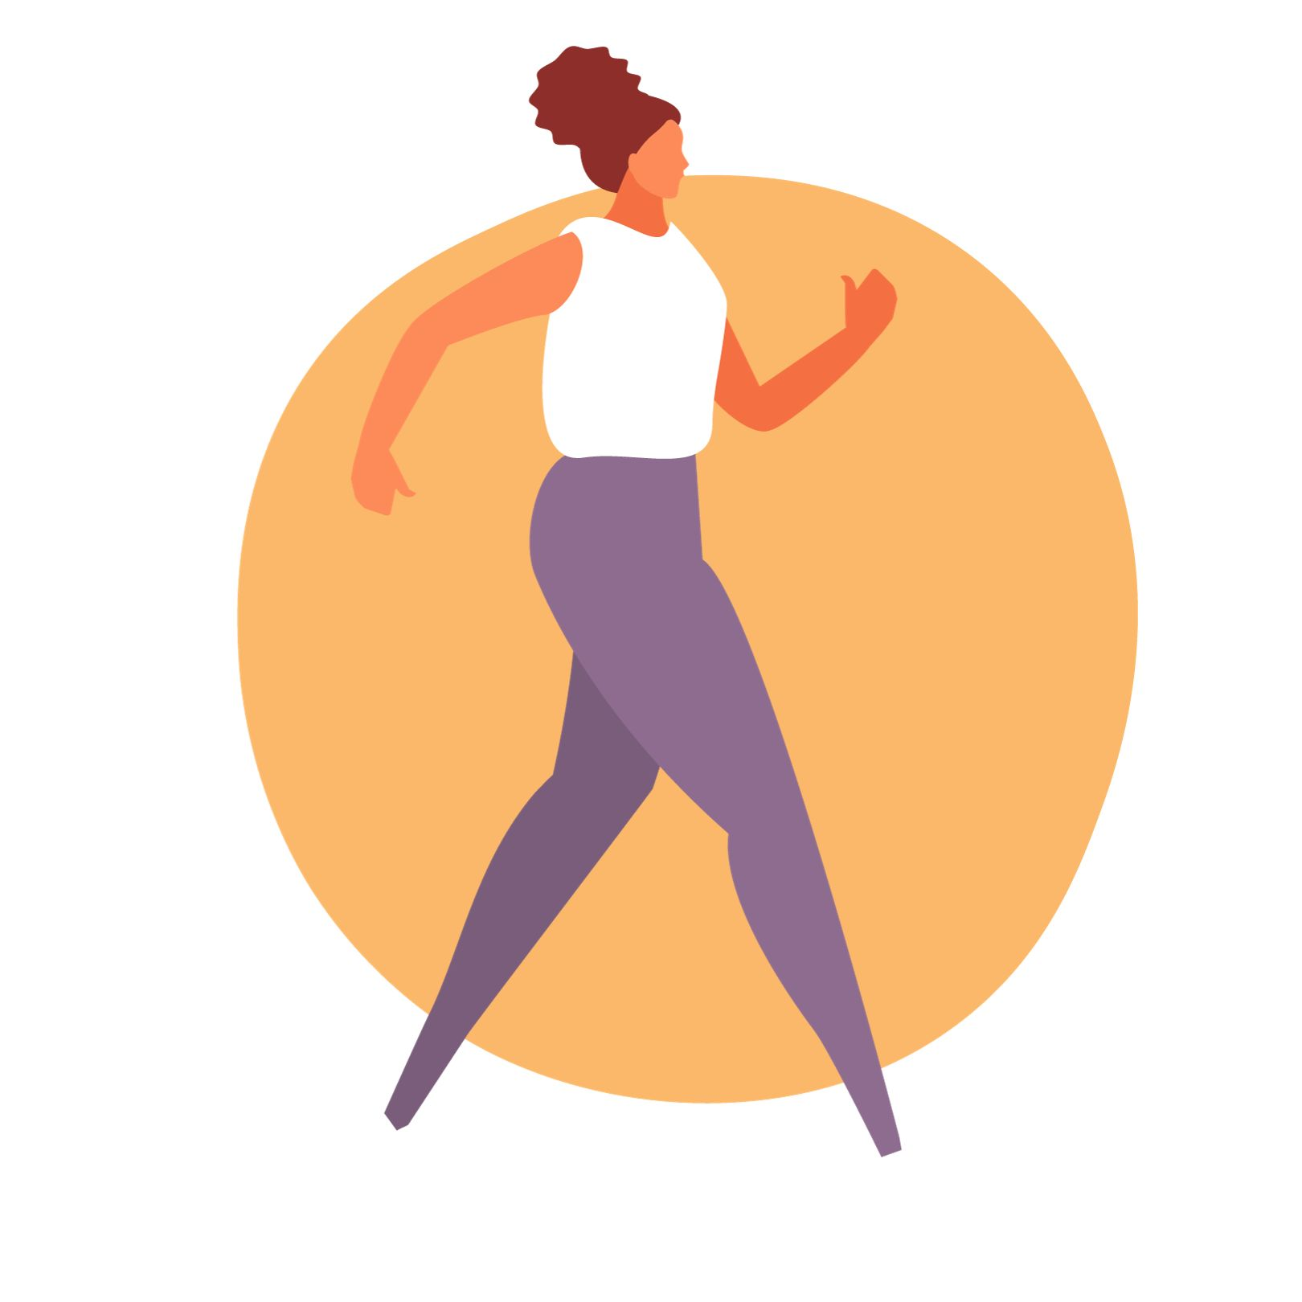
Managing Period Symptoms
Be physically active ​
Go for a walk, swim, bike or play your favourite sport.​
Take a warm bath​
Place a warm heating pad or hot water bottle on
your abdomen​
Eat a variety of foods every day
Have a sleep routine
Notes:
Quality sleep may help with moods and tiredness
Ask adult about taking medication like ibuprofen for cramps
If symptoms are not manageable, talk to a trusted adult or healthcare provider​
Image source: https://www.canada.ca/en/health-canada/services/canada-food-guide/resources/resources-download.html​, canva.com

Slide 22
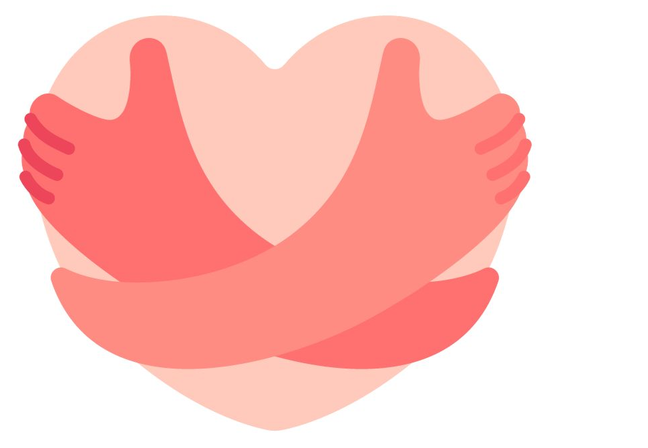
Period Self-Care
Reading a favourite book
Listening to music
Moving your body/stretching
Wearing cozy socks or clothes
Spending time with friends or family
What brings you comfort?
Notes:
Menstruating or a having a period is not an illness but it is a great time for self-care. Think about what brings you comfort

Slide 23
Choosing Food with Iron
Iron helps to build red blood cells
Meat, poultry, fish
Eggs
Beans, peas, lentils, tofu
Some vegetables such as spinach and beets
Some whole grains like quinoa, whole oats and whole grain bread
Nuts, seeds and some dried fruit
Notes:
As the body enters puberty and starts to menstruate, there is greater need to eat iron. Iron is found in many foods. Iron-rich foods should be part of meals on a regular basis.
Sources of iron that come from animals are better absorbed by the body. Vegetarians need to eat almost twice as much iron as people who eat meat, fish and poultry. If you want advice on including iron in your diet, you can speak with a Registered Dietitian through Health811, call 8-1-1.
Eat a variety of foods every day!
Reference: Iron in Foods | HealthLink BC (2022)
Image source: Canva.com

Slide 24
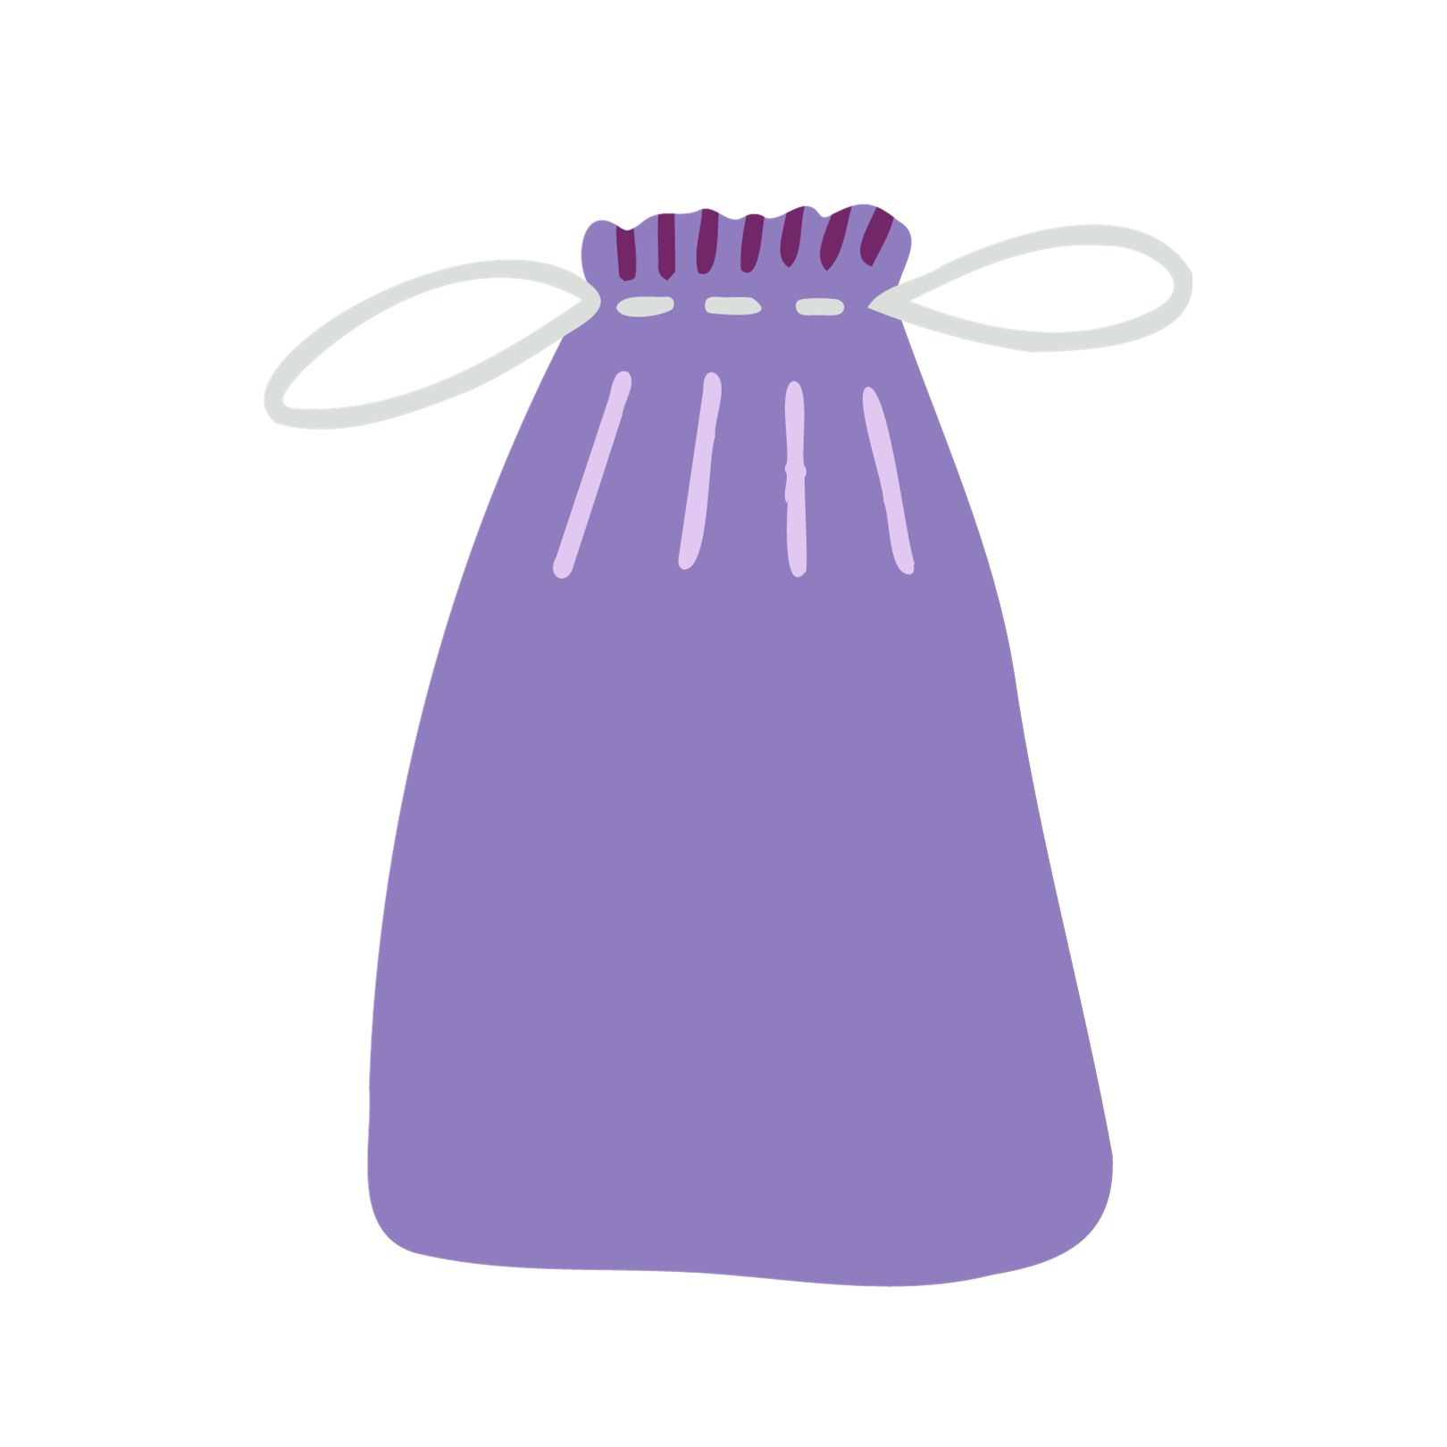
Period Prep Kit
Hygiene products
Hand sanitizer
Extra underwear
Bag for soiled underwear
Notes:
Having a stash of supplies at school can be helpful for when a period starts unexpectedly.
At home, some supplies that can help with comfort include: Rice pad or heating pad, favourite book, favourite music to move your body, an iron-rich snack, sleep mask, fuzzy socks

Slide 25
Feelings
Everyone has different feelings during puberty…this is completely normal!
What are some of the feelings you might experience?

Slide 26
Notes:
You may have mood swings
You may love your friends or family at times and not want to have anything to do with them at other times.
Sometimes you may feel grown-up, other times like a kid.
There may be lots of tears and arguments.
Changing hormones cause some of these feelings.
Image source: Wordart.com

Slide 27
Where can you get more information?
Parents or other family members
Other trusted adults (teachers)
Health professionals
Notes:
Parents can be a really good source of information when it comes to changes during puberty. They can answer questions and give great advice. Students are encouraged to share what they have learned with their parents and ask a trusted adult to answer any of their questions regarding puberty.

Slide 28
Questions?
Notes:
Information in this presentation is from: Nemours Teens Health https://kidshealth.org/en/teens/menstruation.html#catchanging-body

