Slide 1


Grade 7 Immunization Clinics
Created by: Child Health Team
Created: August 2018
Last Reviewed: June 2024
Notes:
PHN introduction script – This presentation is from the Middlesex London Health Unit and it will provide you with information to prepare for the grade 7 immunization clinic.

Slide 2
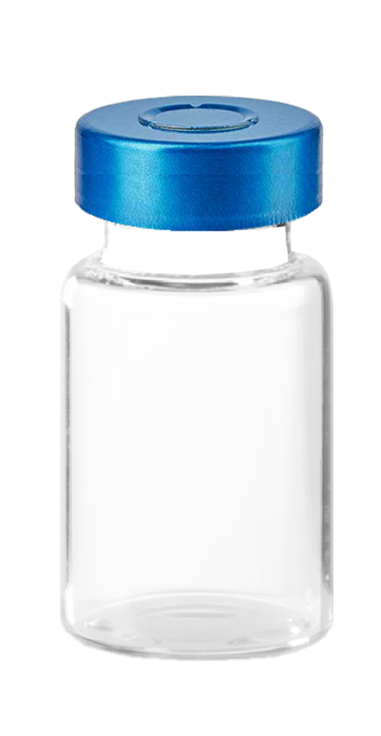
About Vaccinations
Notes:
PHN speaker notes - "We will be showing a short video next that will provide a brief explanation about why we get vaccines"
Image source: https://pixabay.com/illustrations/vaccine-ampoule-injection-vials-alu-5972694/

Slide 3


Slide 4

What Vaccines Are Given?
  Meningococcal ACYW-135
    Protects against Meningococcal Disease - mandatory
  Hep-B
    Protects against Hepatitis B – recommended
HPV-9
  Protects against HPV (human papilloma virus) - recommended
Notes:
PHN speaker notes - Here is a list of the vaccines that will be offered on clinic day. Nurses will come to the school to give these vaccinations, and they are offered to all grade 7 students as well as grade 8 students that may have not have received these vaccines. The meningococcal vaccine is mandatory under the Immunization of Schools Pupils Act, which means that you are required to get this vaccine to attend school. Sometimes, there are some medical or philosphical exemptions for which you can contact the Health Unit. Hep B and HPV are not mandatory vaccines to attend school, but are recommended.
Image source: https://pixabay.com/vectors/checkmark-tick-check-yes-mark-303752/

Slide 5

What is Meningococcal Disease?
Spread: Saliva
Impact: Infection of the lining of the brain
The Meningococcal vaccine is mandatory to attend school, you must get the vaccine or have an exemption on file.
Notes:
PHN Speaker Notes -Meningococcal disease is caused by a bacteria that can cause meningitis, which is a serious illness causing swelling of the lining of the brain and spinal cord. It is spread by saliva and you can spread it by kissing, sharing food & drinks, lip gloss, and musical instruments. Meningitis can lead to serious health complications and in some cases, death. This vaccine is offered as one dose. Students in Grade 7 can receive this vaccine for free and it is mandatory to attend school, unless there is a valid exemption on file.
Image source: https://pixabay.com/vectors/bottledwater-water-bottle-mineral-4127009/

Slide 6
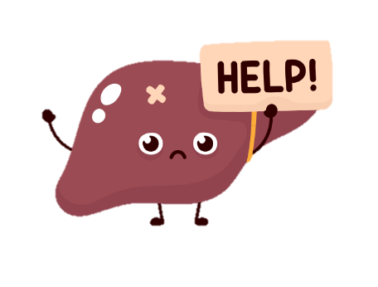
What is Hepatitis B?
Spread: Contact with infected blood & bodily fluids
Impact: Liver disease and cancer
Proof of vaccination is often required for college, university, travel or employment
Notes:
PHN Speaker Notes -Hepatitis B is a virus that affects the liver. The virus is spread through the sharing of items like razors, toothbrushes, or needles. Getting piercings or tattoos with contaminated equipment can also spread the virus. This infection can cause liver damage, cancer and possibly death. The Twinrix vaccine also protects against Hep B, some people may have received it for international travel. Be sure to include the dates of previous vaccines on the consent form so the nurse can determine if another dose is required. This vaccine is offered for free until grade 12.
Image source: canva.com

Slide 7
What is Human Papilloma Virus (HPV)?
Spread: Skin to skin contact with an infected person
Impact: Genital warts, linked to cancers
HPV-9 (Gardasil vaccine) protects against 9 types of the virus.
Notes:
PHN Speaker Notes -Human Papilloma Virus, otherwise known as HPV is a family of many viruses. HPV can be spread through skin to skin contact causing genital warts, cervical changes and many types of cancers. The vaccine helps protect against 9 strains of the HPV virus and reduces the risk of certain cancers. This vaccine is offered for free for all genders until grade 12.
Source: https://www.canada.ca/en/public-health/services/publications/healthy-living/canadian-immunization-guide-part-4-active-vaccines/page-9-human-papillomavirus-vaccine.html

Slide 8
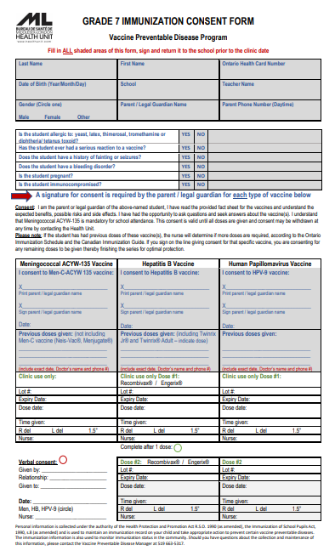
Consent and Information Forms
Notes:
PHN Speaker Notes -Information packages will be distributed to your classrooms to take home to your parent or guardian. We have forms translated in other languages, such as Arabic, Spanish and French. If your family needs assistance in completing the consent form in another language, you can: Contact Health Unit by phone, Connect with a SWIS Worker or ESL Teacher, or ask for help from a friend or family member. Consent forms are to be signed by a parent/guardian, and not the student. Please ensure to complete the student information at the top, answer the health questions, and sign consent for EACH vaccine . Return the form to the teacher before the clinic day.

Slide 9
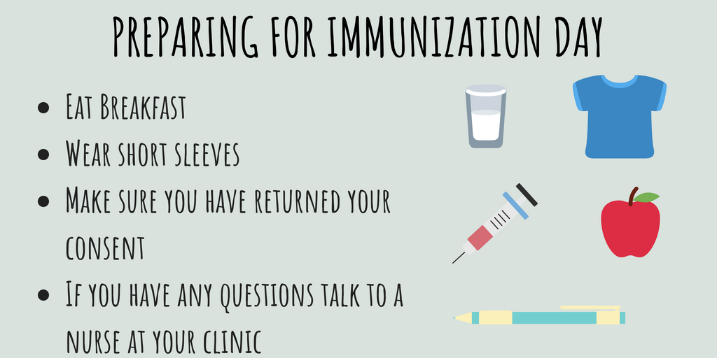

Preparing for Immunization Day
Notes:
PHN Speaker Notes -The following video explains how to prepare and what to expect on immunization day.

Slide 10
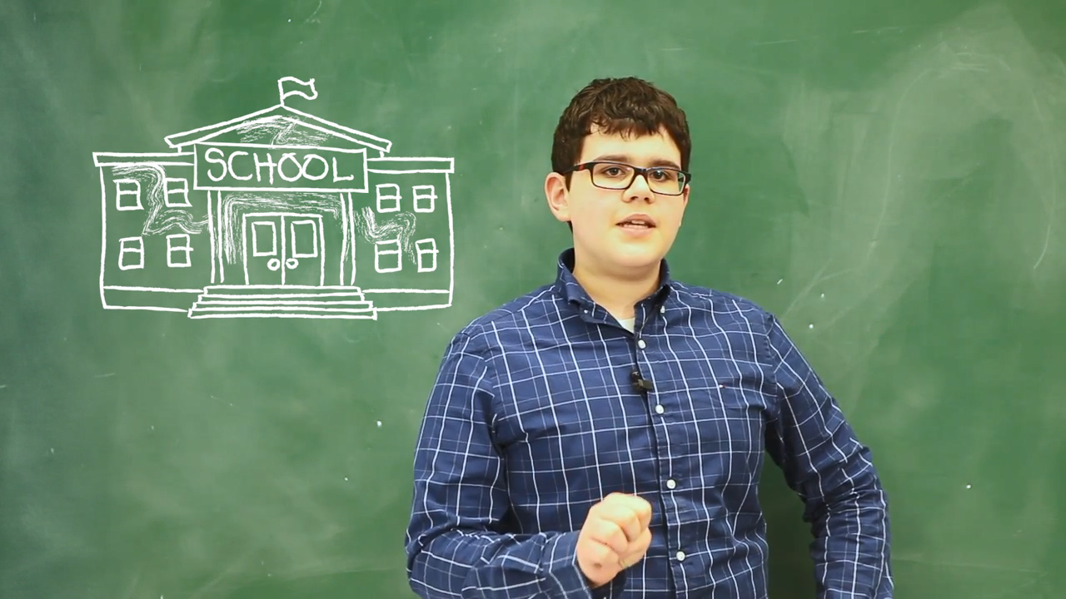
Notes:
Video plays at 2min 33sec
PHN Speaker Notes -Another good tip is to remember to eat breakfast and lunch on the day of your immunizations. Wear short sleeves or something that is easy to pull up on the day of the clinic so that the upper arm can be reached easily. 1-3 needles are given in the fall depending on which vaccines have been consented for. After the needle is given, stay seated for 15min. There will be a second vaccine clinic in the spring.

Slide 11

Important Reminder
Please respect your classmates and their privacy
Notes:
PHN Speaker Notes -It is important to be respectful of your classmates and their privacy. You can help or support others who might be nervous or stressed during the clinic. Everyone deserves respect.
Image source: https://pixabay.com/images/search/boy%20friends%20hugging/

Slide 12
Did you know?
The Health Unit has records of most previous vaccinations and will only give you what you need and have consent for.
Notes:
PHN Speaker Notes –If you have vaccine records from other countries please contact the Health Unit.

Slide 13

Did you know?
If you lose or forget your consent form on the day of the clinic, the nurse may call home to get verbal consent for your immunizations.
Notes:
PHN Speaker Notes –Immunizations are only given with consent, if we do not have your consent form we may call home to talk to a parent or guardian for consent.

Slide 14
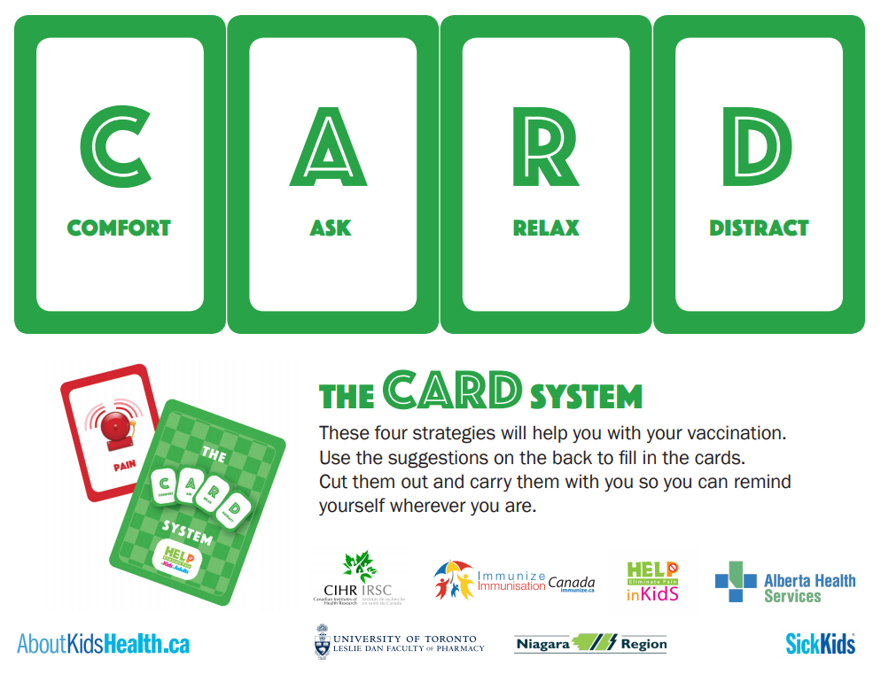
Strategies to help with vaccination
Notes:
PHN Speaker Notes -The CARD system provides four strategies to help you to prepare for immunizations. C stands for comfort, A stands for ask, R stands for relax and D stands for distract.

Slide 15
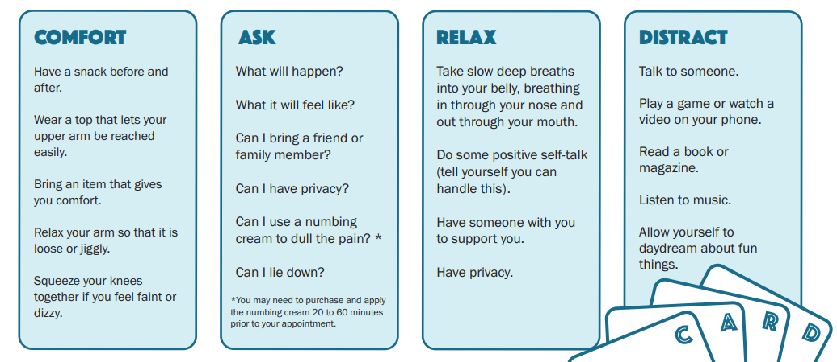
Strategies for a positive vaccination experience
Notes:
PHN Speaker Notes -Here are some examples of different strategies: wear a short-sleeved shirt, ask questions, take slow deep breaths, or talk with someone to distract yourself. Which strategies would work best for you?
Optional Video explaining the CARD System https://youtu.be/c41HvgEKQSk (7:46)
https://assets.aboutkidshealth.ca/AKHAssets/CARD_Vaccination_Handout.pdf
https://assets.aboutkidshealth.ca/AKHAssets/CARD_Vaccination_Poster.pdf
French CARD System Poster: https://immunize.ca/sites/default/files/Resource%20and%20Product%20Uploads%20(PDFs)/Products%20and%20Resources/Pain%20Management/Individuals/card_teens_2021_poster_1f.pdf
French CARD System Student Handout:
https://immunize.ca/sites/default/files/Resource%20and%20Product%20Uploads%20(PDFs)/Products%20and%20Resources/Pain%20Management/Parents/SchoolVaccine-StudentHandout_Fr_10_11_2018.pdf

Slide 16

Questions?
519-663-5317
www.healthunit.com/elementary-grade-seven-clinics
Notes:
PHN Speaker Notes -If you have any questions, please visit our MLHU website or call the Vaccine Preventable Disease Team at the Health Unit. Contact information is on your consent form.
Image Source: canva.com

