Slide 1
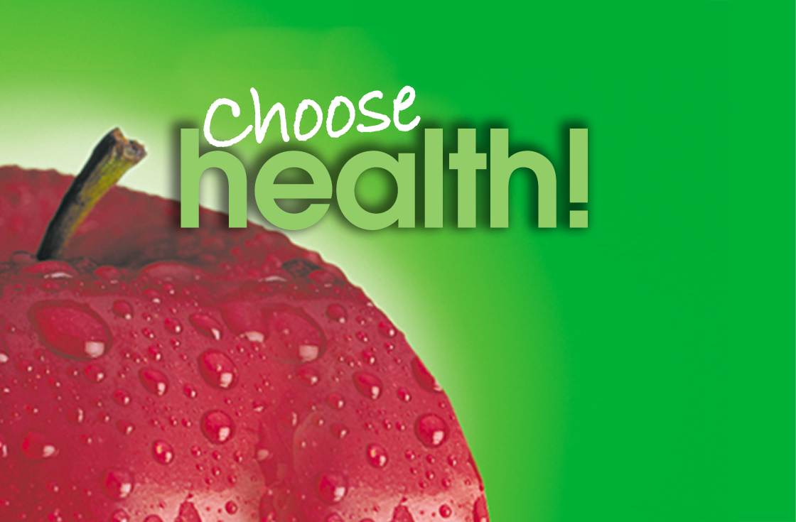


Slide 2
Alcohol

Slide 3
Goals
Increase awareness and knowledge about the effects of alcohol
Understand how to reduce the harmful effects of alcohol misuse
Increase access to community resources/information to help students

Slide 4
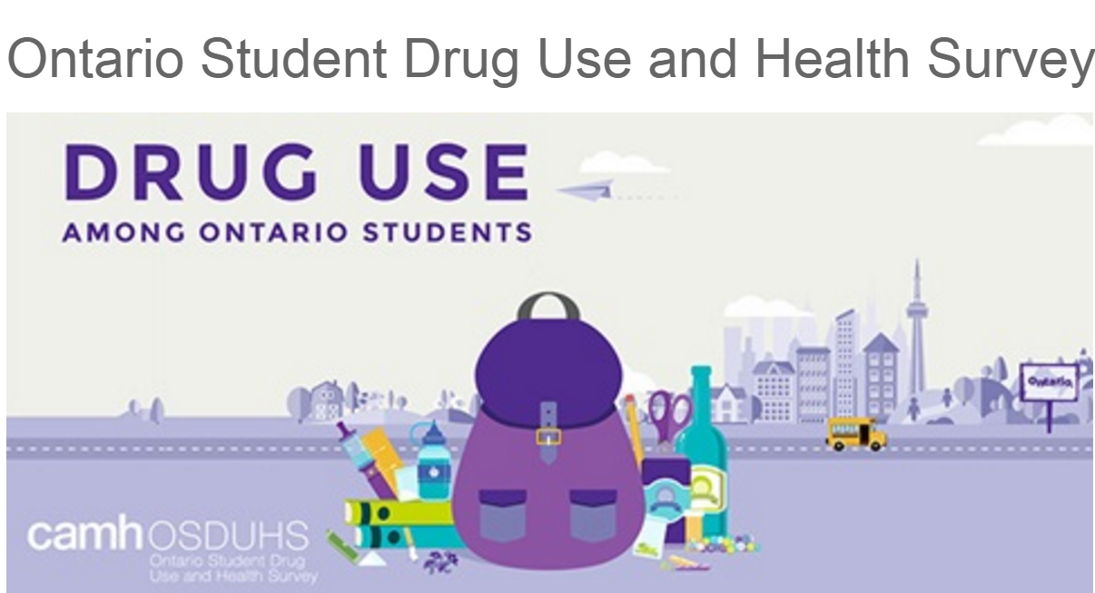
Notes:
Ontario Student Drug Use and Health Survey (OSDUHS) is the longest ongoing school survey of youth substance use in Canada (1977-current). 2017 marks the 40th anniversary of the survey. This survey looks at data from students in Grade 7 through Grade 12. It is a self-administered, anonymous survey conducted across the province every two years with the purpose of identifying epidemiological trends in student drug use, mental health, physical health, gambling, bullying, and other risk behaviours, as well as identifying risk and protective factors. This survey is important because it provides current and reliable information about the health risk behaviours, attitudes and beliefs of Ontario adolescents, and tracks changes over time.
Reference:
Centre for Addiction and Mental Health (2017). Ontario Student Drug Use and Health Survey. Retrieved from http://www.camh.ca/en/research/news_and_publications/ontario-student-drug-use-and-health-survey/Documents/2017%20OSDUHS%20Documents/Summary_DrugUseReport_2017OSDUHS.pdf

Slide 5
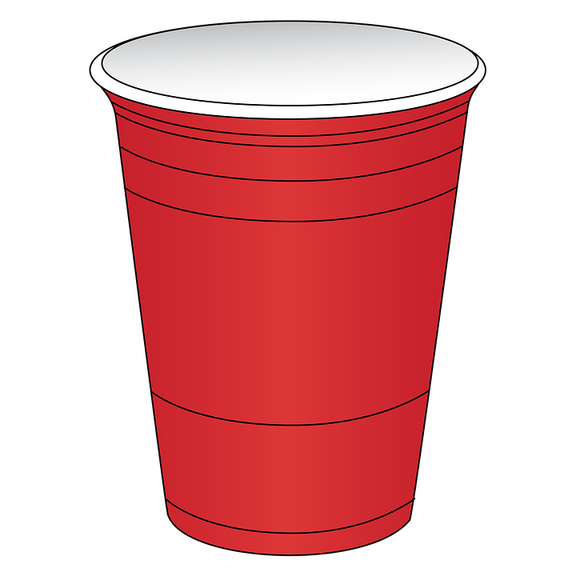
Alcohol
#1 drug used by youth
Youth drink differently than adults
Normalized in media/society
Perception of risk by youth and parents
Notes:
-Many youth (and even adults) don’t consider alcohol a drug, however it is the #1 drug used by youth
-Average age alcohol is used for the first time=14.5yrs
-43% of students grade 7-12 used alcohol in the past year
-Normalized in our society (advertising, part of TV, movies, music, other media, homes, events, parties)
-Youth drink differently than adults
-In past month,
-17% report binge drinking (that’s 153,300 students in Ontario). Binge drinking is defined as 5+ drinks on once occasion
-Girls are drinking just as much as boys
-16% cannot remember while drinking or blacked out
-All of these factors put youth at a high risk for alcohol related harm (fights, assaults, unplanned/unwanted sex, falls, drowning, poisoning)
Perception of risk by parents: 27% of youth say they are allowed to drink at home. This suggests some parents might think it’s safer to supervise kids while they drink. In fact, other research shows that students who are allowed to drink at home are more likely to drink excessively.
Downward Trend 1999-2017: Alcohol Use (from 66.0% to 42.5%)
References:
Centre for Addiction and Mental Health (2017). Ontario Student Drug Use and Health Survey. Retrieved from
http://www.camh.ca/en/research/news_and_publications/ontario-student-drug-use-and-health-survey/Documents/2017%20OSDUHS%20Documents/Summary_DrugUseReport_2017OSDUHS.pdf
Pixabay (n.d.). Red Solo Cup. Retrieved from https://pixabay.com/en/beer-pong-red-solo-cup-plastic-2113853/

Slide 6
Why youth are Drinking…
“It helps me
enjoy a party”
“ It helps me forget about my problems”
“ I use it out of boredom”
“It helps me relax”
“So I won’t feel left out”
“Because I’m not supposed to”
“I’m curious”
“I can’t stop”
Notes:
It’s important to know and have an understanding of what is motivating youth to use
Youth described a number for factors that motivate their use
Enhancement (its exciting)
Socialize/fit in (e.g., it helps me enjoy a party)
Coping (it helps me forget about my problems, deal with stress, family issues, helps me cope with feelings of anxiety, depression, to deal with a painful past)
Conformity (so I wont feel left out)
Routine (I do it out of boredom)
Rebel
Relax
Dependence
Reference:
Canadian Centre on Substance Abuse. (2015). The Effects of Cannabis Use During Adolescence. Retrieved from http://www.ccsa.ca/Resource%20Library/CCSA-Effects-of-Cannabis-Use-during-Adolescence-Report-2015-en.pdf

Slide 7
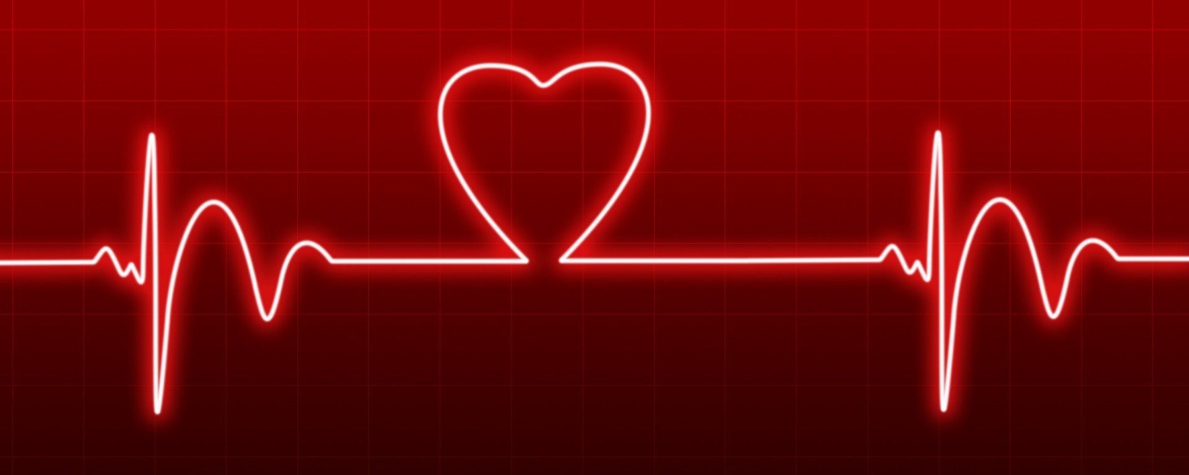
Health Impacts
Notes:
Reference:
https://pixabay.com/en/love-heart-beat-heartbeat-monitor-313417/

Slide 8
What do you think are some immediate risks associated with alcohol use?

Slide 9
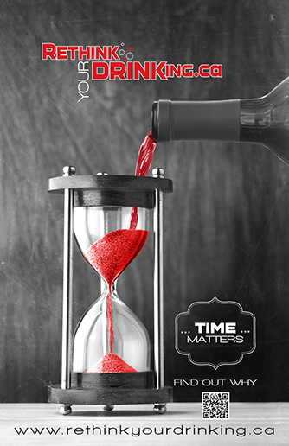
Immediate Health Risks
Violence
Risky sexual behaviors
Alcohol poisoning
Unintentional injuries
FASD
Notes:
Alcohol use has many immediate effects that increase the risk of harmful health and social conditions.
Violence – fights, intimate partner violence
Risky Sexual Behaviours – unprotected sex, sex with multiple partners, and increased risk of sexual assault. These behaviors can result in unintended pregnancy or sexually transmitted infections
Alcohol poisoning – which is a medical emergency
Unintentional injuries – traffic crashes (drunk driving), falls, drowning, burns, and unintentional firearm injuries.
Fetal Alcohol Spectrum Disorder – It is recommended that women who are pregnant or trying to get pregnant avoid drinking alcohol.
FASD can cause a range of disabilities that result from prenatal alcohol exposure including brain damage, learning disabilities, hearing difficulties, vision difficulties, organ damage, slow growth, and poor bone development.
FASD is 100% preventable.
TIME MATTERS – the less time between drinks, the slower the effects wear off , it takes anywhere from 1 hour to 1.5 hours for the body to clear one standard alcoholic drink.
References:
Centre for Addiction and Mental Health (2017). Ontario Student Drug Use and Health Survey. Retrieved from http://www.camh.ca/en/research/news_and_publications/ontario-student-drug-use-and-health-survey/Documents/2017%20OSDUHS%20Documents/Summary_DrugUseReport_2017OSDUHS.pdf
Middlesex London Health Unit (2017). Reduce Your Alcohol Risks. Retrieved from https://www.healthunit.com/reduce-your-alcohol-risks
Rethink Your Drinking (2016). Health Effects. Retrieved from http://www.rethinkyourdrinking.ca/risks/

Slide 10
Possible Consequences of Drinking Alcohol
Did something you later regretted
Forgot where you were or what you did
Got in trouble with the police
Had unprotected sex
Physically injured yourself
Physically injured another person
Seriously considered suicide
Notes:
As reported by a post secondary group of students in Ontario

Slide 11
What do you think some of the long term risks are with alcohol use?

Slide 12
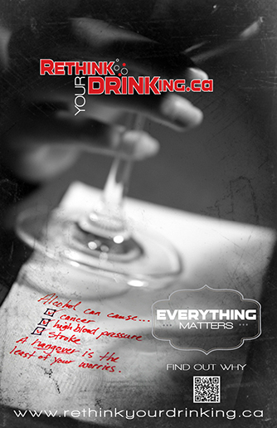
Long Term Health Risks
Cardiovascular Problems
Mental Health
Social Problems
Neurological Problems
Liver Disease/Gastrointestinal Problems
Cancer
Notes:
When we think of alcohol related harms, we often think of things like drunk driving crashes, a bar fight, or struggling with a hangover the next day – those immediate effects like on the pervious slides.
What we don’t always realize is that alcohol use can lead to many long-term health problems such as:
Cardiovascular problems – heart attack, heart disease and high blood pressure
Mental Health– alcohol dependence, depression, anxiety, and suicide. What comes first-the substance use issue or the mental health concern-varies and may be difficult to determine. The two are often intertwined and related.
Social problems – unemployment, lost productivity, financial crisis, and family/friend difficulties.
Neurological problems – dementia and stroke. We will talk about the impact on the teen brain next.
Liver disease and other gastrointestinal problems
Cancer – Cancer is often surprising to the public – even though it was first linked to alcohol in the late 1980s – this includes cancers of the head & neck, liver, colon, and breast. In general, the risk of cancer rises with increasing amounts of alcohol. If you drink & smoke cigarettes, the risk of developing certain cancers is even greater.
It’s important to remember that alcohol is circulated through the blood to every organ and tissue in the body and therefore effects every organ and tissue in the body.
References:
Middlesex London Health Unit (2017). Drinking Alcohol-Short and Long Term Risks. Retrieved from https://www.healthunit.com/risks-of-drinking
Rethink Your Drinking (2016). Health Effects. Retrieved from http://www.rethinkyourdrinking.ca/risks/

Slide 13

Teen Brain
The brain undergoes a considerable amount of development during the teen years, and does not fully mature until around the age of 25.
Notes:
Brain development- The last area to mature is the frontal lobe (prefrontal cortex)- responsible for executive functions- decision making, thinking through consequences of actions, emotional expression, problem solving, memory, language, and judgment/impulse control.
References:
Partnership for Drug Free Kids. (n.d.). Brain Development, Teen Behaviour and Preventing Drug Use. Retrieved from
https://drugfree.org/article/brain-development-teen-behavior/
Winters, K. (2013). Alcohol and Other Drug Use and Adolescent Brain Development. Retrieved from
https://www.oasas.ny.gov/prevention/documents/AdolescentBrain.pdf
Pixabay. (n.d.). Brain. Retrieved from https://pixabay.com/en/anatomy-biology-brain-thought-mind-1751201/

Slide 14
Unfortunately, developing brains are generally more prone to damage. This means that experimentation with alcohol and drugs can have lasting, harmful effects on teen brains.

Slide 15
What influences intoxication ?
A number of factors can increase your risk of alcohol poisoning, including:
Your size and weight
Your overall health
Whether you've eaten recently
Whether you're combining alcohol with other drugs
The percentage of alcohol in your drinks
The rate and amount of alcohol consumption
Your tolerance level
Whether you are male or female
Notes:
References:
Alberta Health Services (2014). Alcohol and the Human Body: Short-term Effects. Retrieved from https://www.albertahealthservices.ca/assets/info/hp/edu/if-hp-edu-amh-alcohol-and-the-human-body.pdf
Butt et. al (2011). Alcohol and Health in Canada: A Summary of Evidence and Guidelines for Low-Risk Drinking. Retrieved from http://www.ccdus.ca/Resource%20Library/2011-Summary-of-Evidence-and-Guidelines-for-Low-Risk%20Drinking-en.pdf

Slide 16
Women and Alcohol
Generally Smaller
Contain Less Water
Less Alcohol Metabolizing Enzyme
Changing Hormone Levels
Stays in Women’s Bodies Longer and at Higher Concentrations – Leads to problems in a shorter period of time
Notes:
Women are anything but equal when we talk about alcohol and we wanted to take a minute to look at the unique characteristics that lead women to distinctive problems associated with alcohol.
Women are generally:
Smaller then men
Have less water in their bodies to dilute alcohol
Have less alcohol dehydrogenase – enzyme that breaks down alcohol in the stomach
Have changing hormone levels that alter how alcohol is processed in our bodies
All of these factors mean that alcohol stays in a woman’s body longer than a man’s and at higher concentrations.
It’s important to remember that alcohol is circulated through the blood to every organ and tissue in the body – a higher alcohol level circulating in the body equals more damage.
References:
Canadian Centre on Substance Use (2014). Women and Alcohol. Retrieved from http://www.ccdus.ca/Resource%20Library/CCSA-Women-and-Alcohol-Summary-2014-en.pdf
Middlesex London Health Unit (2017). Women and Alcohol. Retrieved from https://www.healthunit.com/women-and-alcohol
Rethink Your Drinking (2016). Sex. Retrieved from http://www.rethinkyourdrinking.ca/sex2/

Slide 17
Women and Alcohol cont.
↑ risk for breast cancer (less than1drink/day)
↑ risk for infertility, menstrual abnormalities, adverse pregnancy outcomes, unplanned pregnancies, sexually transmitted infections
Notes:
Increased risk for breast cancer ( 1 drink per day)
Increased risk for fertility issues, unplanned pregnancies, adverse pregnancy outcomes and STI’s
References:
Canadian Centre on Substance Use (2014). Women and Alcohol. Retrieved from http://www.ccdus.ca/Resource%20Library/CCSA-Women-and-Alcohol-Summary-2014-en.pdf
Middlesex London Health Unit (2017). Women and Alcohol. Retrieved from https://www.healthunit.com/women-and-alcohol
Rethink Your Drinking (2016). Sex. Retrieved from http://www.rethinkyourdrinking.ca/sex2/

Slide 18
Drunkorexia
Drinking alcohol in place of eating food…
1) To “save” calories for drinking in an attempt to not gain weight
2) To get drunk faster
3) Don’t have enough money for both and so choose to drink
Those who combine alcohol abuse with calorie restriction have a greater likelihood of:
  Alcohol poisoning
  Substance abuse and addiction
  Violence
  Participating in dangerous sexual behavior
  Chronic disease as they age
Notes:
References:
Partnership News Services Staff (2016). “Drunkorexia” on the Rise Among College Students. Retrieved from https://drugfree.org/learn/drug-and-alcohol-news/drunkorexia-rise-among-college-students/
Simon Fraser University (2012). ‘Drunkorexia’ leads students to risky behaviour. Retrieved from https://www.sfu.ca/university-communications/media-releases/2012/drunkorexia-leads-students-to-risky-behaviour.html
https://www.medscape.org/viewarticle/869561

Slide 19
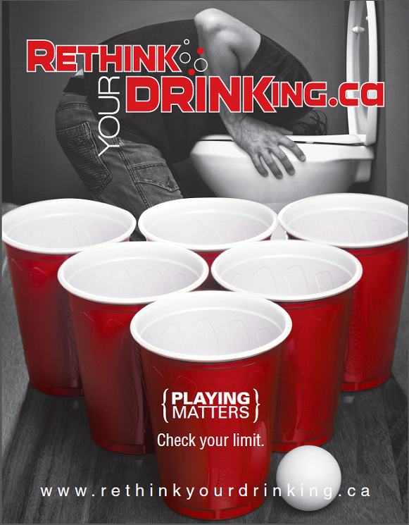
Play Matters
Drinking games result in a large amount of alcohol being consumed in a short amount of time
Examples include: Century Club, Beer Pong, Kings, Chug-A-Lug, Flip Cup
Get caught up in the “game” and lose track of how much has been consumed
Notes:
Its difficult to remember your limits when they are being pushed by the atmosphere of playing the game. We can quickly consume above and beyond what our bodies can handle when we participate in drinking games.
Reference:
Rethink Your Drinking (2016). Risky Drinking. Retrieved from http://www.rethinkyourdrinking.ca/playing-matters/

Slide 20
Who knows what alcohol poisoning is?

Slide 21
Alcohol Poisoning
Occurs when drinking large quantities of alcohol within a short period of time
Binge drinking (≥5 drinks/drinking occasion)
Depresses nerves that control involuntary actions such as breathing and the gag reflex
Funneling, Chugging, Drinking Games
Notes:
-Alcohol is a toxin to the body and as you take in more of it, the body has more difficulty filtering it out. This build up of toxin leads to the feeling of being drunk and also leads to many serious health risks.
-Increased risk for alcohol poisoning with binge drinking. Often occurs when people take part in a funneling or chugging contest and drinking games. You stop realizing how much alcohol you have taken in as you get more excited and invested in these “games”
References:
Canadian Public Health Association. (n.d.). Binge drinking and alcohol poisoning: straight talk for parents. Retrieved from
http://www.cpha.ca/en/programs/portals/substance/article02.aspx
Centre for Addiction and Mental Health. (2008). Partying and Getting Drunk [Brochure]. Toronto, ON. Retrieved from
http://www.camh.ca/en/education/about/camh_publications/Pages/binge_drinking.aspx
Centers for Disease Control and Prevention. (2012). Fact Sheets – Binge Drinking. Retrieved from
http://www.cdc.gov/alcohol/fact-sheets/binge-drinking.htm
Middlesex London Health Unit (2017). Binge-Drinking & Alcohol poisoning. Retrieved from https://www.healthunit.com/binge-drinking

Slide 22
What are the symptoms of alcohol poisoning?

Slide 23
Symptoms
Passing out, semi conscious
Cold, pale, bluish skin
Vomiting while sleeping
Slow breathing
Seizures
Incontinent of urine
Notes:
References:
Canadian Public Health Association. (n.d.). Binge drinking and alcohol poisoning: straight talk for parents. Retrieved from
http://www.cpha.ca/en/programs/portals/substance/article02.aspx
Centre for Addiction and Mental Health. (2008). Partying and Getting Drunk [Brochure]. Toronto, ON. Retrieved from
http://www.camh.ca/en/education/about/camh_publications/Pages/binge_drinking.aspx
Centers for Disease Control and Prevention. (2012). Fact Sheets – Binge Drinking. Retrieved from
http://www.cdc.gov/alcohol/fact-sheets/binge-drinking.htm
Middlesex London Health Unit (2017). Binge-Drinking & Alcohol poisoning. Retrieved from https://www.healthunit.com/binge-drinking

Slide 24
What should you do if someone has alcohol poisoning?

Slide 25
Action
Recovery position
Call 911
Stay with the person until help arrives
NEVER leave the person to sleep it off
Notes:
Reference:
Middlesex London Health Unit (2017). Binge-Drinking & Alcohol poisoning. Retrieved from https://www.healthunit.com/binge-drinking

Slide 26
Recovery Position
Notes:
You may want to have students demonstrate if there is time.
Bacchus Maneuver©: The Student Life Education Company, BACCHUS Canada. Reviewed 2011 Healthy Communities & Injury Prevention Team.

Slide 27
Alcohol and Medication
Mixing alcohol with medication can put you at risk for dangerous reactions
Can make medication less effective (or useless), can intensify side effects (drowsiness, nausea, dizziness, etc.) and can even cause severe medical problems (bleeding, breathing difficulties, heart problems, etc.)
Interactions even if not taken at the same time
Speak to a pharmacist to see if there is a reaction with alcohol
Notes:
References:
Butt et. al (2011). Alcohol and Health in Canada: A Summary of Evidence and Guidelines for Low-Risk Drinking. Retrieved from http://www.ccdus.ca/Resource%20Library/2011-Summary-of-Evidence-and-Guidelines-for-Low-Risk%20Drinking-en.pdf
Centre for Addiction and Mental Health. (2018). Do You Know…Alcohol. Retrieved from
http://www.camhx.ca/About_Addiction_Mental_Health/Drug_and_Addiction_Information/alcohol_dyk.html

Slide 28
Alcohol and Energy Drinks
Grade 7-12 Students use of High-caffeine Energy Drinks – 34.1% (OSDUHS 2017)
Counteracts the effects of a downer (alcohol) with an upper (caffeine)
Caffeine does not sober you up
It makes you a “wide awake drunk” meaning you feel less tired and feel like you can drink more for longer periods.
Notes:
References:
Centre for Addiction and Mental Health (2017). Ontario Student Drug Use and Health Survey. Retrieved from http://www.camh.ca/en/research/news_and_publications/ontario-student-drug-use-and-health-survey/Documents/2017%20OSDUHS%20Documents/Summary_DrugUseReport_2017OSDUHS.pdf
Canadian Centre on Substance Use and Addiction (2018). Alcohol and Caffeine. Retrieved from http://www.ccsa.ca/Eng/topics/alcohol/Alcohol-and-caffeine/Pages/default.aspx
Middlesex London Health Unit (2017). Alcohol and Energy Drinks. Retrieved from https://www.healthunit.com/alcohol-and-energy-drinks

Slide 29
Alcohol and Energy Drinks
Increased risk of injury and high risk behaviour:
  Drunk driving or passenger of drunk driver
  Alcohol poisoning
  Victim or perpetrator of aggressive physical or sexual behaviour
  Injury requiring medical attention
Notes:
References:
Centre for Addiction and Mental Health (2017). Ontario Student Drug Use and Health Survey. Retrieved from http://www.camh.ca/en/research/news_and_publications/ontario-student-drug-use-and-health-survey/Documents/2017%20OSDUHS%20Documents/Summary_DrugUseReport_2017OSDUHS.pdf
Canadian Centre on Substance Use and Addiction (2018). Alcohol and Caffeine. Retrieved from http://www.ccsa.ca/Eng/topics/alcohol/Alcohol-and-caffeine/Pages/default.aspx
Middlesex London Health Unit (2017). Alcohol and Energy Drinks. Retrieved from https://www.healthunit.com/alcohol-and-energy-drinks

Slide 30
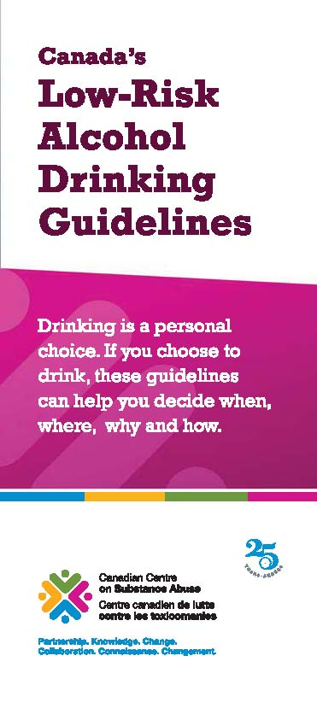
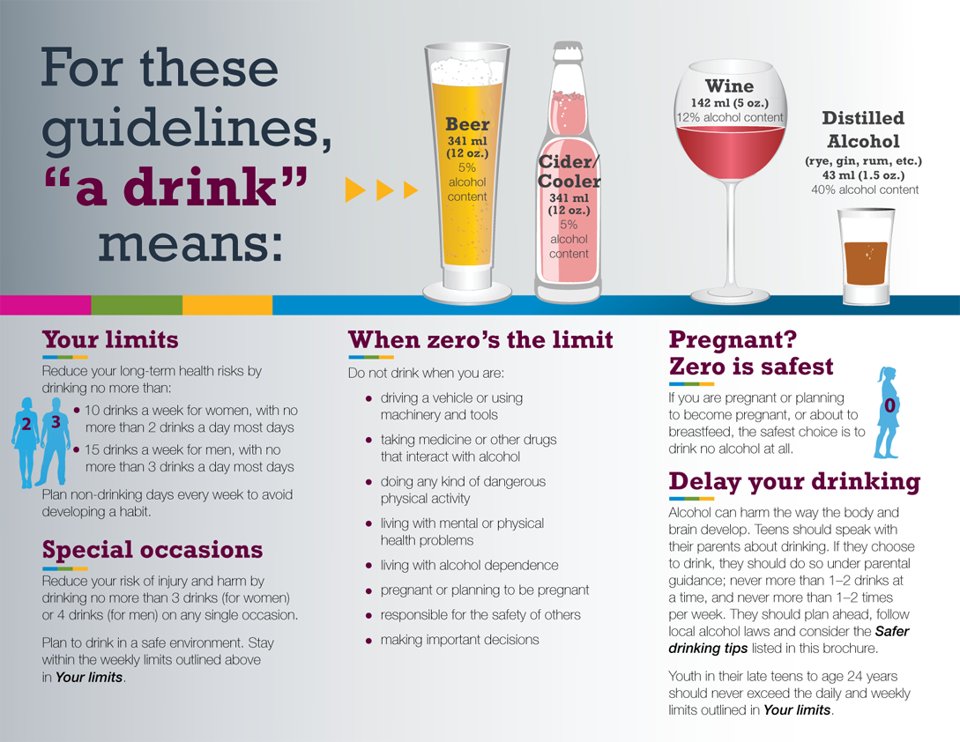
Low-Risk Alcohol Drinking Guidelines
Notes:
In 2011 Canada developed one national set of low-risk alcohol drinking guidelines, with the support of federal, provincial and territorial health ministers, as well as many respected Canadian organizations.
These guidelines, which are intended for Canadians of legal drinking age who choose to drink alcohol, are informed by the most recent and best available scientific research and evidence. They are intended to provide consistent information across the country to help Canadians moderate their alcohol consumption and reduce their immediate and long-term alcohol-related harm.
The idea is if all Canadian drinkers were drinking alcohol within the proposed guidelines, it is estimated that alcohol-related deaths would be reduced by approximately 4,600 per year.*
There are 5 sections to the LRDGs
Reference:
Canadian Centre on Substance Use and Addiction (2018). Drinking Guidelines. Retrieved from http://www.ccsa.ca/Resource%20Library/2012-Canada-Low-Risk-Alcohol-Drinking-Guidelines-Brochure-en.pdf

Slide 31
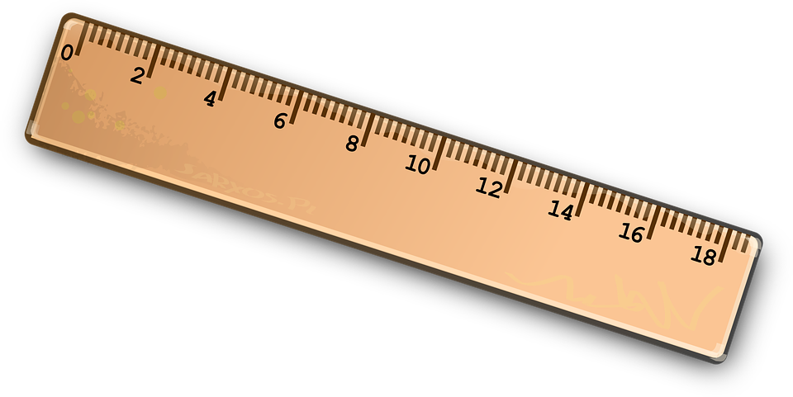
What is a Standard Drink?
Many people do not know how much alcohol they are actually consuming in a drink
Underestimating one’s consumption of alcohol can lead to binge drinking and related harms
Notes:
What do you think a standard drink is for wine? Beer? Hard liquor?
Optional: Use the Sum it Up Cup activity at this point as a hands on experience if appropriate
Reference:
https://pixabay.com/en/ruler-straight-edge-tool-geometry-145940/

Slide 32
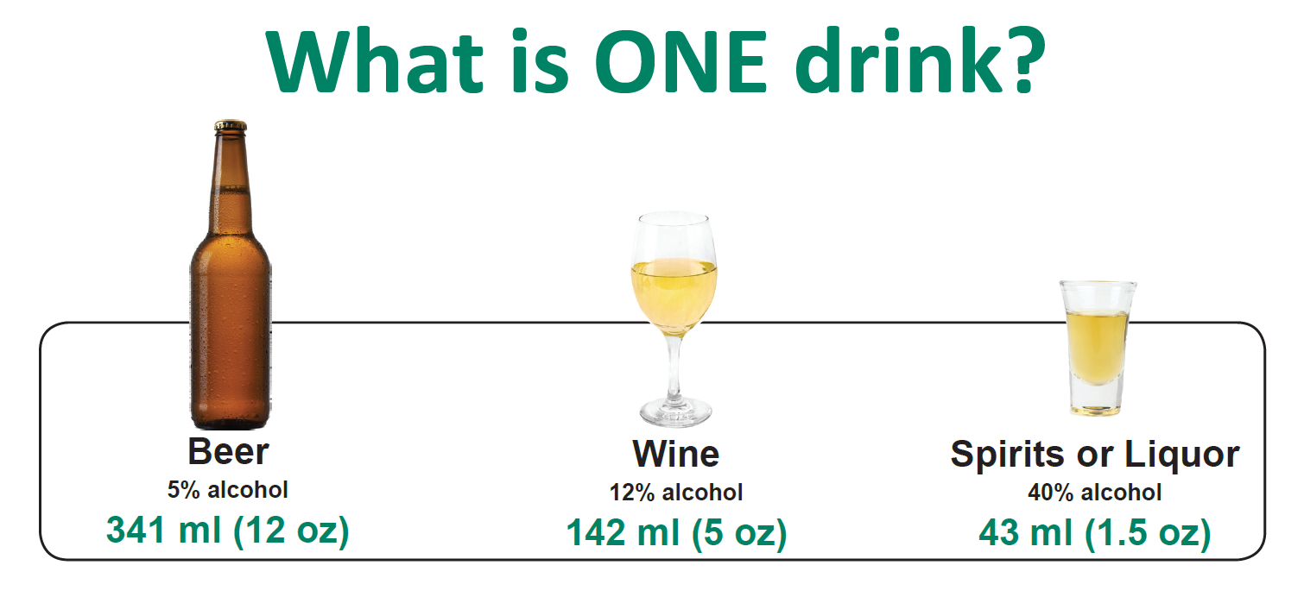
Notes:
Reference:
Middlesex London Health Unit (2017). Standard Drink Poster. Retrieved from https://www.healthunit.com/standard-drink-of-alcohol (standard_drink_poster_adapted_from_durham.pdf)

Slide 33
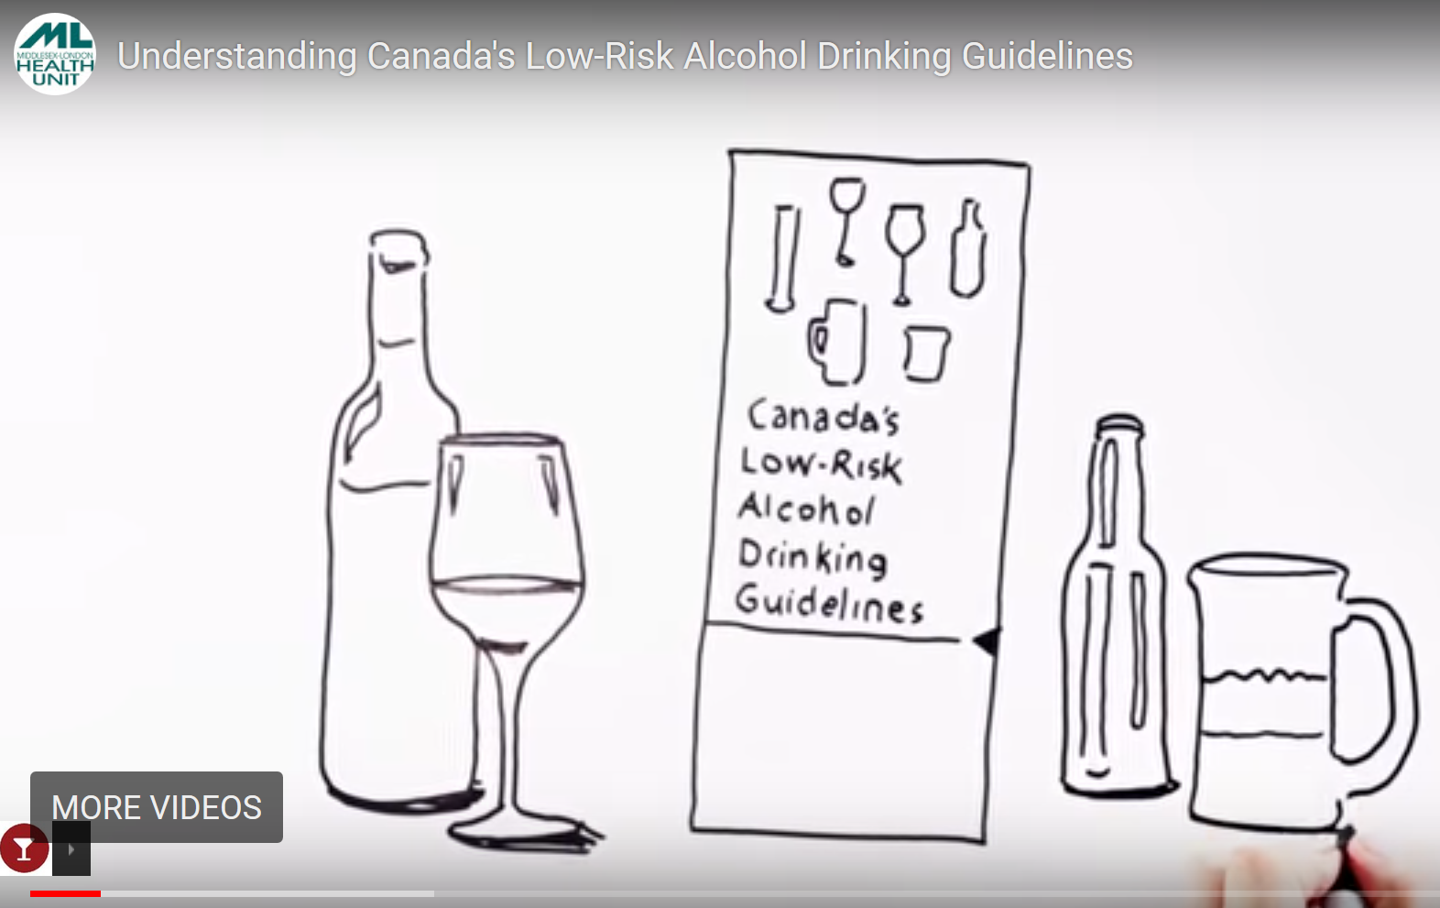

Low Risk Drinking Guidelines
Video
https://youtu.be/NbpdMFE-AIE
Notes:
Important to note that these guidelines apply to adults of drinking age (>19 years).
Reference:
Rethink Your Drinking (2016). Guidelines. Retrieved from http://www.rethinkyourdrinking.ca/information/

Slide 34
School Alcohol Policy
Know your schools alcohol and drug policy.
Being in possession of alcohol or under the influence of alcohol on school property is unacceptable.
Providing others with alcohol is unacceptable.
Consequences can range from report to police, suspension, possible expulsion from school, and possible referral to appropriate counselling programs.
Notes:
No tolerance-suspension, alt. to suspension etc.

Slide 35
The Law
The Liquor Control Act prohibits the sale of alcoholic beverages to any person under the age of 19, and prohibits the sale of alcohol to an intoxicated person
Drinking and Driving laws are extensive
  Impaired driving causing bodily harm – Maximum Sentence: 10 Years in Prison
  Impaired driving causing death – Maximum sentence: Life Imprisonment
Owner/Operator Liability
Notes:
References:
Government of Canada (2018). Drinking and Driving Laws – Criminal Code of Canada. Retrieved from http://laws-lois.justice.gc.ca/eng/acts/C-46/section-255.html
Government of Ontario (2017). Liquor License Act. Retrieved from https://www.ontario.ca/laws/statute/90l19

Slide 36
“New” Law
As of August 1st, 2010 – Any driver 21 and under and novice drivers must have ZERO ( 0%) Blood Alcohol Concentration = NO Alcohol .
Starting July 1, 2018 - Young and novice drivers will also be prohibited from having any presence of cannabis in their system as well as other drugs.
Notes:
Ontario Ministry of Transportation (2018). Impaired Driving. Retrieved from http://www.mto.gov.on.ca/english/safety/impaired-driving.shtml

Slide 37
Penalties
Starting July 1, 2018, Ontario will have tougher penalties for young and novice drivers who have alcohol in their system and will add matching penalties for drugs.
You will be subject to an immediate licence suspension and a monetary penalty. You will also face a licence reinstatement fee.
Subsequent charges will result in higher fees, education programs, ignition interlock requirements and medical evaluations.
Notes:
Ontario Ministry of Transportation (2018). Impaired Driving. Retrieved from http://www.mto.gov.on.ca/english/safety/impaired-driving.shtml

Slide 38
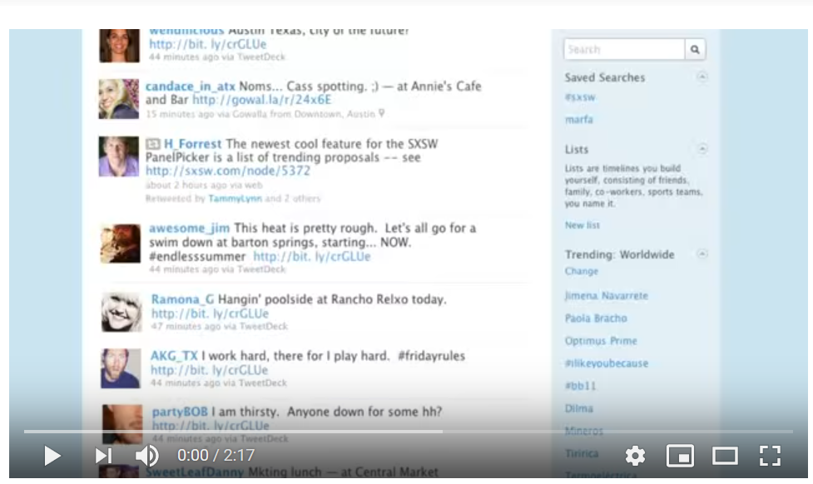
Happy Hour Fail
Video
https://www.youtube.com/watch?v=YYG0wskyWhg
Notes:
2:17 MINUTES
Alcohol advertising tends to glamourize drinking and having a good time ….
This video shows some of the realities of alcohol (specifically drinking and driving) that you’ll never see on typical alcohol advertisement .
Reference:
Texas Department of Transportation (2010). Happy Hour Fail. Retrieved from https://www.youtube.com/watch?v=YYG0wskyWhg

Slide 39
Alcohol Liability
Provider Liability - providing alcohol to intoxicated individuals who later injure themselves or others – even after leaving event (Liquor License Act)
Occupier Liability - responsible for any alcohol-related injuries that occur on your property (need to protect guests)
Notes:
References:
Fitzgerald-Husek, L. (2017). Social Host Liability in Ontario: Update. Retrieved from https://oatleyvigmond.com/social-host-liability-ontario-update/
Government of Ontario (2017). Liquor License Act. Retrieved from https://www.ontario.ca/laws/statute/90l19
Government of Ontario (2016). Occupiers’ Liability Act. Retrieved from https://www.ontario.ca/laws/statute/90o02?search=e+laws

Slide 40
Reduce Your Risks
Follow Canada’s Low Risk Drinking Guidelines
Know what a Standard Drink is
Keep Track of Your Drinks
Plan Ahead
Watch out for your friends
Watch your drink
Notes:
Reducing Your Risk
There are many things you can do to reduce the risk of hurting yourself or others.
Follow Canada’s low-risk drinking guidelines if you choose to drink:
• Remember that these guidelines apply for most alcohol-related health problems but as we’ve discussed even very low amounts of alcohol can increase your risk of certain problems like cancer. The best way to reduce your risk is to reduce the amount you drink.
2. Know what a standard drink is. This way you will know how much you are actually drinking. Help yourself by using a measuring cup or marked shot glass or drink out of something you’re familiar with so that you know how much you’re consuming.
3. Keep track of how much you drink—per day and per week.
4. Plan ahead so you have a safe ride home
Watch out for your friends. Make sure if you go to the bar/party with them that you come home with them.
Watch your drink – don’t leave it unattended
Reference:
Centre for Addiction and Mental Health. (2018). Alcohol and Chronic Health Problems. Retrieved from https://www.camh.ca/en/health-info/guides-and-publications/alcohol-and-chronic-health-problems
Middlesex London Health Unit (2017). Reduce Your Alcohol Risks. Retrieved from https://www.healthunit.com/reduce-your-alcohol-risks

Slide 41
Reduce Your Risks
Wait at Least 1 hour Between Drinks
Eat something substantial
For every alcohol beverage have 1 glass of water
Spread the Word
Talk to Your Doctor
Notes:
7. Wait at least one hour between drinks to let your body start processing the alcohol.
8. Make sure you eat before and while you drink – will slow the absorption of the alcohol
9. If you are hosting a party where you serve alcohol, offer your guests food and non-alcoholic drinks. Make sure everyone has a safe ride home.
10. Consider talking to other important people in your life about the links between alcohol and short and long term problems. People can improve their health if they
know the facts and reduce their risks.
11. If you are concerned that your drinking may be affecting your health, please check with your doctor.
References:
Centre for Addiction and Mental Health. (2018). Alcohol and Chronic Health Problems. Retrieved from https://www.camh.ca/en/health-info/guides-and-
publications/alcohol-and-chronic-health-problems
Middlesex London Health Unit (2017). Reduce Your Alcohol Risks. Retrieved from https://www.healthunit.com/reduce-your-alcohol-risks

Slide 42
Community Supports
Your Doctor or Nurse Practitioner
Your School Nurse
School Social Worker

Slide 43
Community Supports
Notes:
TVAS-numerous programs staffed by professionals- support, education and treatment. Services are free and confidential.
CAMH- educational, web-based, research- programs based in Toronto. The Youth Addiction and Concurrent Disorders Service (YACDS) offers treatment to young people (14 to 24 years) who have substance use challenges/concerns, with or without concurrent mental health concerns, and to their families.
Connex- Access to Addiction, Mental Health, and Problem Gambling Services. ConnexOntario provides free and confidential health services information for people experiencing problems with alcohol and drugs, mental illness or gambling. Funded by the Government of Ontario. Helpline is 24/7, confidential and free.

Slide 44
Community Supports
Notes:
CMHA- Promotes good mental health, prevent further illness, offer treatment, support recovery and provide mental health education in the communities of London, Middlesex, Exeter and Goderich.
Reach Out is a confidential 24/7 information, support and crisis service for people living with mental health or addictions concerns in Elgin, Oxford, Middlesex and London.

Slide 45
Web Resources
The Middlesex London Health Unit
Drug Free Kids Canada
Canadian Centre on Substance Abuse
Think about It
Rethink Your Drinking

Slide 46

Questions?
Notes:
https://pixabay.com/en/question-question-mark-request-63916/

