Slide 1
Sexually Transmitted Infections (STI)
Created by: School Health Team
Created: June 2022
Last Reviewed: June 2022
Recommended for Grades 7-12
Notes:
To provide an inclusive environment for all students, regardless of their gender identity, we use the names of body parts and hormones to discuss physical differences rather than the use of gender.

Slide 2
Class Overview
Consent
Sexually Transmitted Infections (STI)
Prevention
Testing
Where to go for help

Slide 3
Consent
If someone doesn’t say “No”, it doesn’t mean Yes
Notes:
Image source: wordart.com

Slide 4
Everyone has the right to choose:
If they want to be in a relationship
Who they want to be in a relationship with
How intimate they want to be with their partner
Notes:
Image source: https://www.pexels.com/photo/hands-on-a-metal-railing-7496143/

Slide 5
Consent-Elementary Video (see next slide for secondary)
https://www.youtube.com/watch?v=JC_GOjKwcsU
Notes:
* Consent video geared to secondary students can be found on the next slide.
Optional Consent Quiz through Kids Help Phone: https://kidshelpphone.ca/get-info/quiz-consent/
FRENCH VIDEO: https://www.youtube.com/watch?v=AaKoSIeLAKc

Slide 6
Consent – Secondary Video
https://www.youtube.com/watch?v=-JwlKjRaUaw
Notes:
https://www.youtube.com/watch?v=-JwlKjRaUaw

Slide 7
What does STI stand for?
S Sexually
T Transmitted
I Infection
Notes:
Infections that are transmitted through sexual contact are considered STIs.
Infections that are transmitted through exposure to infected blood, and sexual contact, fall under the acronym STBBI (sexually transmitted blood borne infections).
All sexually transmitted and blood borne infections fall under the acronym STBBI, however for this presentation we will continue to refer to them all as STIs for consistency for staff and students.
This presentation covers viral and bacterial STIs. There are parasitic and fungal infections – for more information see https://www.sexandu.ca/stis/

Slide 8
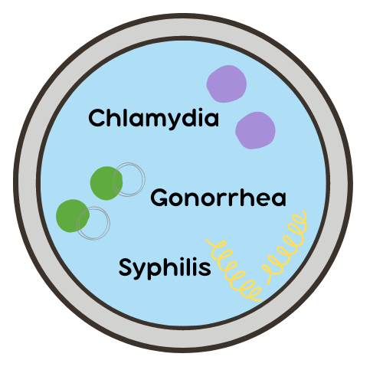
Bacterial Infections
Caused by bacteria
Can be cured with antibiotics
Long-term consequences if not treated
Notes:
Image: Canva

Slide 9
Chlamydia
Most people with chlamydia have no symptoms
It is the most common bacterial STI
Symptoms can include:
Itching and pain when urinating
Discharge from the penis or vagina
Vaginal bleeding after sex or between periods
Treated with antibiotics
Notes:
Chlamydia is transmitted through unprotected oral, vaginal and anal sex
-Typically tested through a urine sample. If the individual has discharge a swab may be taken to rule out other infections.
-Treated with a one-dose antibiotic taken by mouth
Once treated, individuals can be re-infected if exposed again.
Untreated chlamydia can lead to pelvic inflammatory disease and cause future difficulties with getting pregnant.
Reference:
Image: Canva

Slide 10
Gonorrhea
Individuals can be co-infected with chlamydia
Symptoms can include:
No symptoms
Pain during sexual intercourse
Discharge from the penis or vagina
Testicular pain
Treated with antibiotics
Notes:
Gonorrhea is transmitted through unprotected oral, vaginal and anal sex
-Typically tested through a urine sample. If the individual has discharge a swab may be taken to rule out other infections.
-Treated with both oral antibiotics and an injection
Once treated, individuals can be re-infected if exposed again.
Untreated gonorrhea can lead to pelvic inflammatory disease and cause future difficulties with getting pregnant.
Reference:
Image: Canva

Slide 11
Syphilis
Can have no symptoms
Progresses in stages, beginning with a painless open sore
Serious health consequences if not treated
Treated with antibiotics
Notes:
Syphilis is transmitted through unprotected oral, vaginal and anal sex. Syphilis is a STBBI
-Tested through a blood sample.
-Treated with a series of antibiotics administered by intramuscular injection (needle)
Once treated, individuals can be re-infected if exposed again.
Untreated syphilis can cause potentially life-threatening complications, and permanent damage to the brain, heart, bones, and blood vessels.
Reference: https://www.sexandu.ca/stis/syphilis/
Image: Canva

Slide 12
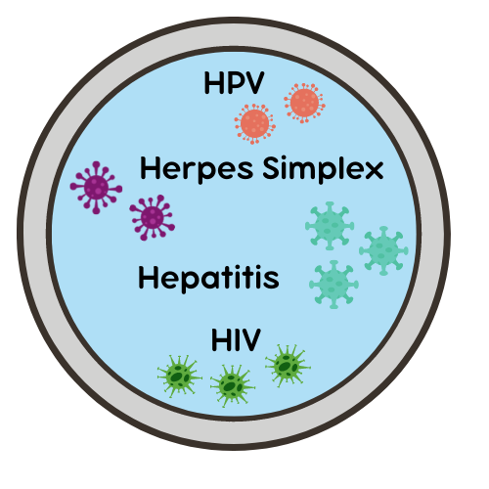
Viral Infections
Caused by a virus
There is no cure
Treatments are available to manage symptoms
Some viral STIs will resolve on their own while others will remain in the body for life
Notes:
Image: Canva

Slide 13
Human Papillomavirus (HPV)
There are over 200 different HPV viruses
40 of the 200 viruses cause either genital warts or cancer
If not immunized, 75% of sexually active Canadians will get at least one HPV infection in their lifetime
Notes:
Once infected with HPV, you are at increased risk of re-infection and of persistent HPV infection. Thus both genital warts and cancerous changes to the cervix can reoccur.
Reference:
https://www.hpvinfo.ca/what-is-hpv/
https://www.sexandu.ca/stis/hpv/
https://www.canada.ca/en/public-health/services/publications/healthy-living/canadian-immunization-guide-part-4-active-vaccines/page-9-human-papillomavirus-vaccine.html
Image: Canva

Slide 14
Human Papillomavirus (HPV) Presentation: Genital Warts
Lower risk HPV viruses cause genital warts and usually clear on their own within a few years
Genital warts are small cauliflower-like growths on the vulva, penis or anus
Can cause itching and bleeding/discomfort during intercourse
Notes:
Once infected with HPV there is no cure, the body must clear the infection on its own. Most people with healthy immune systems will clear the virus within two years.
There are treatments available to address the cell changes and growths associated with genital warts, however they will continue to reappear until the body has cleared the virus.
HPV and genital warts are spread through skin-to-skin contact
Shaving the pubic area when warts present can increase the spread of genital warts.
Reference: https://www.sexandu.ca/stis/hpv/
Image: Canva

Slide 15
Human Papillomavirus (HPV) Presentation: Cancer
Higher risk HPV viruses cause cancer
Most commonly in the vulva, cervix, penis, anus and throat
PAP tests detect early signs of cervical cancer. PAP tests are recommended every three years for sexually active individuals who are over the age of 21.
Notes:
Reference: https://www.sexandu.ca/stis/hpv/
Image: Canva

Slide 16
Human Papillomavirus (HPV) Prevention: Vaccination
Vaccination is the best prevention against HPV
Current vaccine products reduce the risk of both cancer and genital warts
The HPV vaccine is offered routinely with the grade 7 vaccination campaign in schools
Notes:
Vaccination is most effective if done before becoming sexually active however it can help reduce infection related diseases at any time.
The HPV vaccine is offered routinely with the grade 7 and 8 vaccination campaigns in schools.
Condoms do help prevent infection, however they do not provide perfect coverage.
In Canada, HPV vaccination is approved for people with a vulva from ages 9 - 45 and people with a penis from ages 9 - 26
Reference:
https://www.canada.ca/en/public-health/services/publications/healthy-living/canadian-immunization-guide-part-4-active-vaccines/page-9-human-papillomavirus-vaccine.html
https://www.sexandu.ca/stis/hpv/
Image: Canva

Slide 17
Herpes Virus: Herpes Simplex Virus 1 and 2
Herpes Simplex Virus (HSV) is not curable and does not resolve on its own
HSV-1 | HSV-2
Primarily associated with oral infection. Example: cold sores | Primarily associated with genital infection. Example: genital ulcers (small blister-like sores on the penis, anus or vulva)
Notes:
There are two types of Herpes simplex virus. HSV-1 and HSV-2
HSV-1 is primarily associated with oral infection – cold sores.
HSV-2 is primarily associated with genital infection.
HSV-2 is present in about 20% of adults.
You can get HSV-1 on the genitals it is rare to get HSV-2 orally
Symptoms of primary infection often resolve within 15-23 days.
Symptoms of secondary infections often resolve within 9-11 days.
Infection from oral sex can cause ulcers within the mouth and on the lips.
Prevention: use condoms and do not have sexual contact with an individual in active outbreak.
Up to 70% of all genital HSV-2 infections are transmitted when people are not having any symptoms or lesions. This is called “asymptomatic shedding.”
This infection is not curable and does not resolve on its own. Will remain in your body for life. There are medications that can be taken to reduce the number of outbreaks, or the severity of outbreaks, experienced within your lifetime.
Reference: https://www.sexandu.ca/stis/herpes/ https://www.canada.ca/en/public-health/services/infectious-diseases/sexual-health-sexually-transmitted-infections/canadian-guidelines/sexually-transmitted-infections/genital-herpes-counselling-tool.html
Image: Canva

Slide 18
Herpes Virus: Herpes Simplex Virus-2
Symptoms can include:
Small blisters on the genitals
Genital pain and pain while urinating
There are medications that can be taken to manage symptoms, reduce the number of outbreaks and reduce the severity of outbreaks experienced
Notes:
HSV will remain in your body for life.
Primary infection presents with flu like symptoms, genital pain, pain while urinating and small blisters on the penis, vulva and anus (also called genital ulcers).
Recurrent infections can be triggered by stress, sexual intercourse, medications, surgery and the menstrual cycle.
Often begins with tingling, burning and itching, followed by the genital ulcers.
Medications are most effective when initiated immediately after/during primary infection.
Reference: https://www.sexandu.ca/stis/herpes/
Image: Canva

Slide 19
Hepatitis Subgroups: A, B, C
Hepatitis is a virus that affects the liver
Type A | Type B | Type C
Fecal oral transmission (ingesting contaminated food or water often while travelling) | Sexually transmitted | Transmitted through blood, usually spread through the sharing of needles
Notes:
Hepatitis A
- transmission is fecal oral and most often occurs when ingesting contaminated food.
- Transmission can occur when engaging in oral-anal sexual activity (contact with feces) of an individual who has hepatitis A.
- Symptoms appear 2-7 weeks after infection and can include:
fever
loss of appetite
stomach cramps
jaundice (yellowing of the skin and eyes)
dark urine
Fatigue
Hepatitis B – See next slide for more details.
Hepatitis C
- transmission is through blood and most often occurs through the shared use of contaminated needles or equipment (example: drug use, tattooing).
- Transmission can occur when engaging in sexual activity when an individual who has hepatitis C.
- There is no vaccine for hepatitis C.
- Symptoms can include:
Flu-like symptoms
Jaundice of the skin
Dark urine and clay colored stool
References:
https://www.canada.ca/en/public-health/services/food-poisoning/hepatitis-a.html
https://www.sexandu.ca/stis/hepatitis-b/
https://www.sexandu.ca/stis/hepatitis-c/
Image: Canva

Slide 20
Hepatitis Subgroup: B
Hepatitis B is transmitted through oral, anal or vaginal sex
Symptoms can include:
Flu-like symptoms
Joint paint
Jaundice (yellowing of the eyes and skin)
Once infected, there is no cure
Hepatitis B is a vaccine preventable disease
Notes:
Hepatitis B is a Sexually Transmitted Blood Borne Infection.
Hepatitis B is sexually transmitted through oral, anal or vaginal sex. It can also be transmitted through shared needles.
50-70 % of people do not show symptoms. Symptoms often present two months after infection.
Hepatitis Vaccines are administered in the routine grade 7 school vaccine clinics.
Reference: https://www.sexandu.ca/stis/hepatitis-b/
Image: Canva

Slide 21
Human Immunodeficiency Virus (HIV)
Spread through:
Unprotected sex (oral, vaginal and anal)
Using contaminated needles or equipment (e.g. tattooing, drug use)
Attacks the immune system
Daily HIV treatment can reduce severity of illness
Untreated HIV can result in AIDS
There is no vaccine for HIV
Notes:
HIV can be transmitted through sexual contact and exposure to contaminated blood, HIV is considered a Sexually Transmitted Infection AND a Blood Borne Infection.
HIV transmission has also been seen through breastfeeding and childbirth from parent to child.
The immune system protects the body from infection, HIV decreases the body’s ability to fight infections.
Daily HIV treatment and ongoing medical care can result in HIV being a long-term chronic condition.
If HIV is untreated, the immune system continues to weaken and the body can develop AIDS (Acquired immunodeficiency syndrome). Severe infections (cancers, pneumonia, brain conditions) are considered AIDS-defining illnesses.
Testing is done through a blood sample
It is estimated that 20% of those infected with HIV are unaware. Stigma around HIV can prevent people from getting tested.
Image: Canva

Slide 22
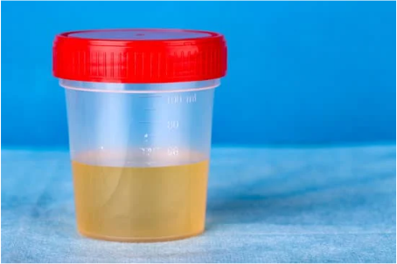
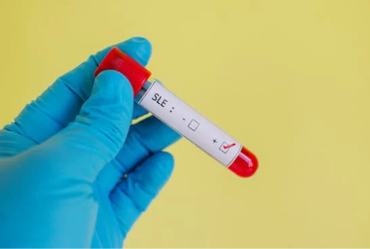
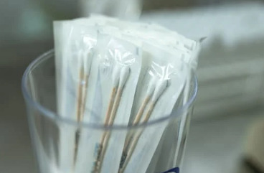
Most STIs Have No Symptoms!
How can someone know if they or their partner has a sexually transmitted or blood-borne infection?
Testing
Notes:
Getting tested is the only way to know for sure.
Routine testing includes a urine sample for chlamydia and gonorrhea and a blood sample for HIV, Hepatitis B, C and Syphilis.
A swab may be taken, depending on the presence of symptoms.
When someone tests positive for some STI/STBBIs (reportable diseases) they will get a call from the Health Unit to ensure proper treatment and partner notification. This is done to decrease community spread of STBBIs.
Image Source: canva.com

Slide 23
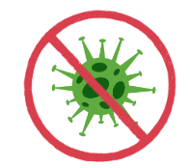
Prevention
Abstinence
Harm Reduction
Barrier Methods
Notes:
Image: Canva

Slide 24
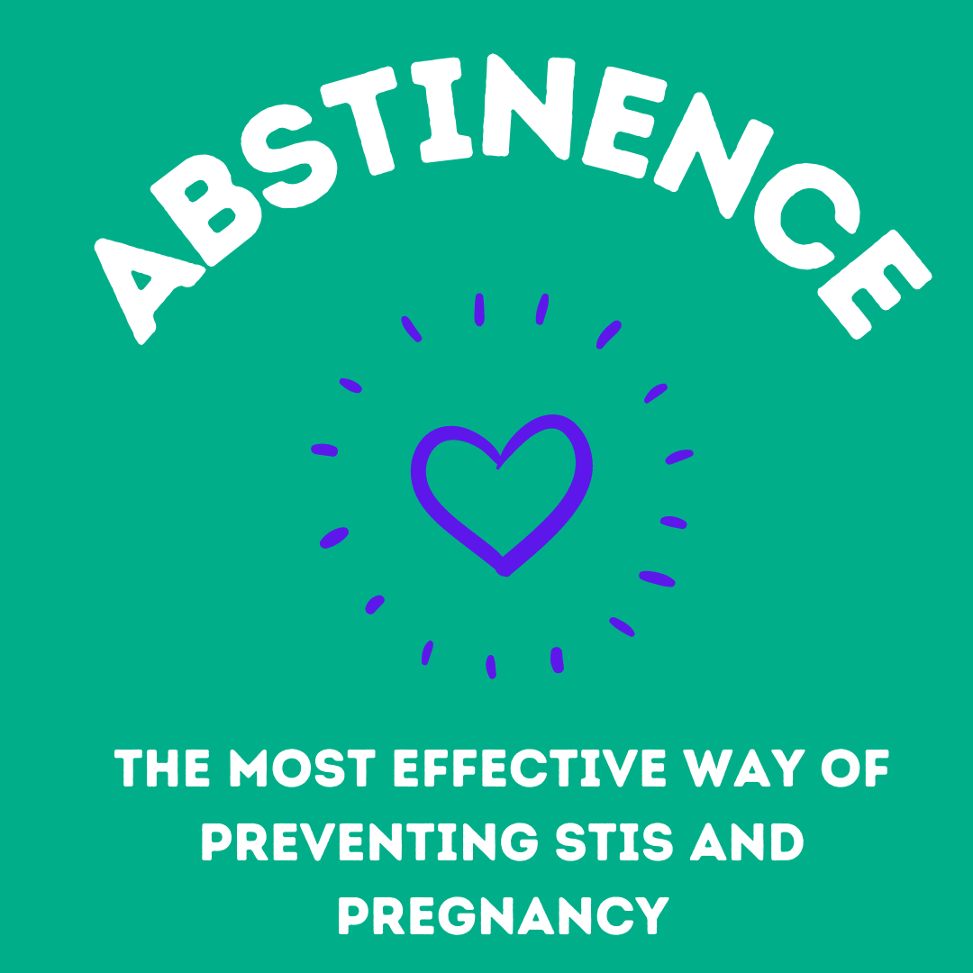
Notes:
Abstinence is the only 100% effective method against STIs and pregnancy if there is no vaginal, anal, oral sex or skin to skin contact.
Ask the class what other ways two people can be intimate if they are practicing abstinence. (e.g. hugging, holding hands, kissing)
What should students consider when setting personal limits on physical intimacy? e.g. family and personal values, religious beliefs, risks and how to reduce risks
Image source: canva.com

Slide 25
Harm Reduction
Limit the number of sexual partners
more partners=more STI risk
Talk about sexual history and STI testing with partners
Avoid sexual contact if you or your partner have an active outbreak
Use barrier methods
Get Vaccinated!
Notes:
If someone chooses to have sex (oral, vaginal, anal), there is risk of getting an STI. Harm reduction means there are things that can be done to reduce the risk but not eliminate it.
Using alcohol and other substances, such as cannabis, can impair judgement and increase likelihood of unprotected sex and having multiple partners. This can increase the risk of getting an STI
Regular testing and partner notification are important to reduce the spread of all STIs
Reference: https://www.sexandu.ca/stis/

Slide 26
Condoms
Penis Condom
Worn on an erect penis as a barrier between the penis and a partner's body parts/fluids.
Vulva Condom
Polyurethane sheath inserted into the vagina before sex.
Condom Demonstration Video (YouTube sign in required)
Notes:
Condom Demonstration: (may choose to demonstrate with a real condom while showing the slides)
https://teachingsexualhealth.ca/teachers/resource/using-a-condom-video/
Condoms are widely available at low or no cost and no prescription is required
Condoms catch sperm during ejaculation, preventing it from fertilizing an egg.
Made of thin latex or polyurethane
Condoms reduce the risk of spreading sexually transmitted and blood-borne infections and can be used in addition to other birth control methods for greatest protection.
Condoms need to be put on an erect penis before any skin to skin contact and removed and thrown away after ejaculation.
A new condom is needed with every act of intercourse.
Condoms have an expiry date and need to be stored correctly to reduce the risk of breaking.
Condoms can be made into dental dams, which can be used during oral sex.
Reference: https://www.sexandu.ca/contraception/non-hormonal-contraception/
Image Source: h ttps://unsplash.com/photos/Wb-rLP27Gvo

Slide 27
Who to talk to
Partner
Parents or other family members
Other trusted adults (teachers)
Health professionals (Your school public health nurse)
Notes:
Partner: Having a discussion about STIs before being sexually active allows individuals to consider their personal values and options before being in the moment.

Slide 28
Where to get more information
https://www.healthunit.com/sexually-transmitted-infections
https://www.sexandu.ca/stis/
https://sexualhealthontario.ca/en/stis

Slide 29
STI Clinics Middlesex-London Health Unit
2 locations: Citi Plaza in London and 51 Front St. in Strathroy
STI testing and treatment
Birth control counselling, prescriptions and emergency contraception
Free Condoms
Call 519-663-5317 to book an appointment
Notes:
At the MLHU STI testing clinic clients can be tested and treated for a variety of STIs. In secondary schools, STI testing can be completed by the school public health nurse.
At the Birth Control Clinic in London, we offer birth control, pregnancy testing and birth control counselling, emergency contraception, and Pap tests to individuals under 50 years of age. Clients are counselled about birth control options, most of which can be purchased at the clinic at an affordable price. Appointments are required and you must bring a valid health card to each visit.
Birth Control Counselling
Low cost birth control
Low cost emergency contraception
Pregnancy testing (*based on assessment)
Cervical Cancer Screening
STI/infection checks/Pelvic Pain
IUD consultation
IUD insertion
Free condoms

